Slide 1
Somatic CNVs in Cancer and Normal Tissues
Peter Kharchenko
Principal Investigator
Altos Labs, San Diego Institute
BIOSTEC | February 2025

Slide 2
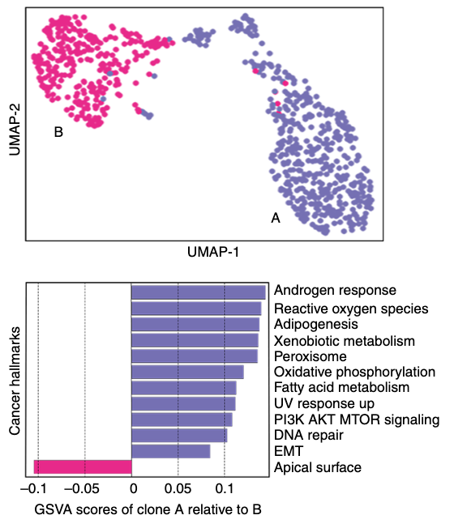
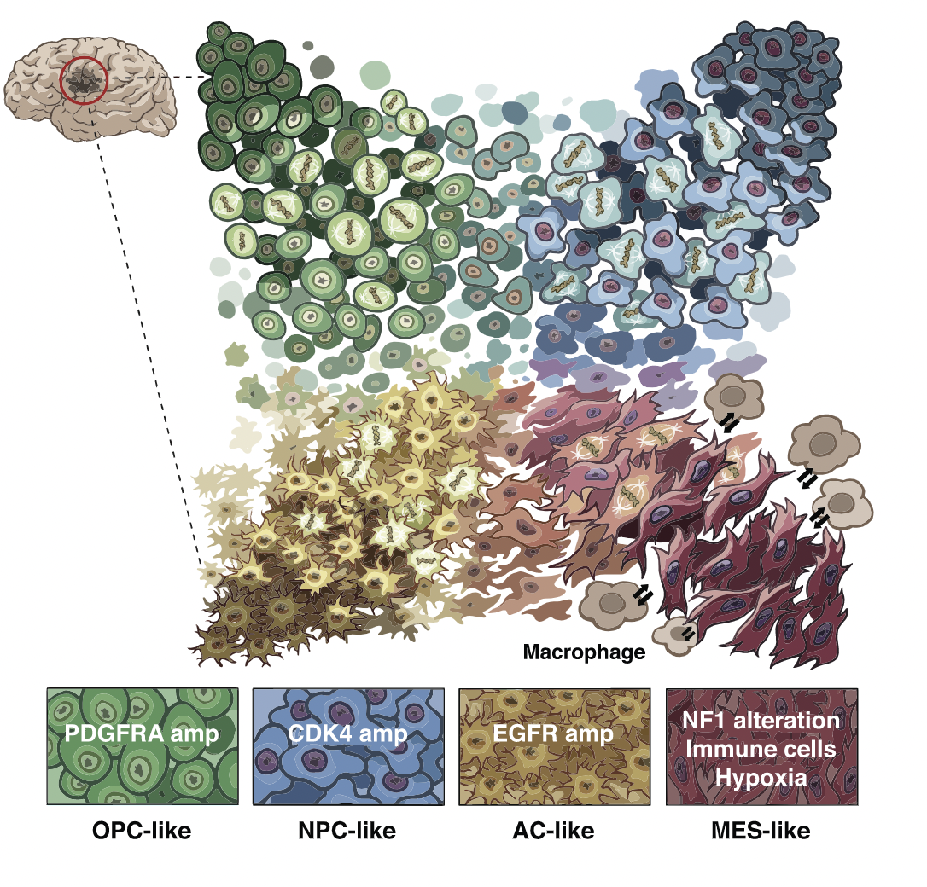
Background and Motivation
Functional genomics insights beyond tumor genomes
Expression states and pathways driving clonal phenotypes
State transitions, epigenetic states
Tumor microenvironment
scRNA-seq: Opportunity to delineate transcriptional and genetic heterogeneity
Subclone B
Subclone A
Gao et al. Nature Biotechnology, 2021
Neftel et al, Cell, 2019
Shi et al, MedComm, 2020

Slide 3
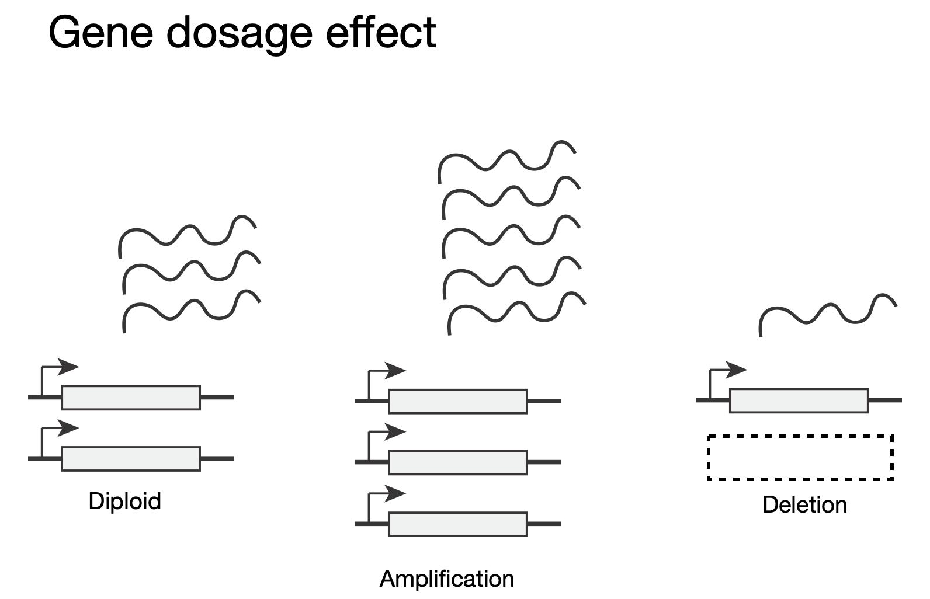
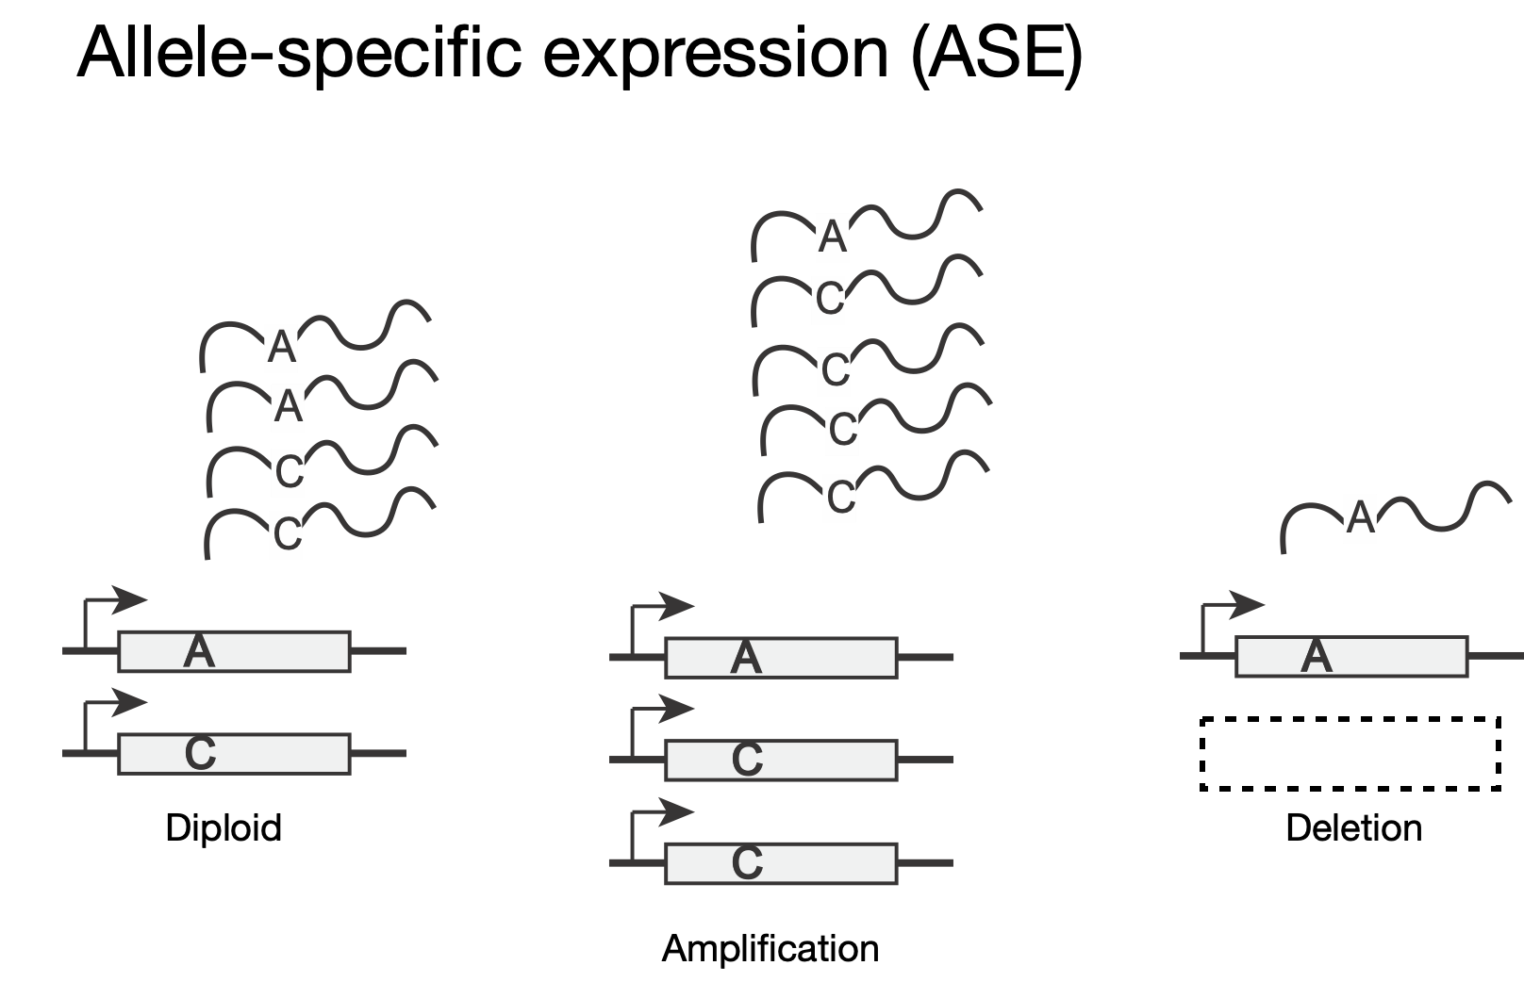
Detecting CNVs in (sc)RNA-seq data
Locally-averaged gene expression magnitude
Allelic ratio of heterozygous SNPs
Paternal/maternal allele ratio is altered by all unbalanced CNVs
Fan et al, Genome Research’18

Slide 4
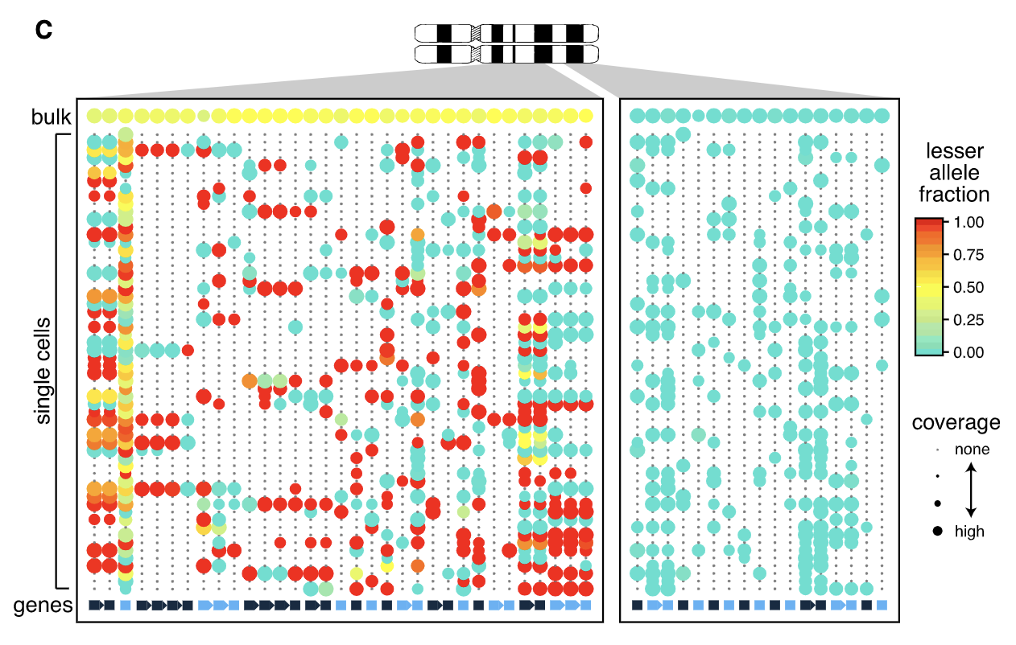
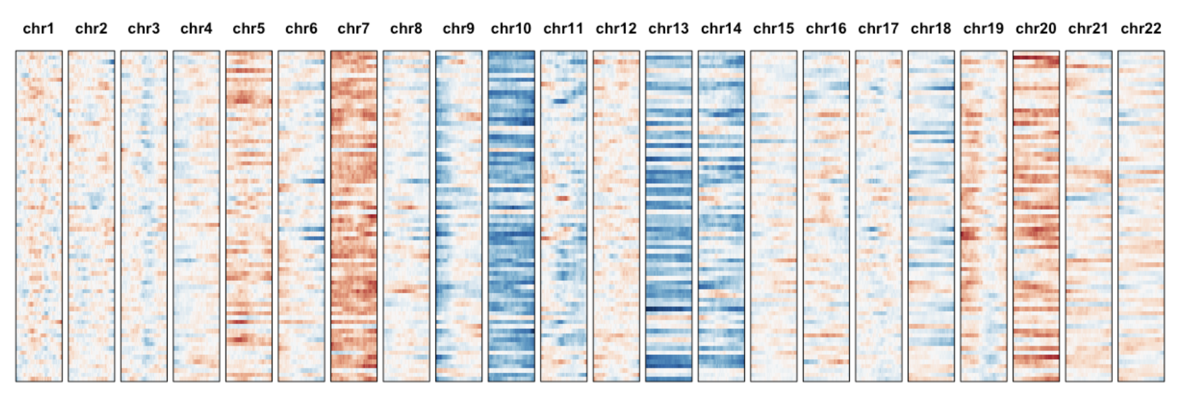
Detecting CNVs in (sc)RNA-seq data
Locally-averaged gene expression magnitude
Limited sensitivity
Prone to reference mismatch
Allelic ratio of heterozygous SNPs
Paternal/maternal allele ratio is altered by all unbalanced CNVs
Stochastic monoallelic expression
Sparse coverage in single-cells
Fan et al, Genome Research’18

Slide 5
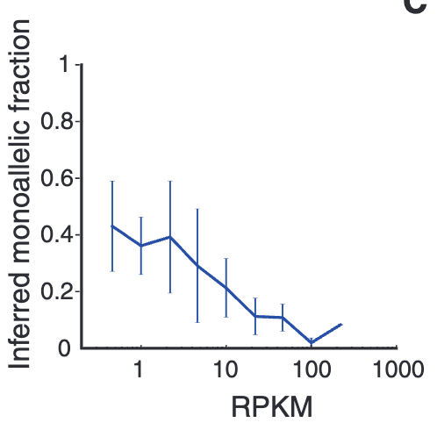
Monoallelic Detection, Bursting, Noise
Monoallelic Detection
Bursting
Biases are independent between genes, cells
C
A
T
A
A
T
A
G
T
A
G
T
maternal
A
G
C
T
paternal
C
T
T
A
Deng et al. Science’14

Slide 6
Monoallelic Detection, Bursting, Noise
Monoallelic Detection
Bursting
Biases are independent between genes, cells
C
A
T
A
A
T
A
G
T
A
G
T
maternal
A
G
C
T
paternal
C
T
T
A
Deng et al. Science’14

Slide 7
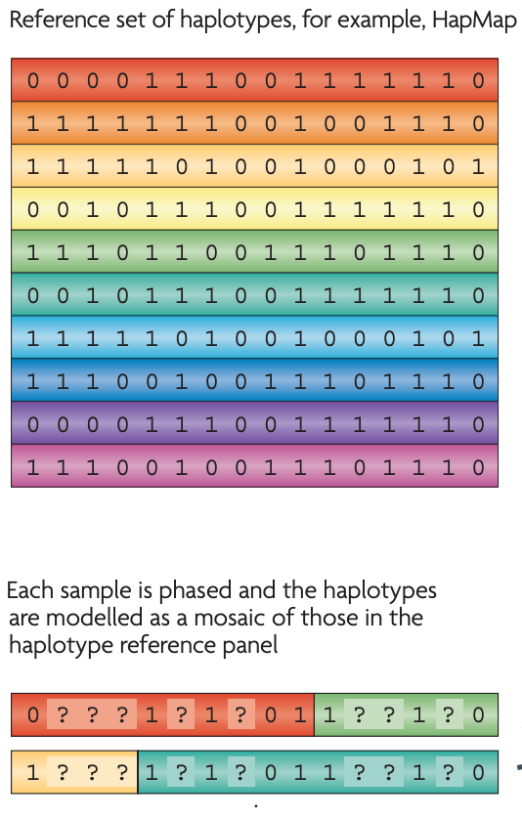
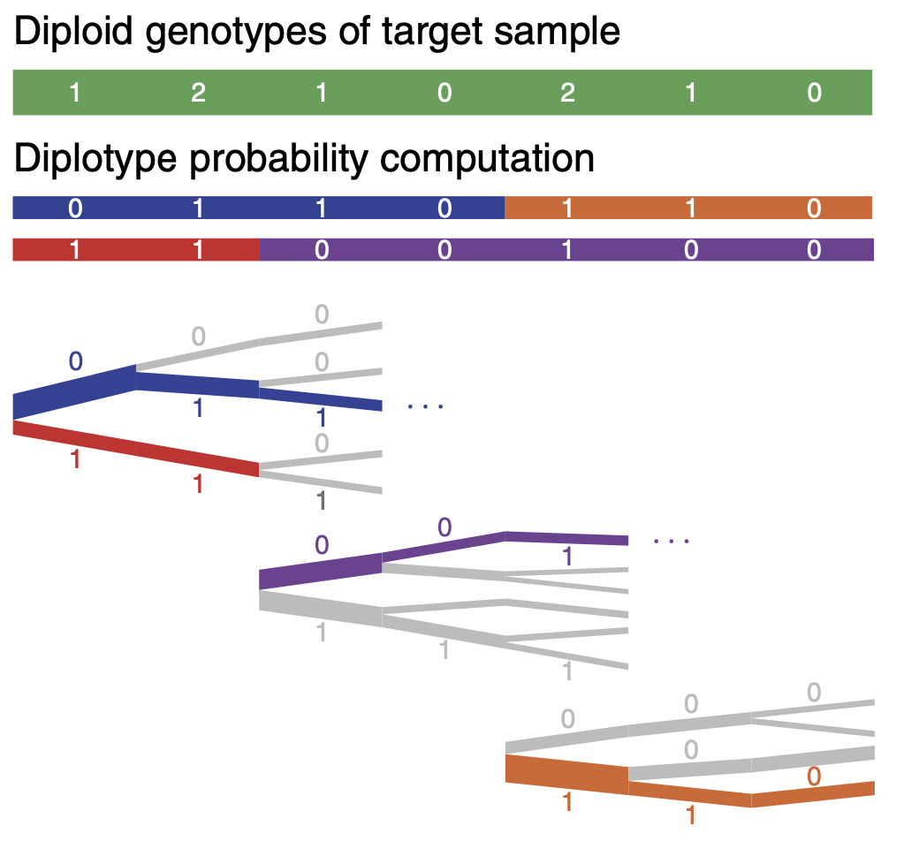
Using Phasing to Amplify Allele Signals
genomes
diplotype
Eagle2
Po-Ru Loh et al. Nat. Gen’17
Marchini, J., Howie, B. Genotype imputation for genome-wide association studies. Nat Rev Genet

Slide 8
Using Phasing to Amplify Allele Signals
genomes
diplotype
Phased haplotype blocks
Marchini, J., Howie, B. Genotype imputation for genome-wide association studies. Nat Rev Genet

Slide 9
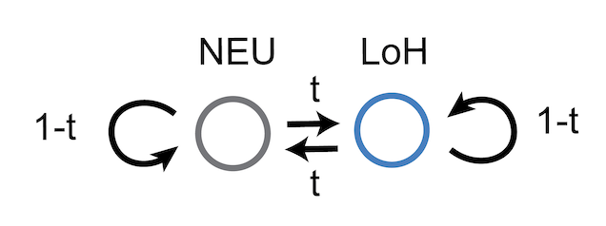
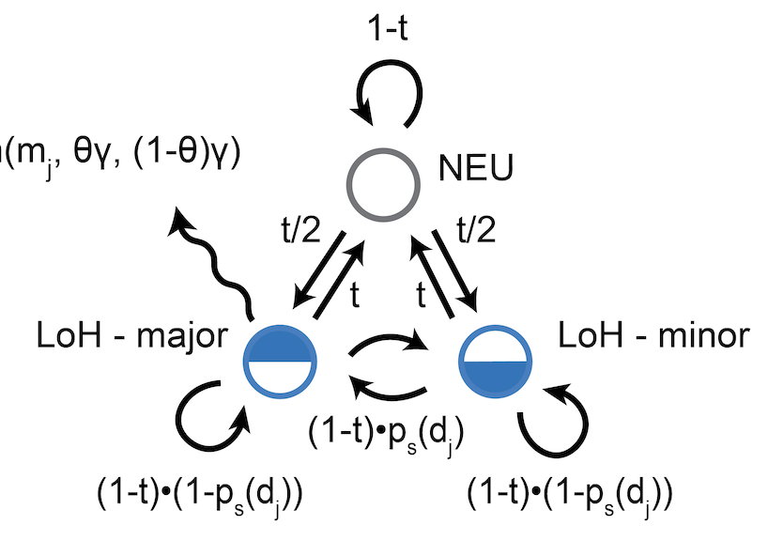
Using Phasing to Amplify Allele Signals
BB
Phased haplotype blocks

Slide 10
Using Phasing to Amplify Allele Signals

Slide 11
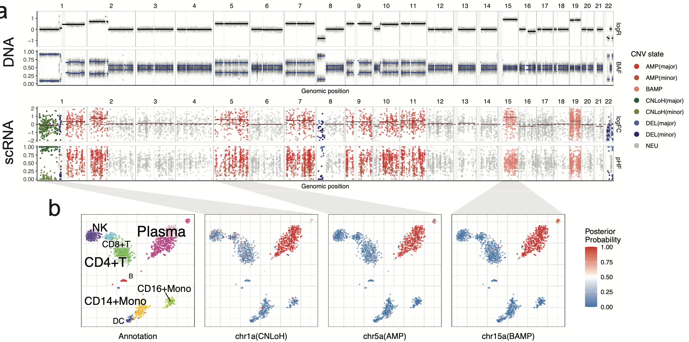
Using Phasing to Amplify Allele Signals
chromosome / genomic position
multiple myeloma
Liu et al., Nat. Comm’21

Slide 12
Using Phasing to Amplify Allele Signals
chromosome / genomic position
multiple myeloma
Liu et al., Nat. Comm’21

Slide 13
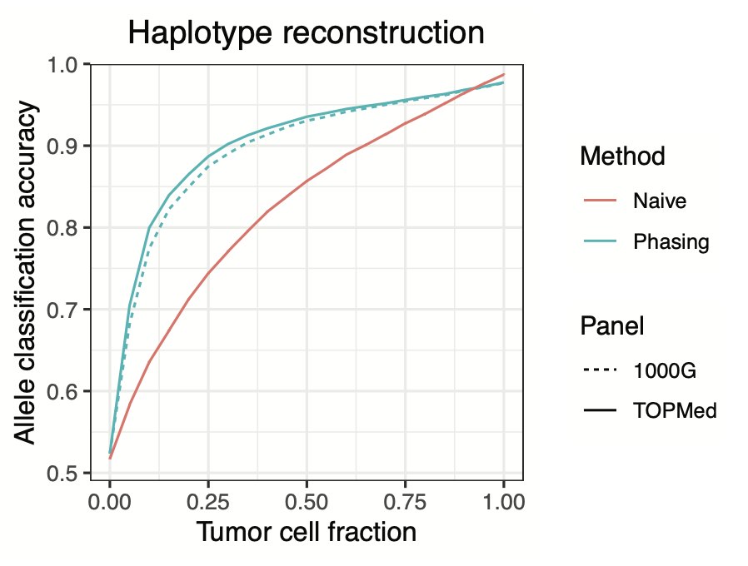
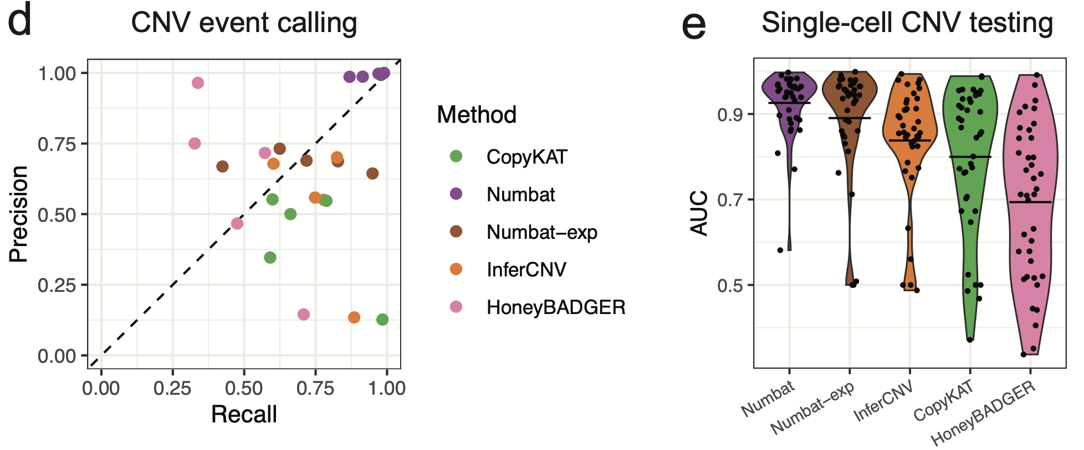
Using Phasing to Amplify Allele Signals
chromosome / genomic position

Slide 14
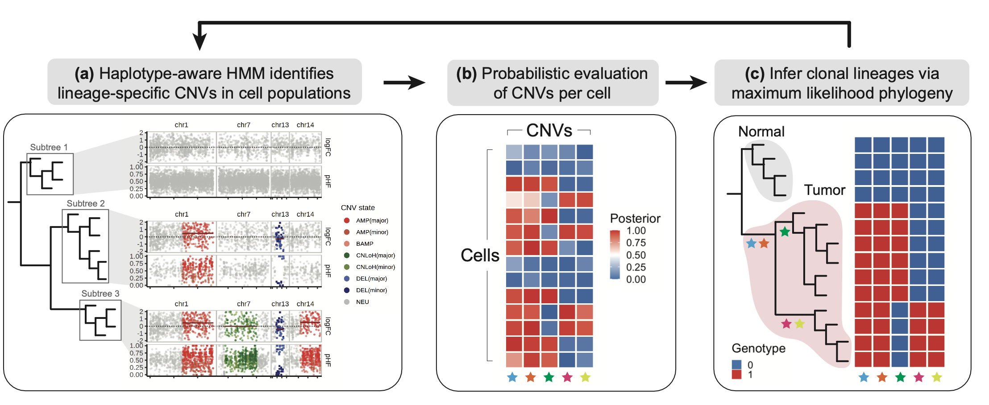
Detecting CNVs and Subclonal Populations
iterate until convergence
ScisTree

Slide 15
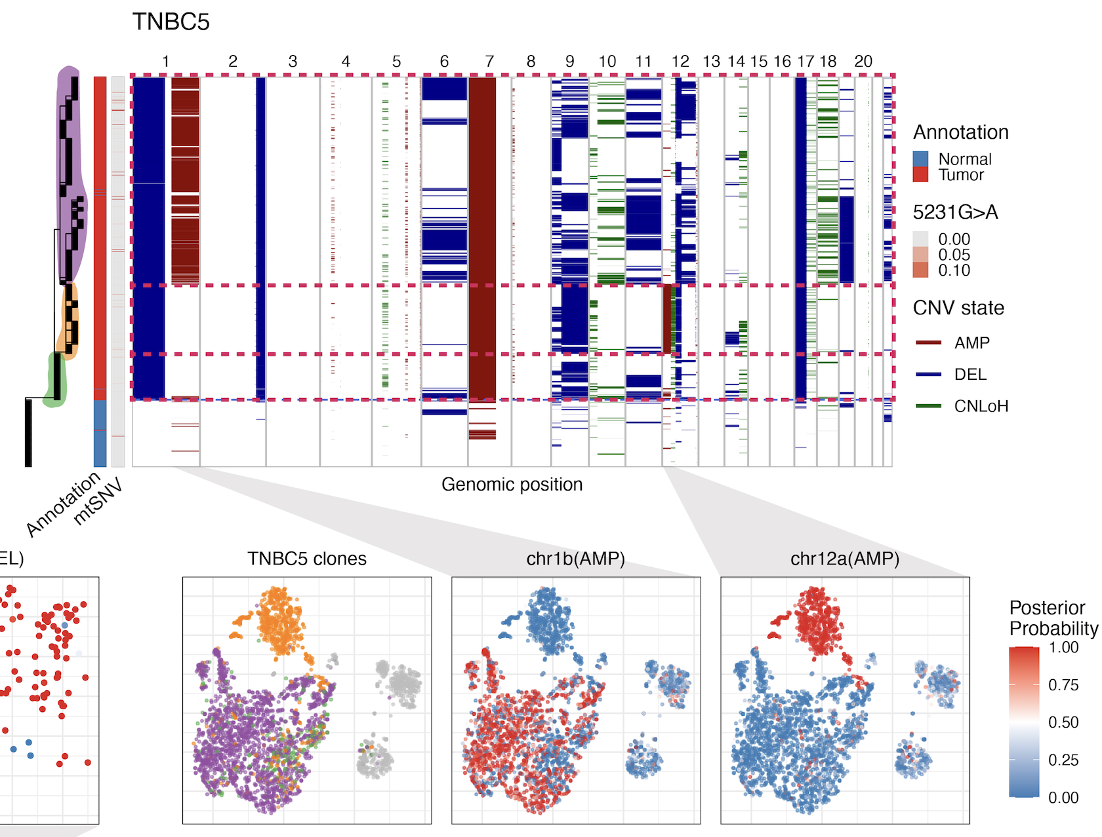
Recovering Subclonal Structure
TNBC5
triple negative breast cancer
Gao et al., Nat. Biotech’21

Slide 16
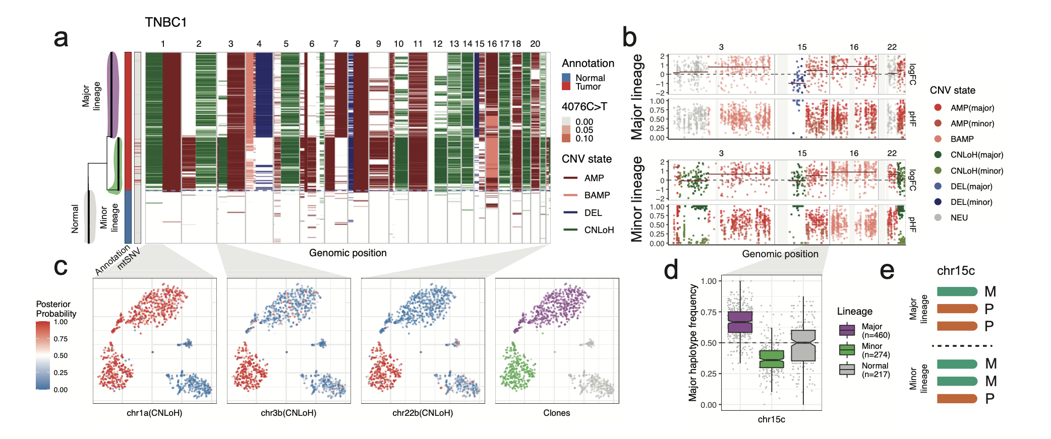
Recovering Subclonal Structure
s
triple negative breast cancer
Gao et al., Nat. Biotech’21

Slide 17
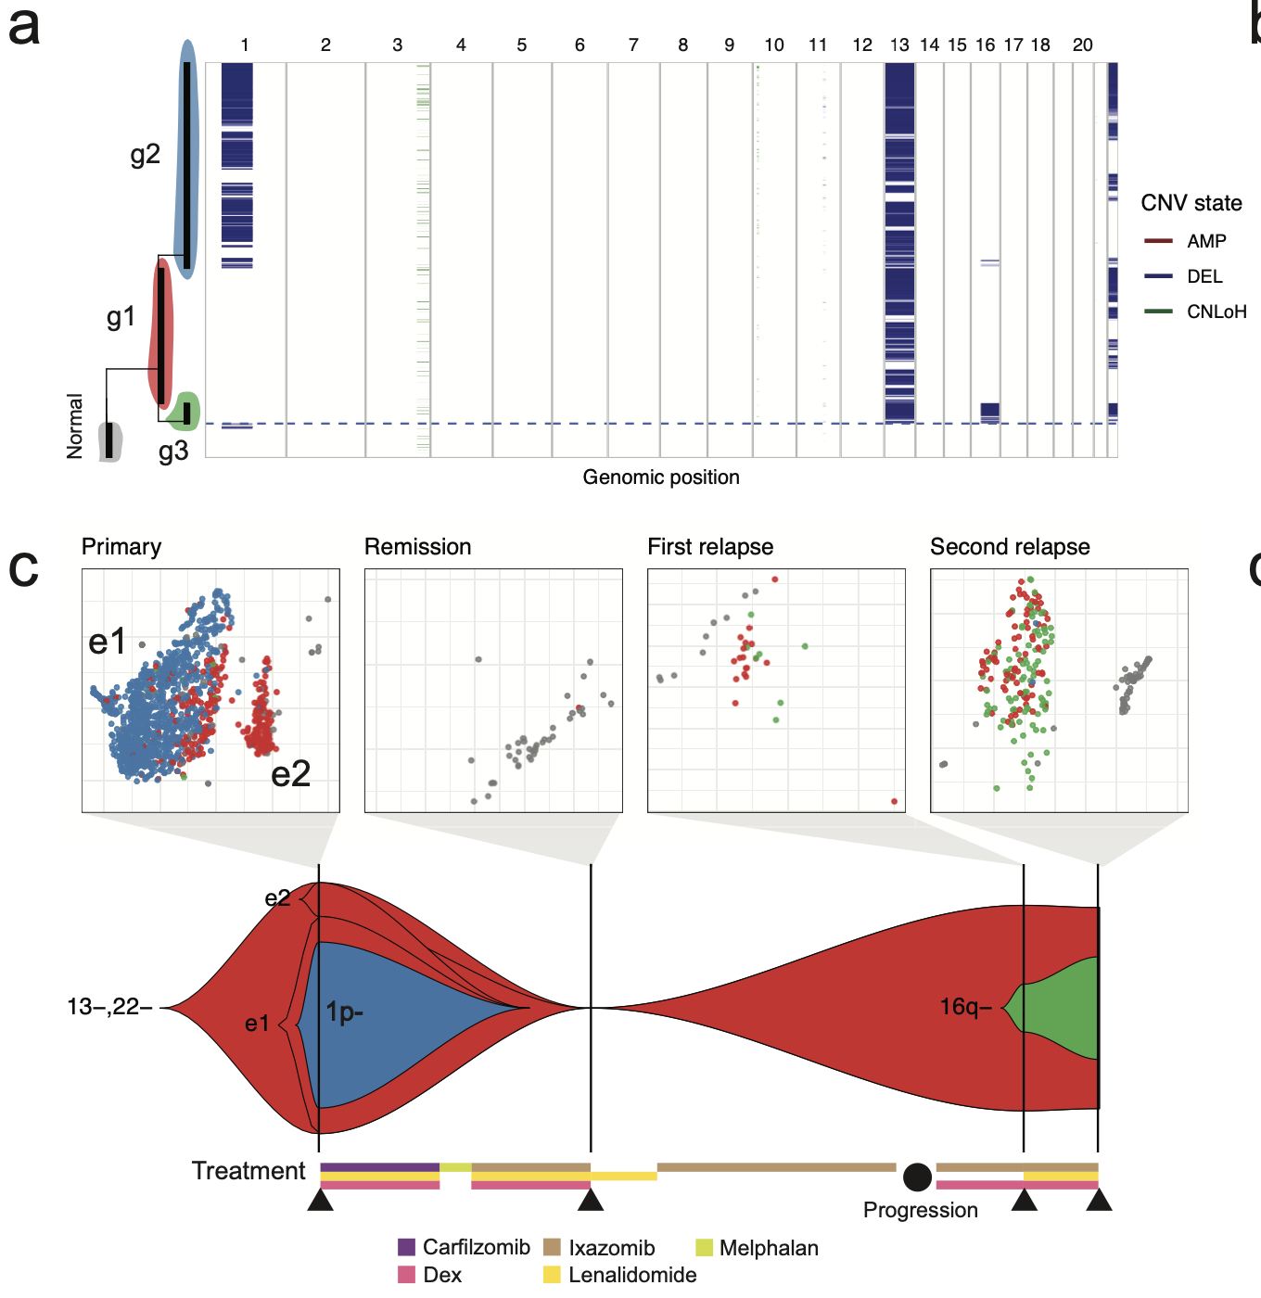
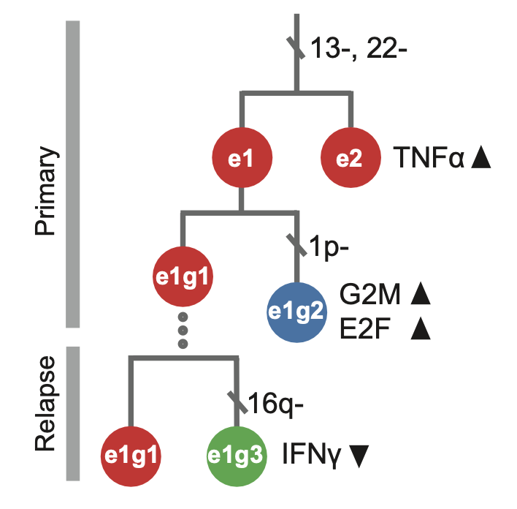
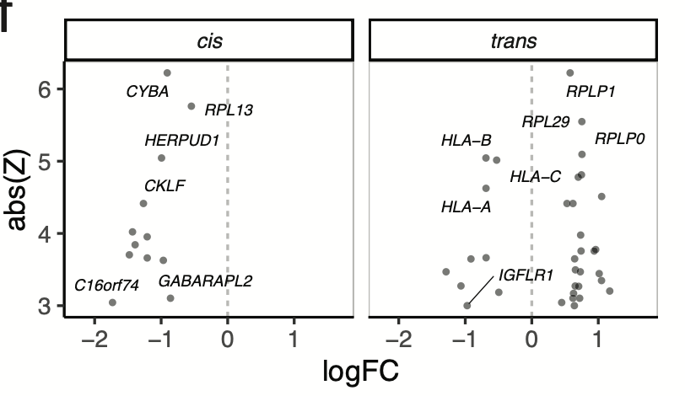
triple negative breast cancer
Gao et al., Nat. Biotech’21
multiple myeloma
Liu et al., Nat. Comm’21

Slide 18
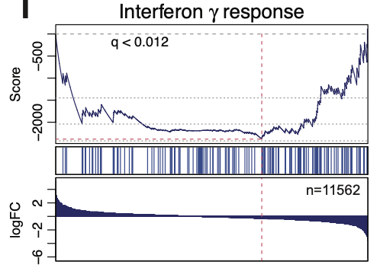
higher
in e1g3
lower
in e1g3
triple negative breast cancer
Gao et al., Nat. Biotech’21
multiple myeloma
Liu et al., Nat. Comm’21

Slide 19
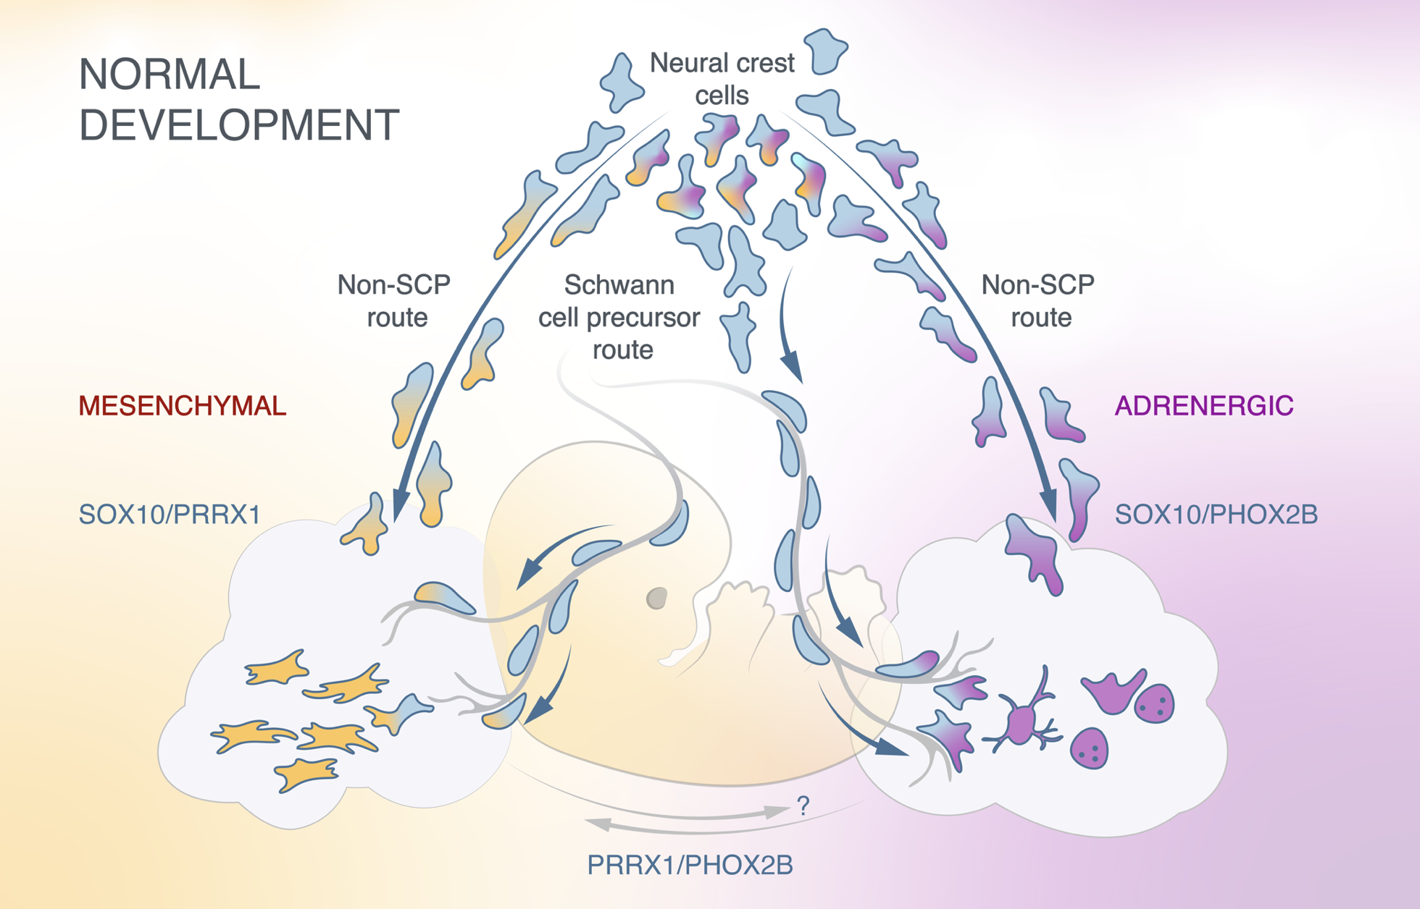
Neuroblastoma
Highly aggressive cancer responsible for 15% total cancer-related death in children
Heterogenous disease with diverse clinical outcomes
Arise from the developing neural crest
Cell of origin under debate
Intratumoral plasticity can be a potential source of therapy resistance
Olsen et al. bioRxiv. 2020
Notes:
Neural crest -> Sympathoblast
Consensus: adregernic

Slide 20
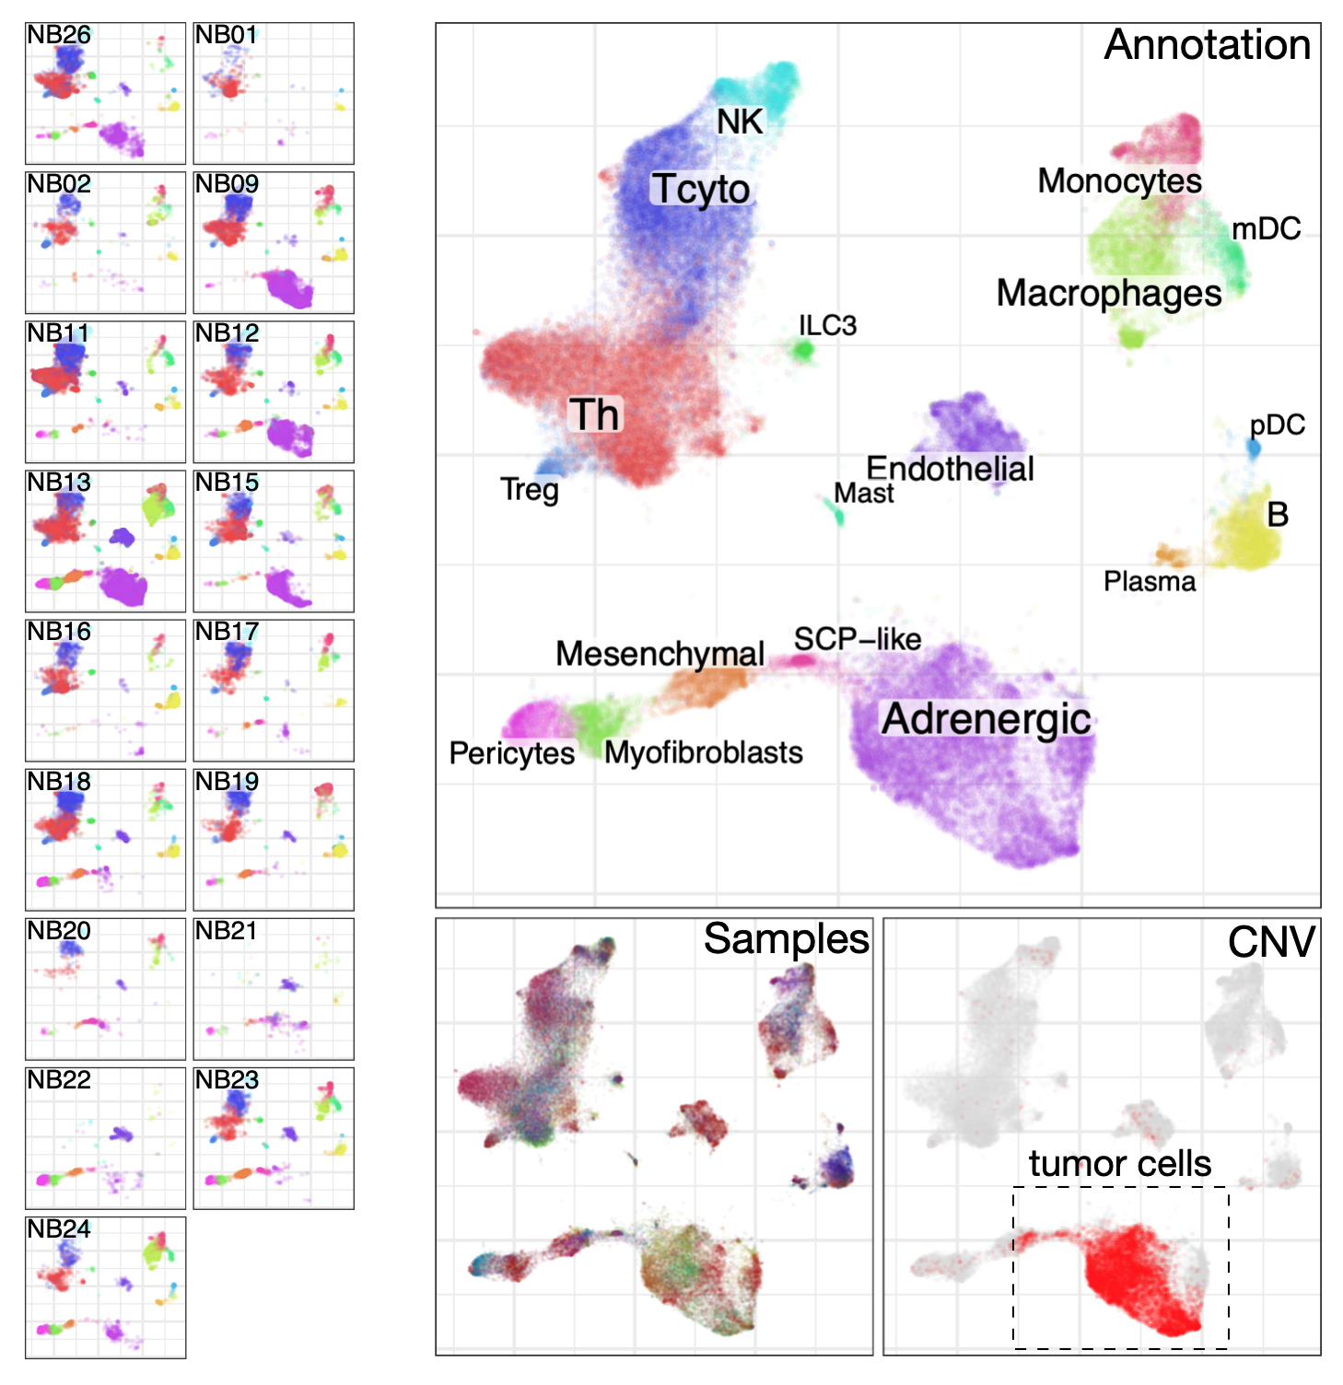
Neuroblastoma
Ninib Baryawno (KI)
Igor Adameyko (KI / MedUni Wien)
Highly aggressive cancer responsible for 15% total cancer-related death in children
Heterogenous disease with diverse clinical outcomes
Arise from the developing neural crest
Cell of origin under debate
Intratumoral plasticity can be a potential source of therapy resistance
20 patients
biopsy and surgical material
scRNA-seq, CNV arrays
scRNA+scDNA-seq
Notes:
Neural crest -> Sympathoblast
Consensus: adregernic

Slide 21
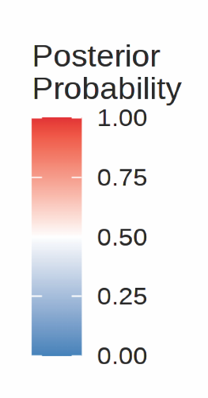
Neuroblastoma
Malignant SCP population
NB26
Notes:
Neural crest -> Sympathoblast
Consensus: adregernic

Slide 22
Neuroblastoma
Malignant SCP population
chr17 amplification – highly prevalent in NB
Normal neural crest
Mesenchymal
17amp
MRCA
3 CNVs
15 CNVs
SCP-like
Cell type
SOX10
Adrenergic
Notes:
Neural crest -> Sympathoblast
Consensus: adregernic

Slide 23
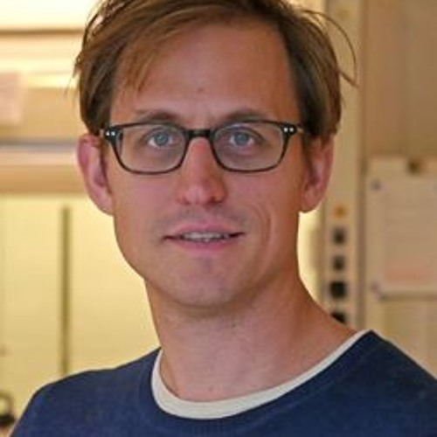
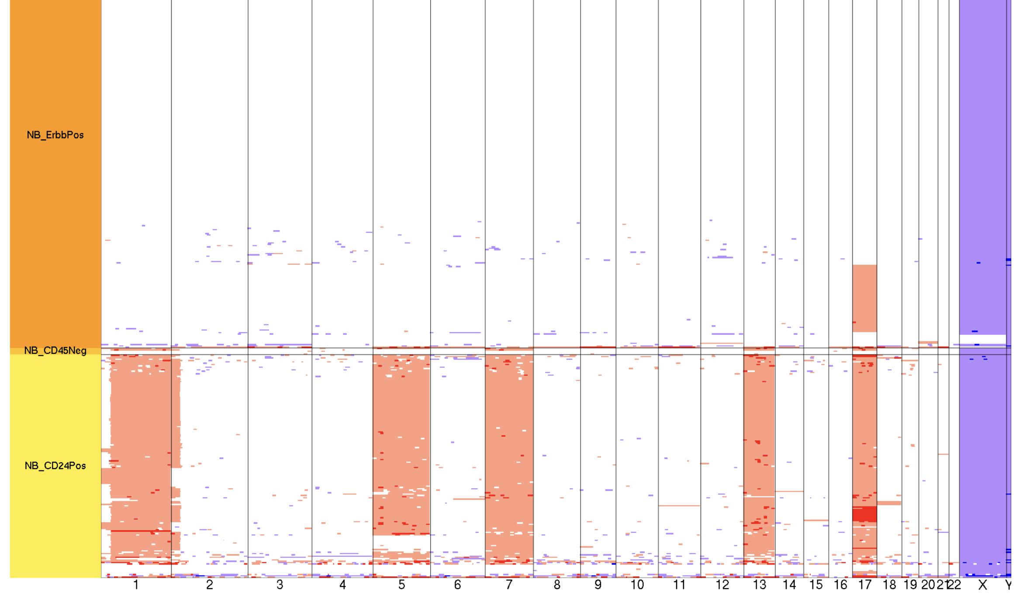
Neuroblastoma
Malignant SCP population
chr17 amplification – highly prevalent in NB
DNA+RNA FISH
DNA+RNA-seq
Martin Enge (KI)
DNTR-seq: Zachariadis et al. Mol Cell’20
SCP-like
Adrenergic
Notes:
Neural crest -> Sympathoblast
Consensus: adregernic

Slide 24
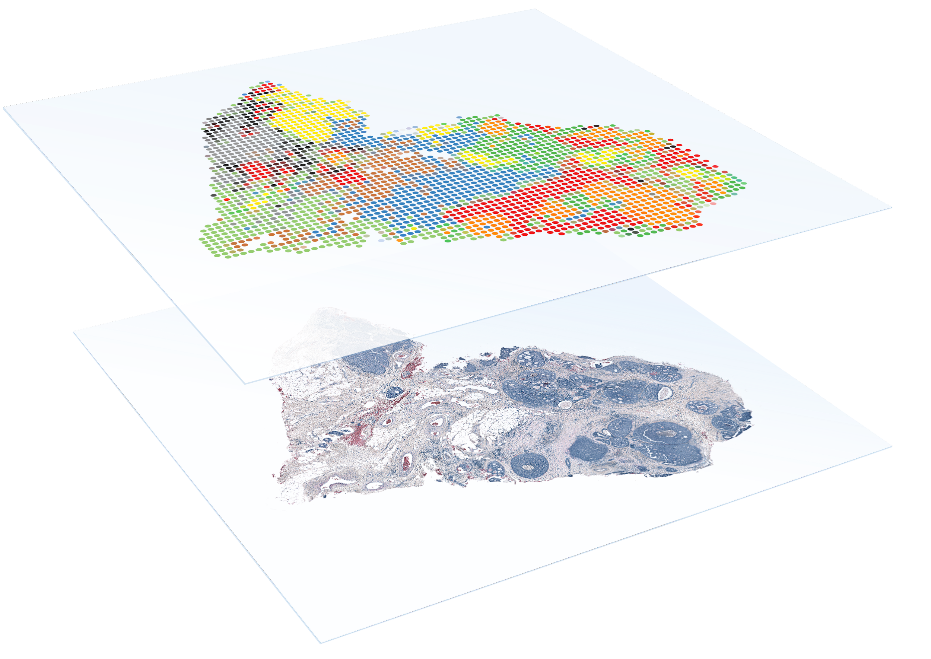
Spatial Transcriptomics: What Can We Learn?
Informs on cellular context
relationships with other cells
link to microscopy
Malignant vs. non-malignant
cell states at tumor boundary
Distribution of subclones
immune infiltration
relative positions, distribution of clones
10x Visium
100um spot-spot distance
55um spot diameter

Slide 25
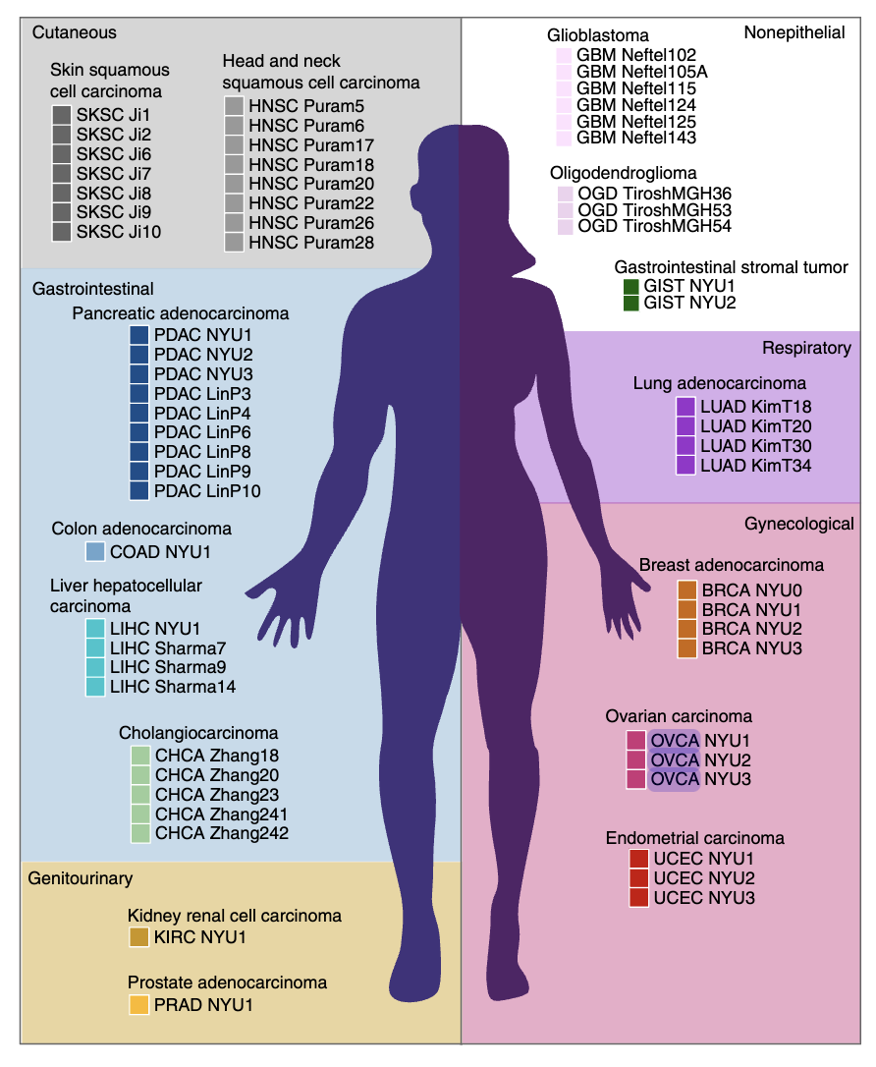
Numbat Application to Spatial Cancer Data
Barkley et al. Nature Genetics’22
ovarian, breast, gastrointestinal stromal samples
Analyzing Visium Data
sparse data, higher CNV uncertainty
external genotype information helps!

Slide 26
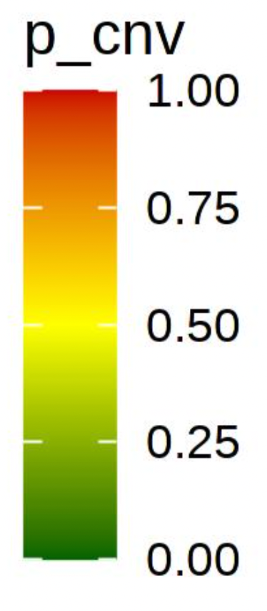
Numbat Application to Spatial Cancer Data
Barkley et al. Nature Genetics’22
ovarian, breast, gastrointestinal stromal samples
Analyzing Visium Data
sparse data, higher CNV uncertainty
external genotype information helps!
Malignant vs. Normal
Aneuploidy probabilities
GIST1

Slide 27
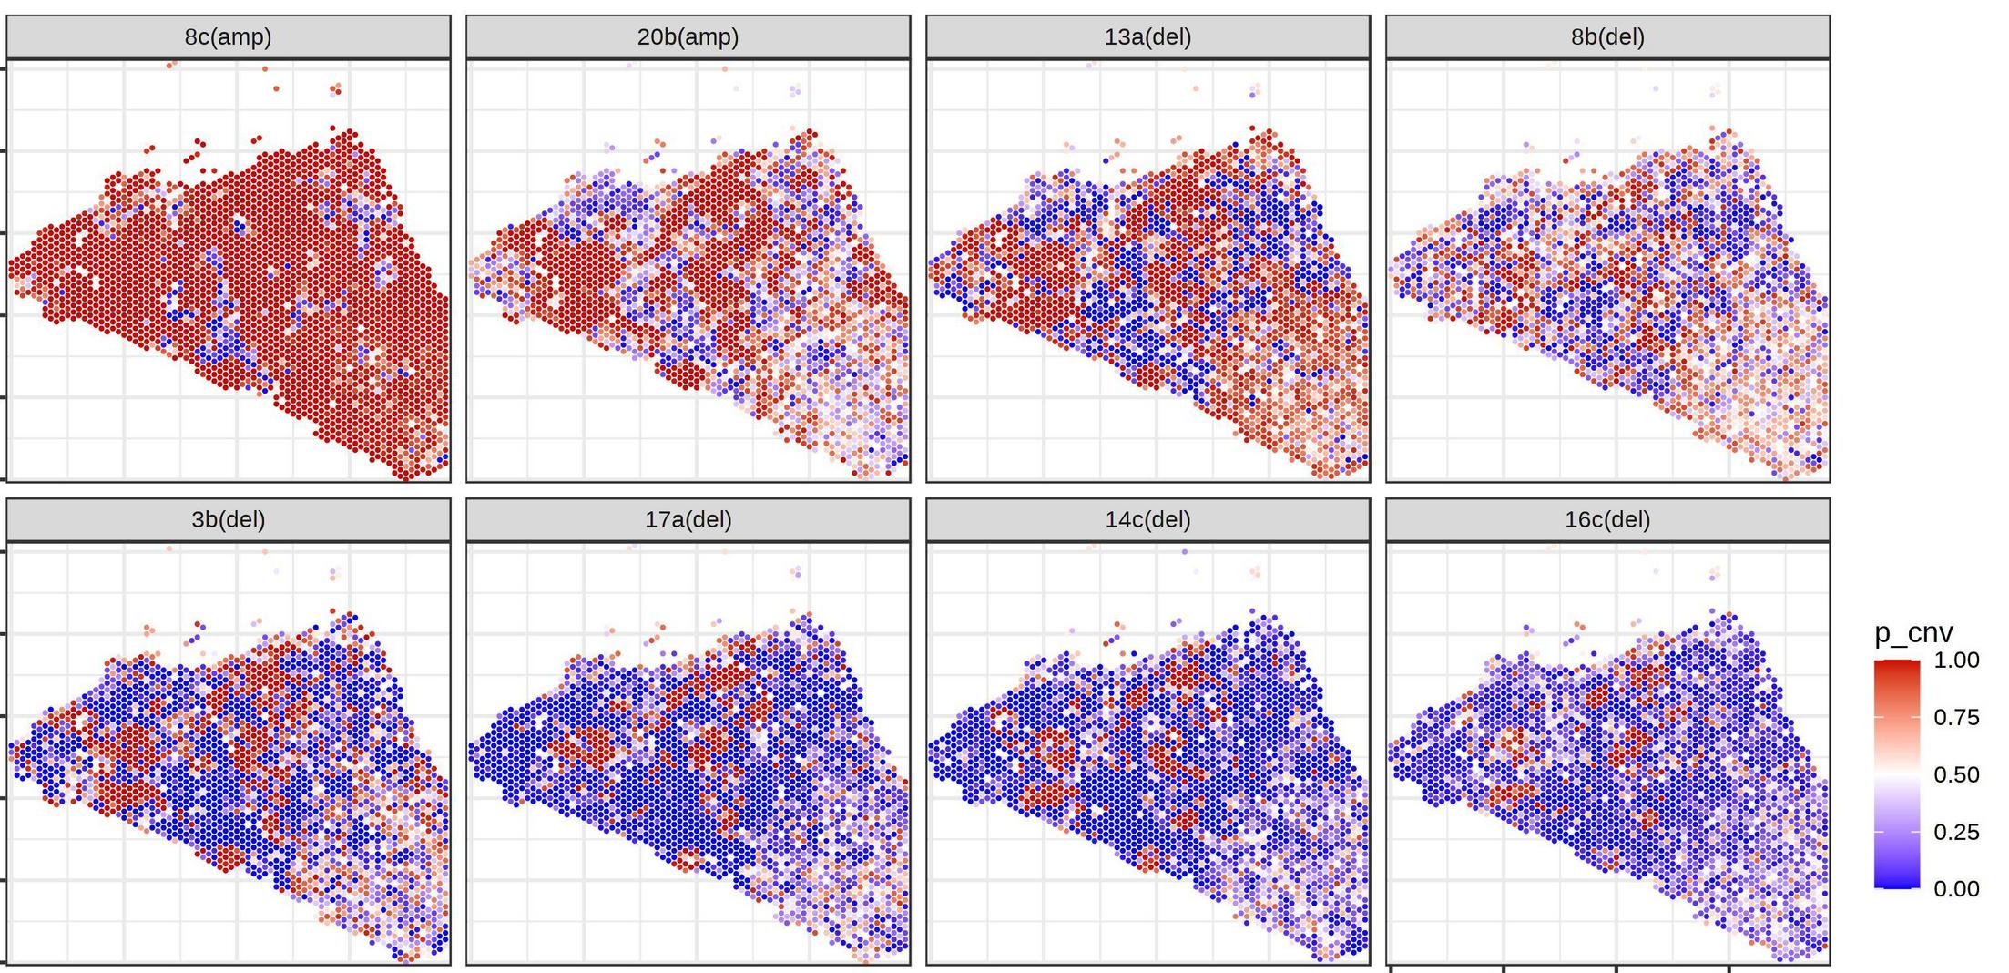
Numbat Application to Spatial Cancer Data
Subclonal Analysis
per CNV probabilities
BRCA0

Slide 28
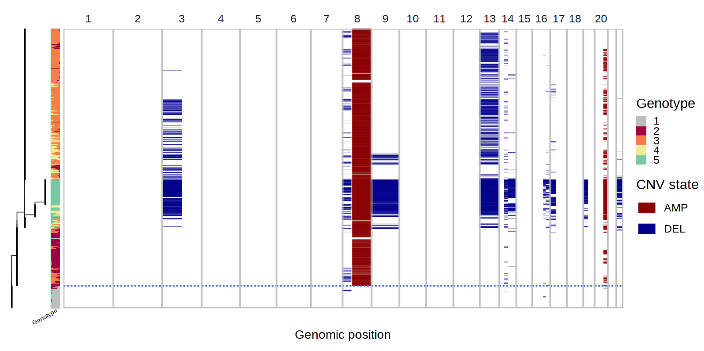
Numbat Application to Spatial Cancer Data
Subclonal Analysis
per CNV probabilities
subclonal annotation
BRCA0

Slide 29
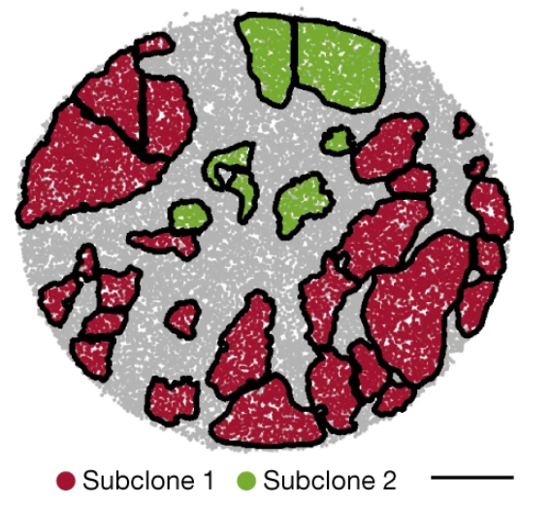
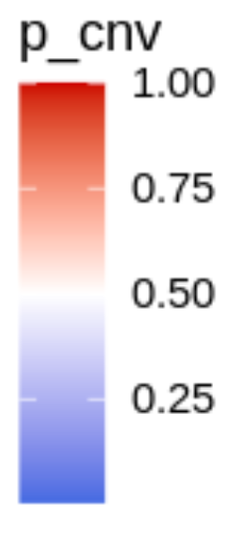
Numbat Application to Spatial Cancer Data
Subclonal Analysis
per CNV probabilities
subclonal annotation
example with Slide-seq2
DNA-based labels
Colorectal
adenocarcinoma
Tongtong Zhao, Zachary D. Chiang et al, Nature. 2022

Slide 30
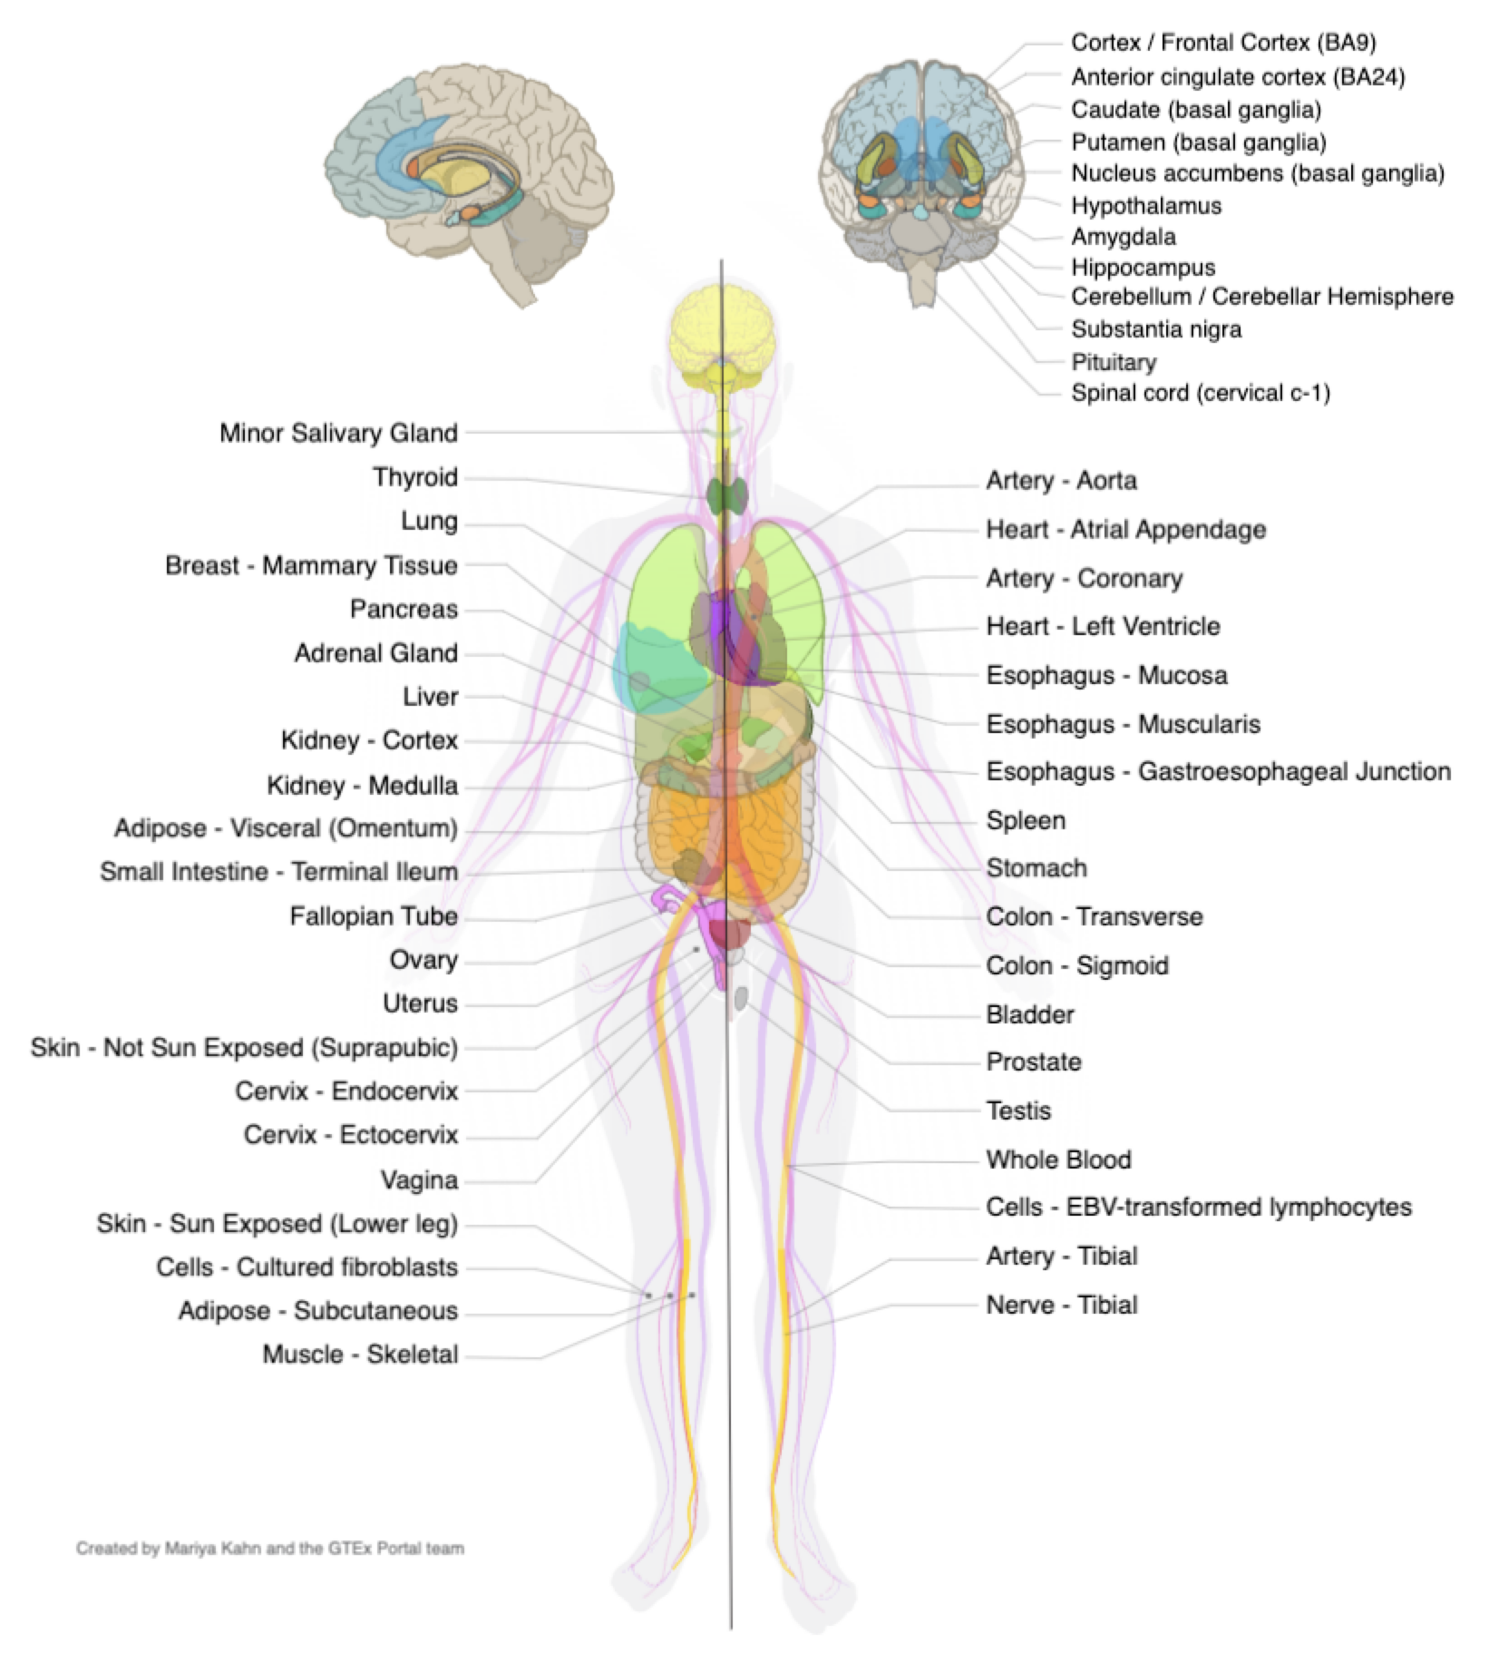
Clonal Expansions in Normal Tissues
Detecting rare CNV events in normal tissues
number of samples, tissue coverage
DNA sequencing
RNA tissue collections - GTEX
bulk RNA-seq

Slide 31
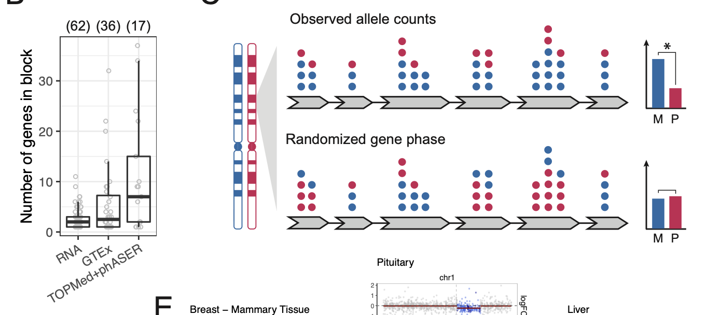
Clonal Expansions in Normal Tissues
Improved phasing power based on genome sequence, TOPMED
Within-gene randomization test

Slide 32
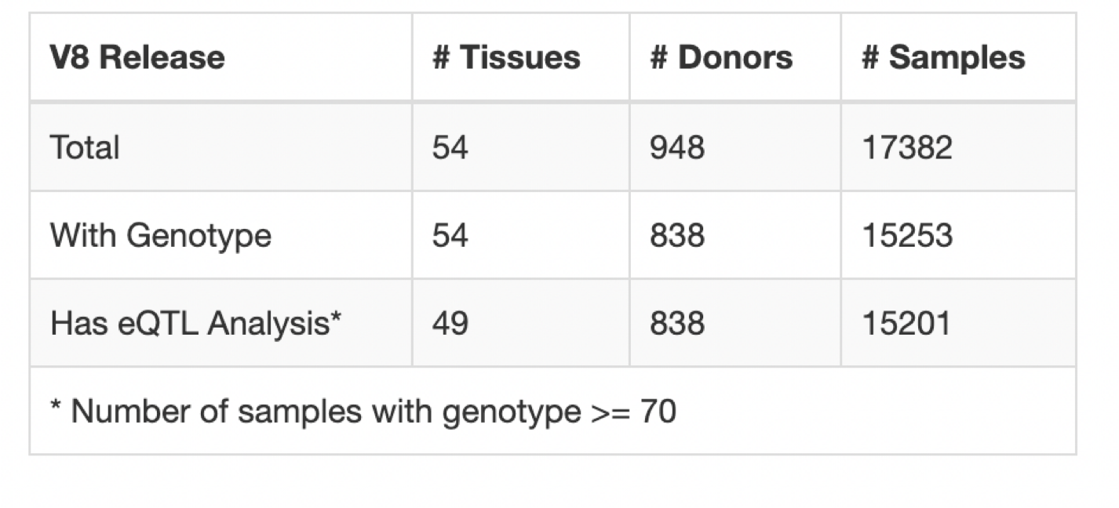
Clonal Expansions in Normal Tissues
GTEX Consortium Data
Vast collection of bulk RNA data
Phenotypes, genotypes

Slide 33
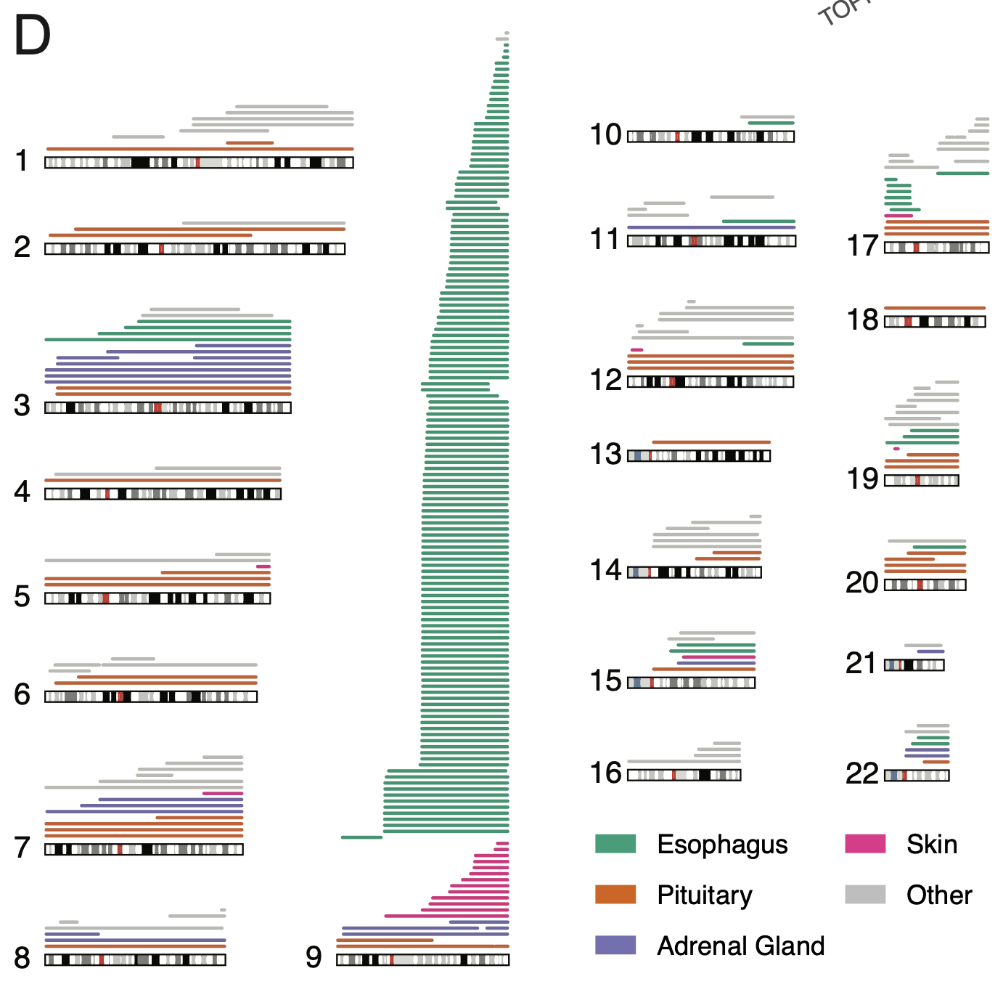
Clonal Expansions in Normal Tissues

Slide 34
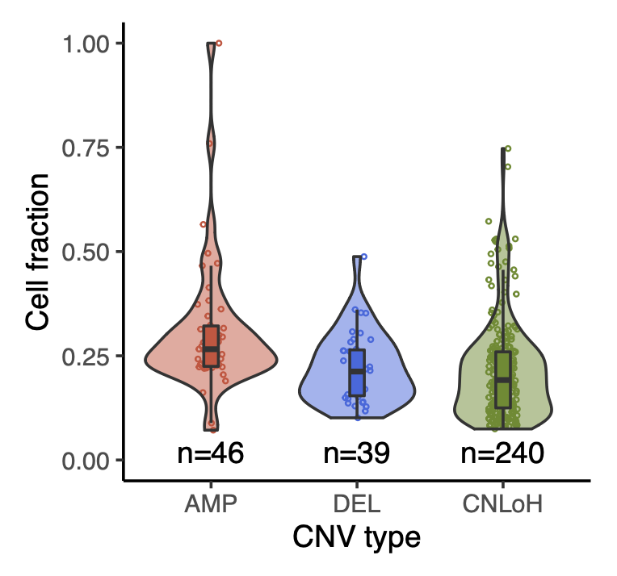
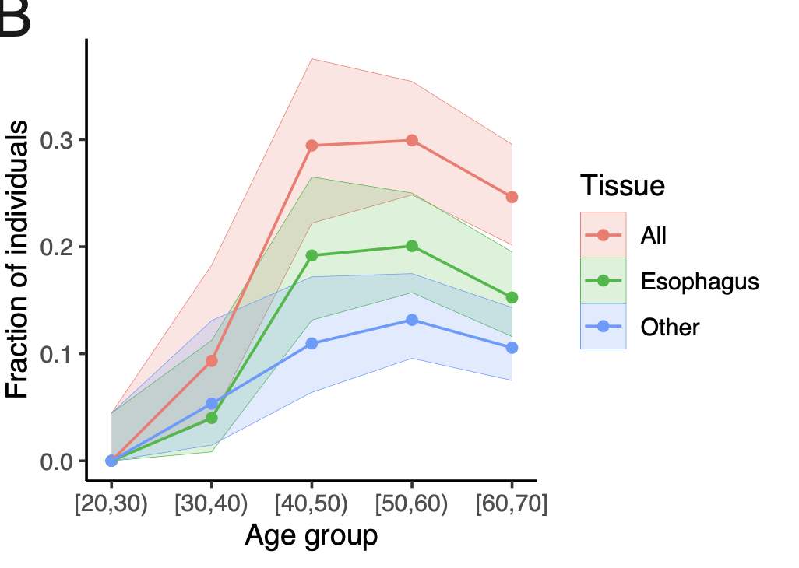
Clonal Expansions in Normal Tissues

Slide 35
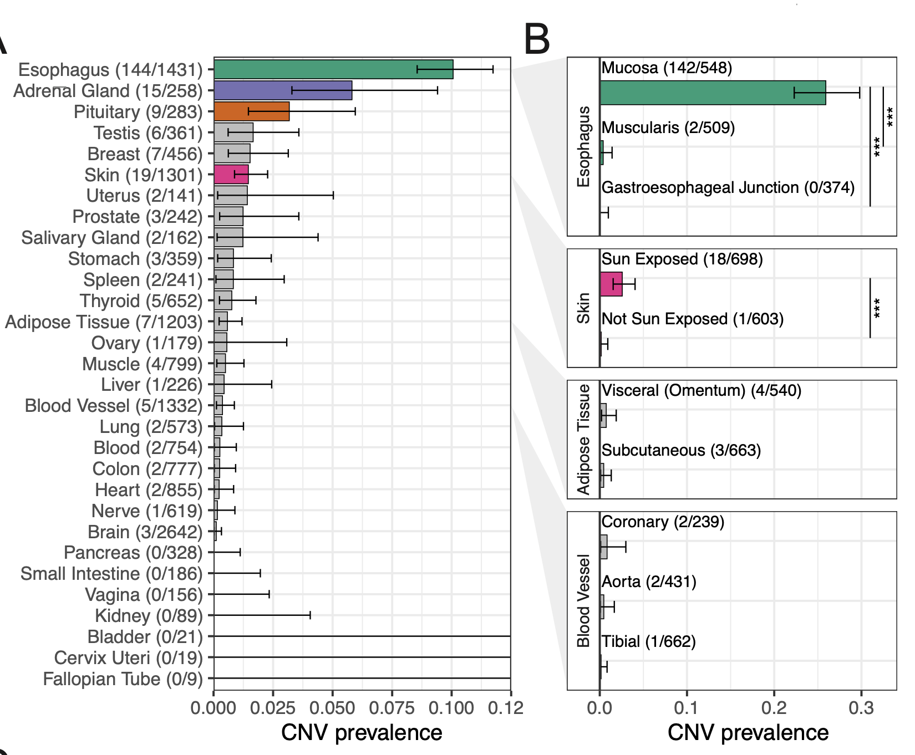
Clonal Expansions in Normal Tissues

Slide 36
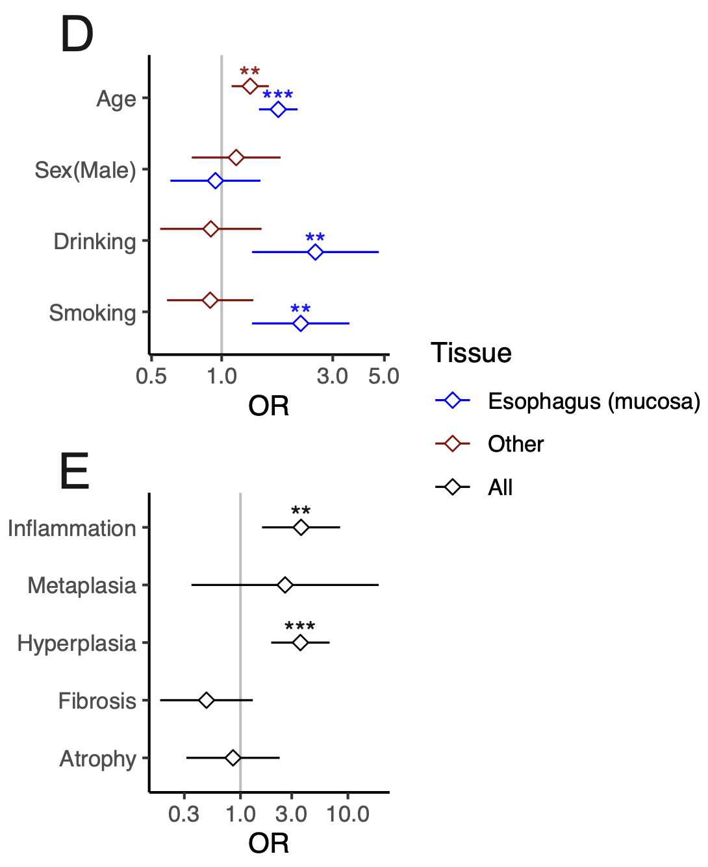
Clonal Expansions in Normal Tissues

Slide 37
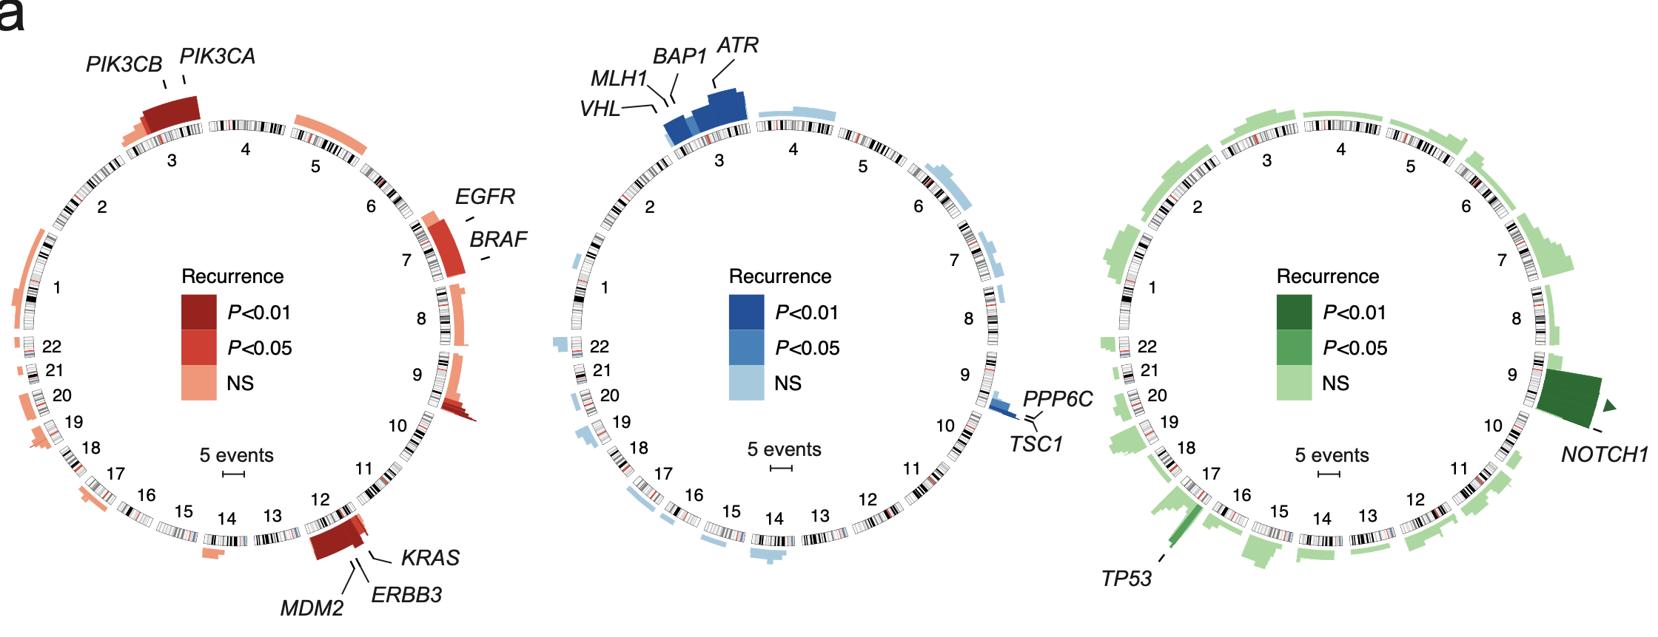
Expansions in Normal Tissues: Recurrence
Amplifications
Deletions
CNLoH

Slide 38
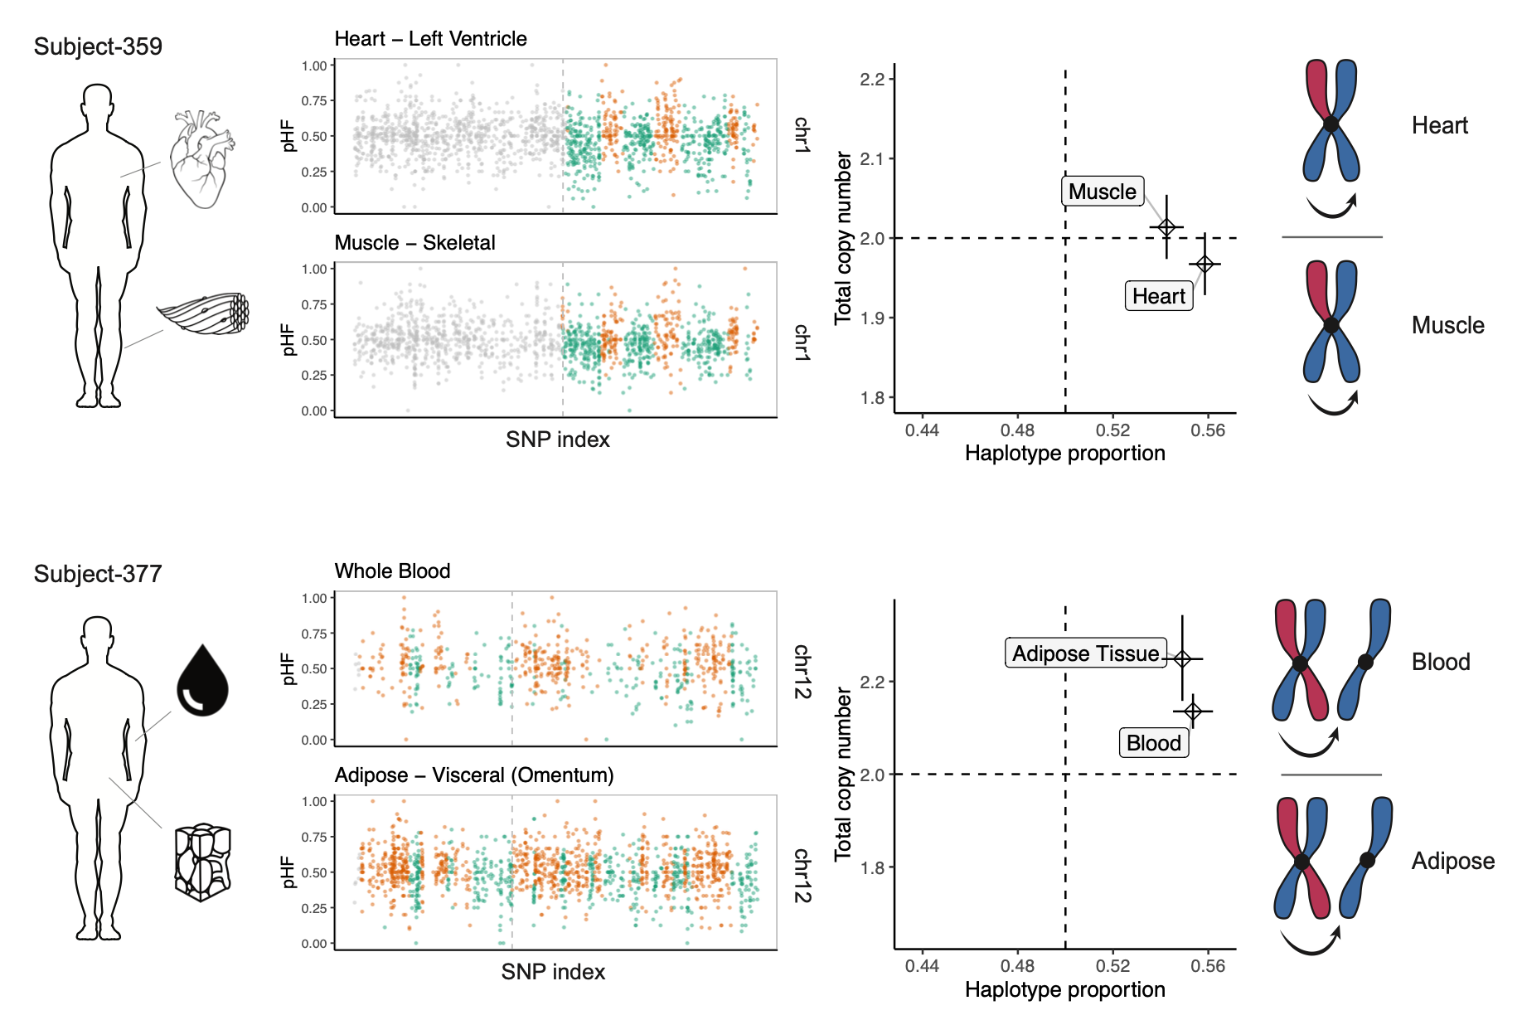
Expansions in Normal Tissues: Recurrence

Slide 39
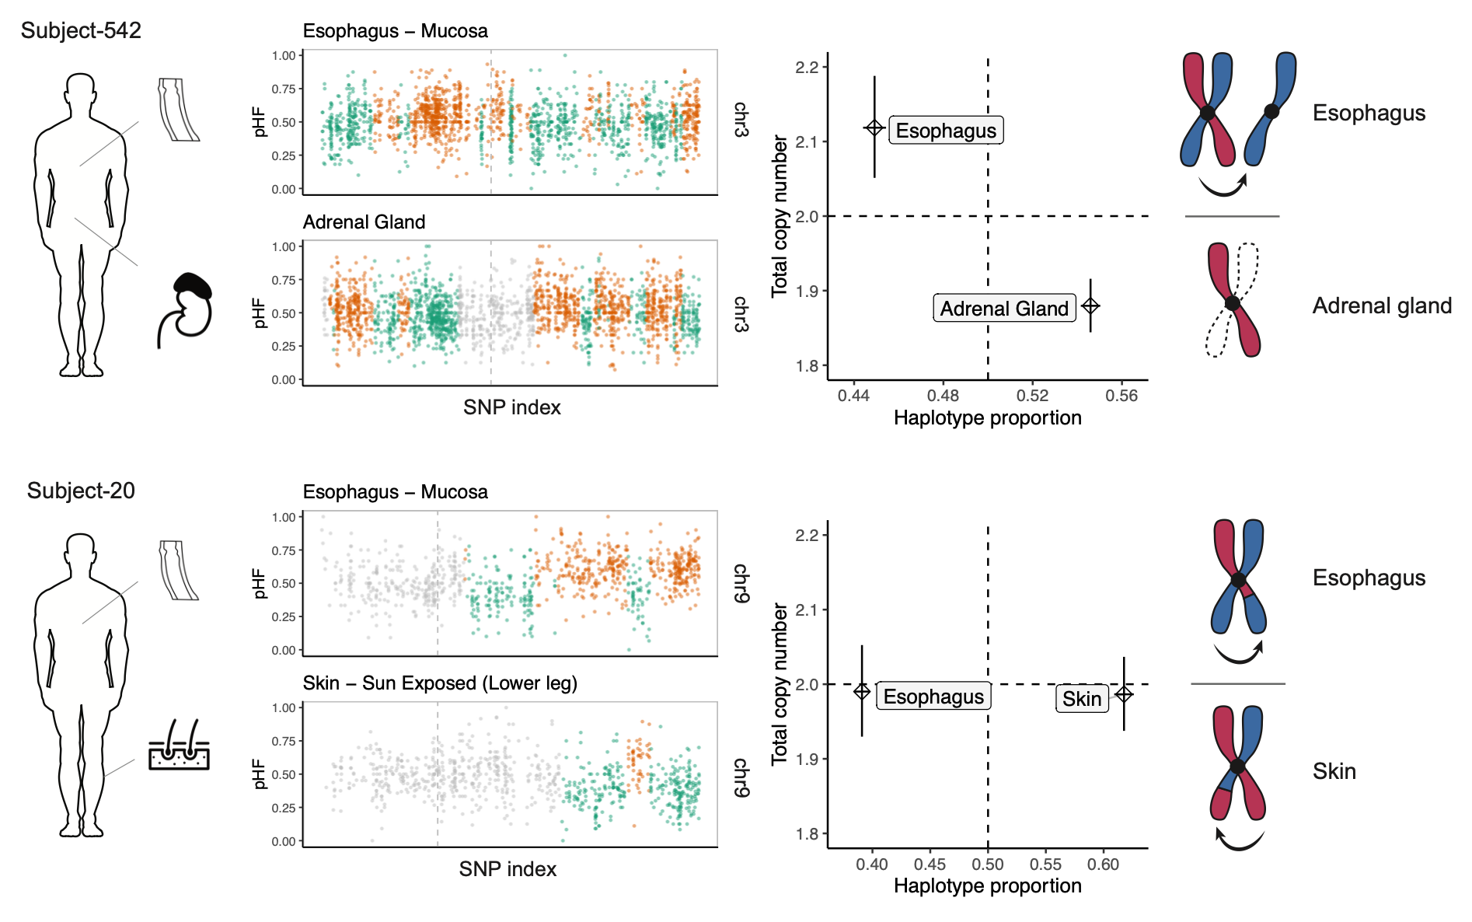
Expansions in Normal Tissues: Recurrence

Slide 40
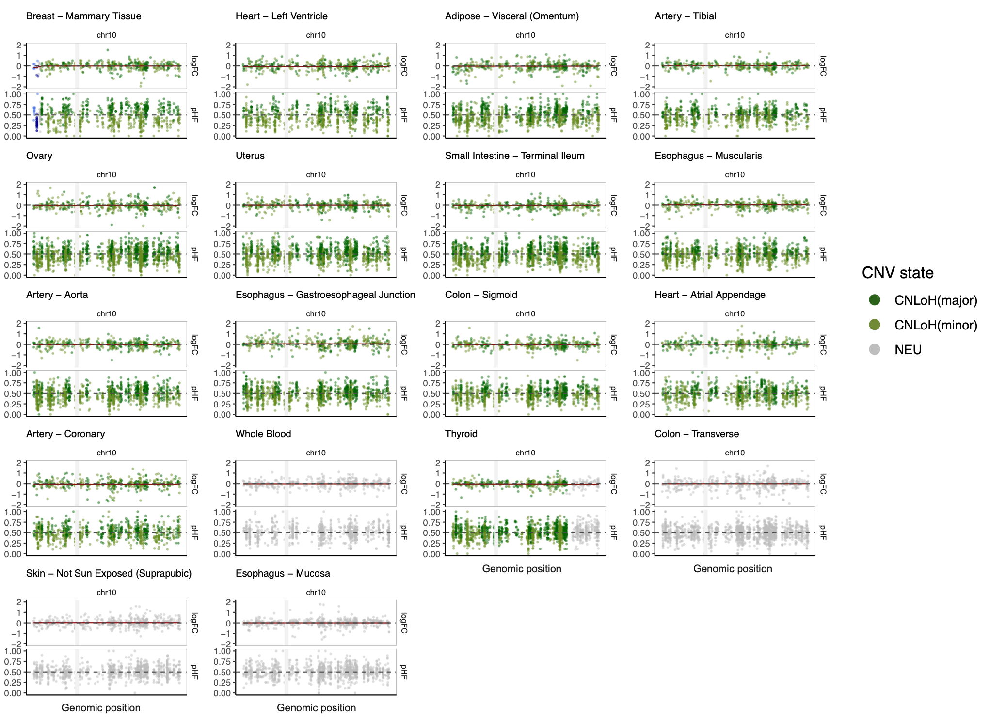
Expansions in Normal Tissues: Recurrence

Slide 41
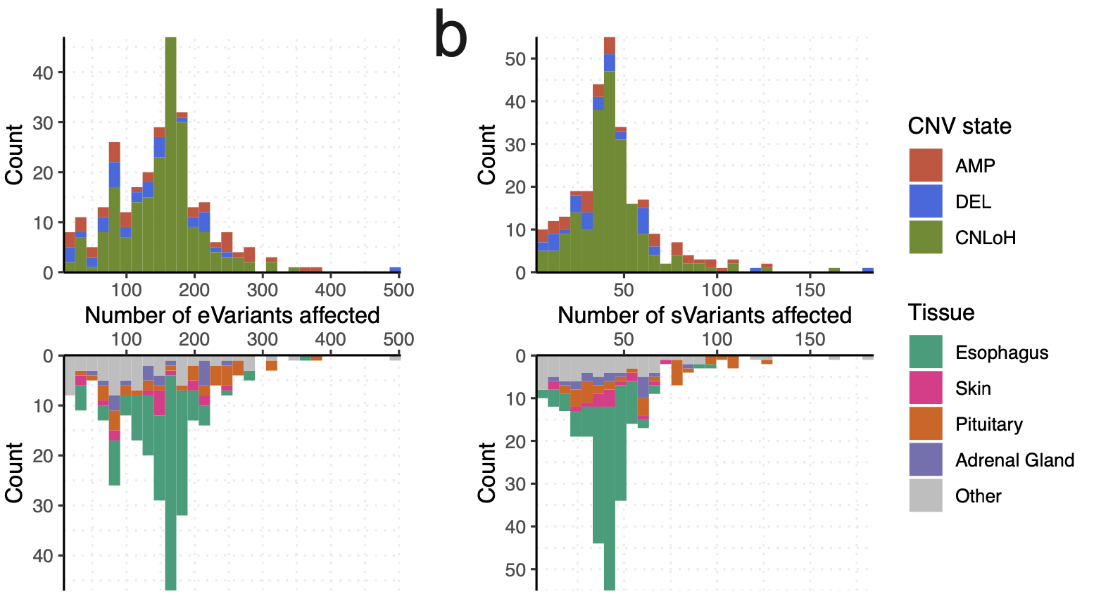
Expansions in Normal Tissues: Impact
expression QTL
splicing QTL

Slide 42
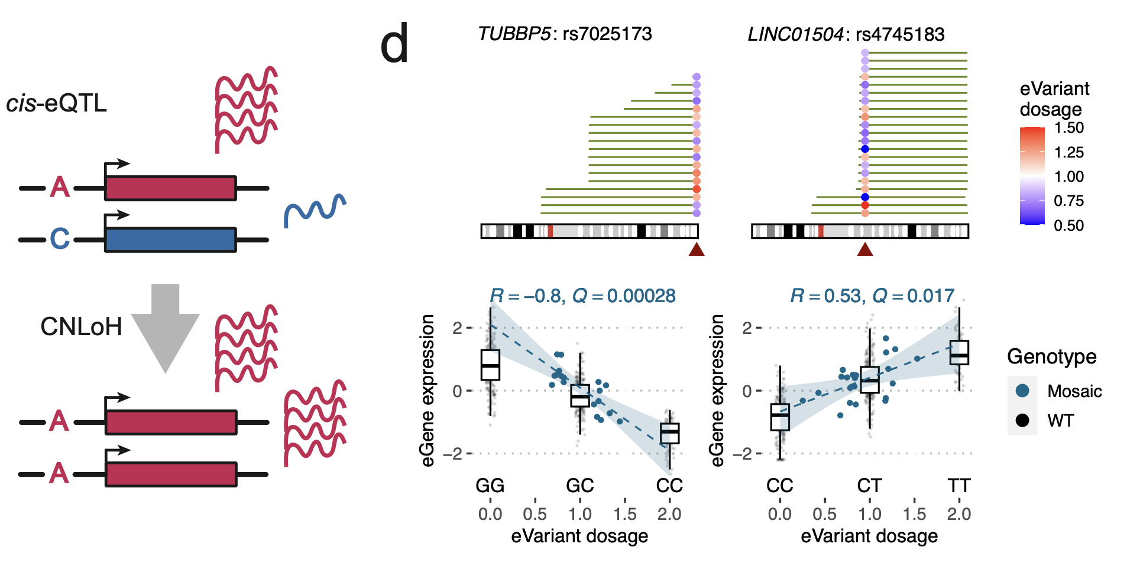
Expansions in Normal Tissues: Impact

Slide 43
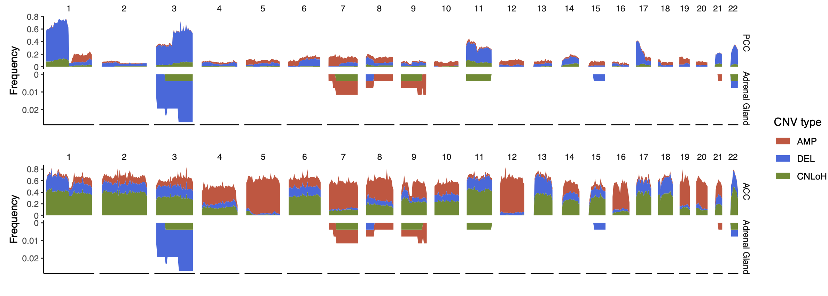
Clonal Expansions in Adrenal Tissues

Slide 44
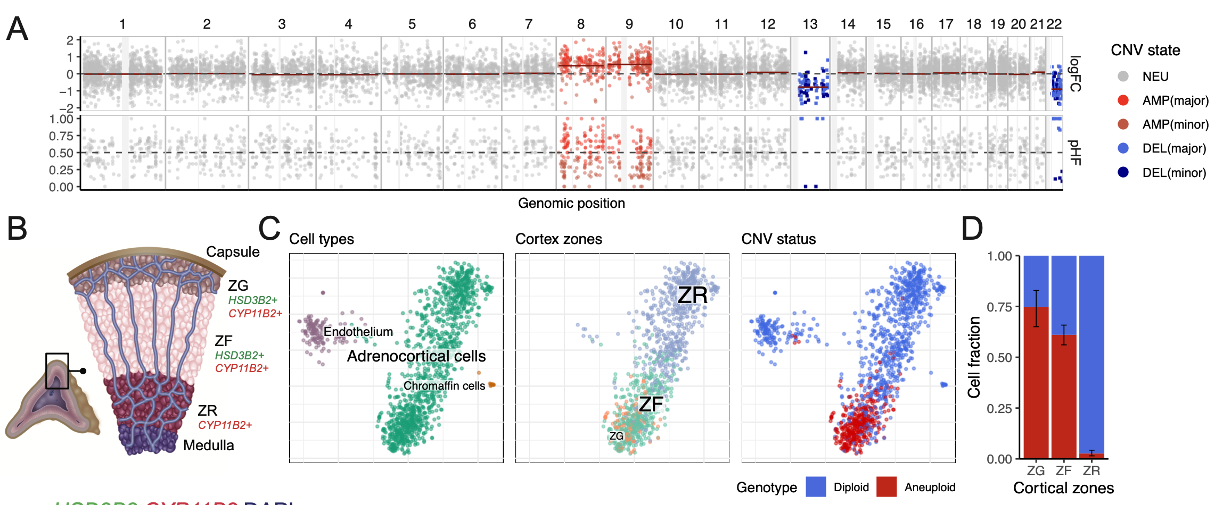
Clonal Expansions in Adrenal Tissues

Slide 45
Summary
Population-based phasing improves CNV detection from scRNA-seq
Numbat: iterative approach for CNV-based subclonal phylogeny reconstruction
Subclonal vs. expression state subpopulations
Developmental origin in neuroblastoma
CNV prevalence in normal tissues
Normal neural crest
Mesenchymal
17amp
MRCA
3 CNVs
15 CNVs
SCP-like
Adrenergic
Notes:
In summary, we introduce a novel computational method that utilize population based phasing to enhance CNV detection from scRNA-seq
Through benchmarking experiments with paired WGS, we have shown that Numbat outperforms existing methods

Slide 46
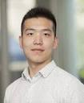
Acknowledgements
Marilena Kastriti
Ruslan Soldatov
Hirak Sarkar
Evan Biederstedt
Adam Kurkiewicz
Teng Gao
kharchenkolab/numbat
Ninib Baryawno
Igor Adameyko
Martin Enge
Po-Ru Loh

