Slide 1
Networked Business Models, Interorganizational Business Processes and Cooperative Information Systems
A Holistic Point of View
Paul Grefen, Professor of Information Systems, Principal Digital Business Architect

Slide 2
all pictures/trademarks owned
by the respective firms

Slide 3
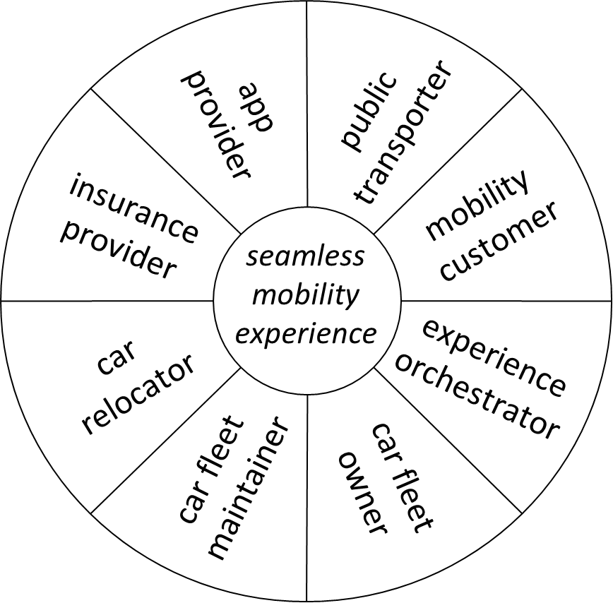
all pictures/trademarks owned
by the respective firms

Slide 4
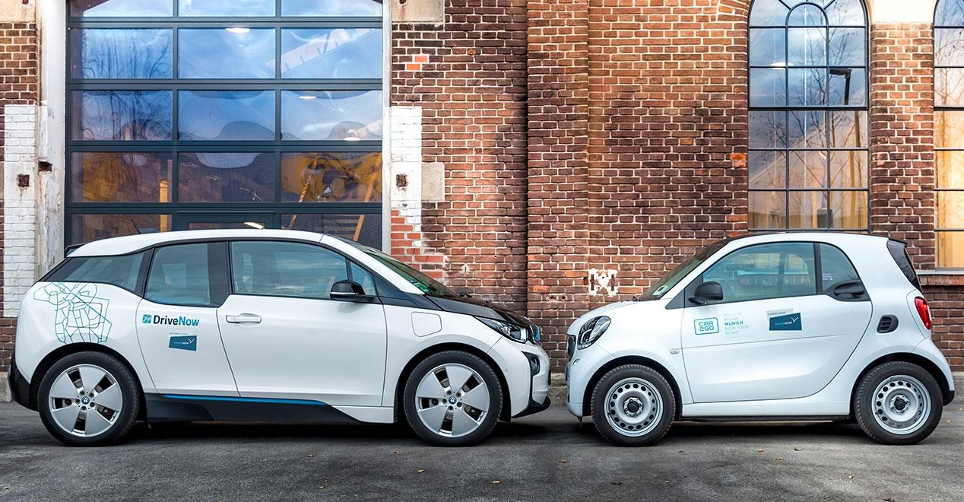
app
provider
app
provider
public
transporter
public
transporter
mobility
customer
insurance
provider
mobility
customer
insurance
provider
seamless
mobility
experience
seamless
mobility
experience
experience
orchestrator
car
relocator
experience
orchestrator
car
relocator
car fleet
maintainer
car fleet
maintainer
car fleet
owner
car fleet
owner

Slide 5
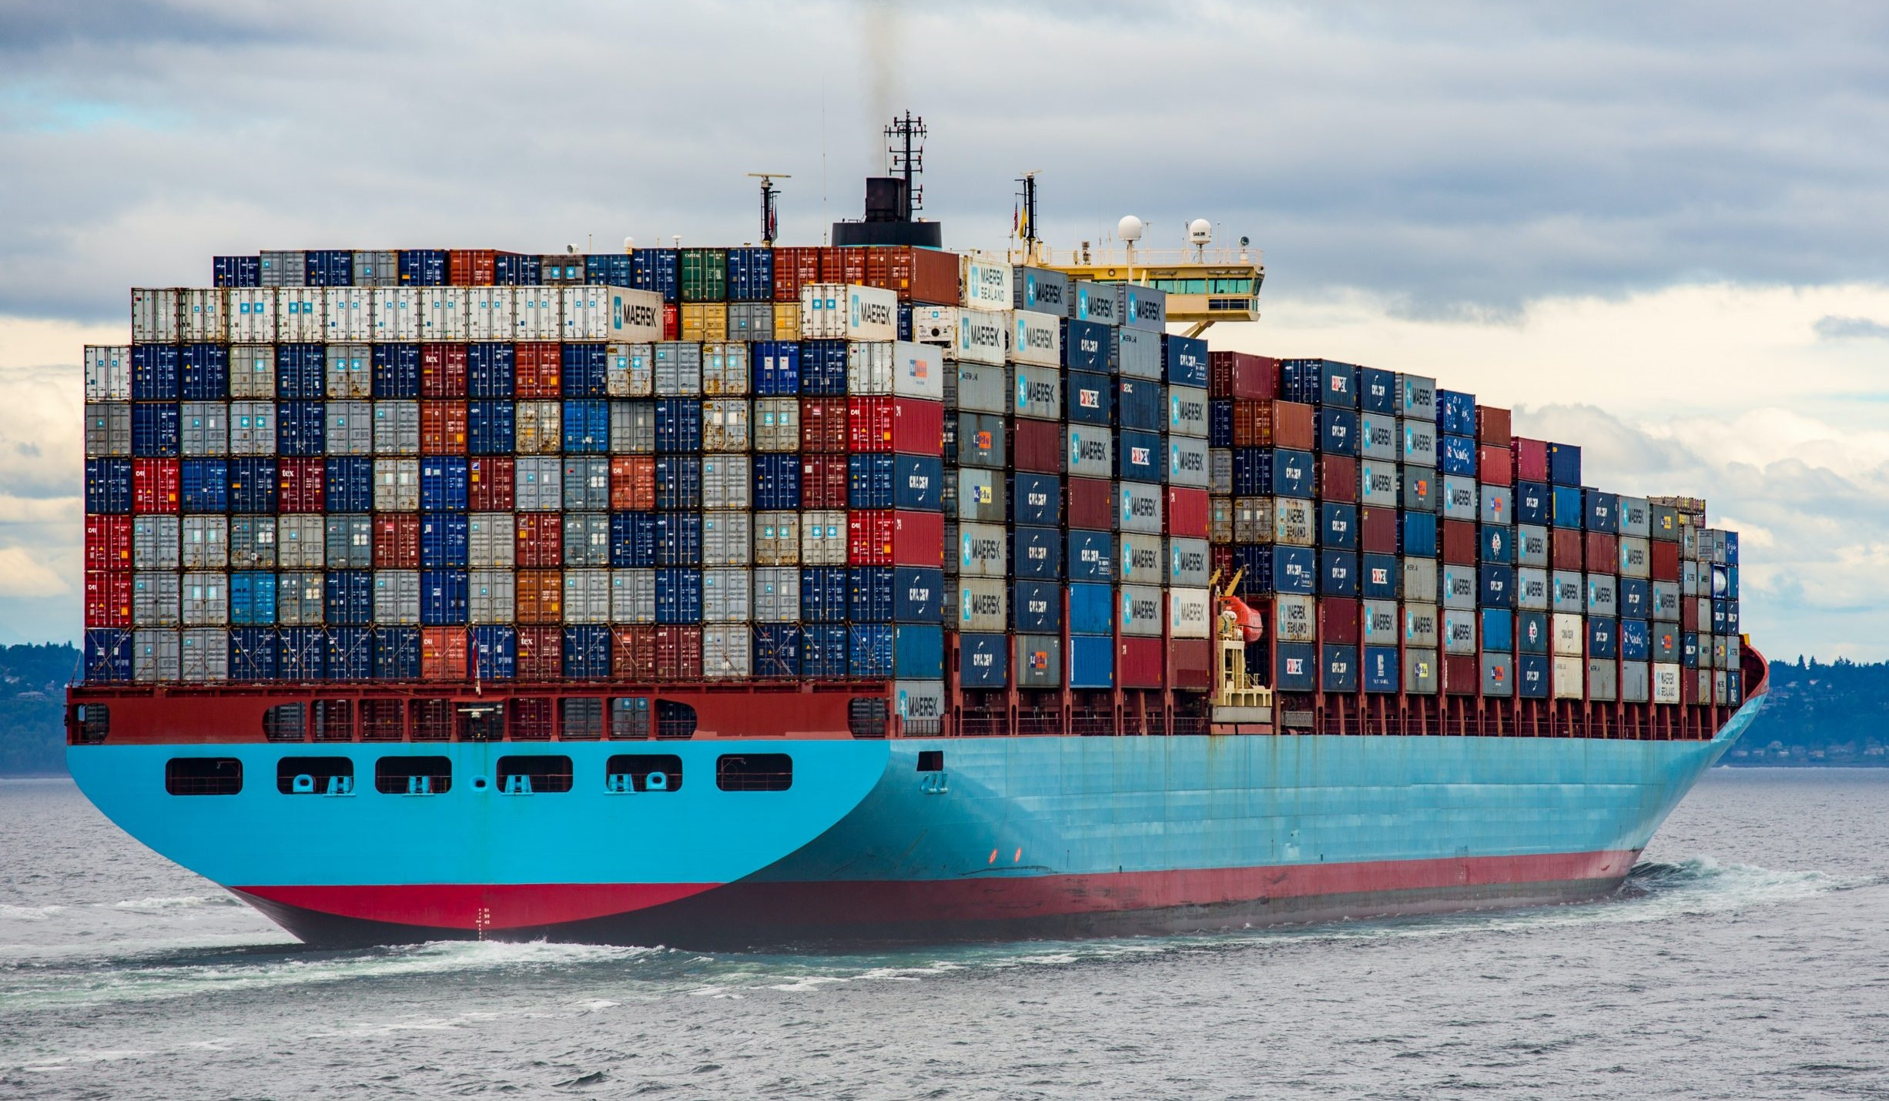
all pictures/trademarks owned
by the respective firms

Slide 6
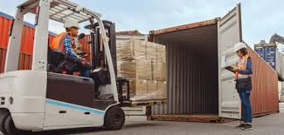
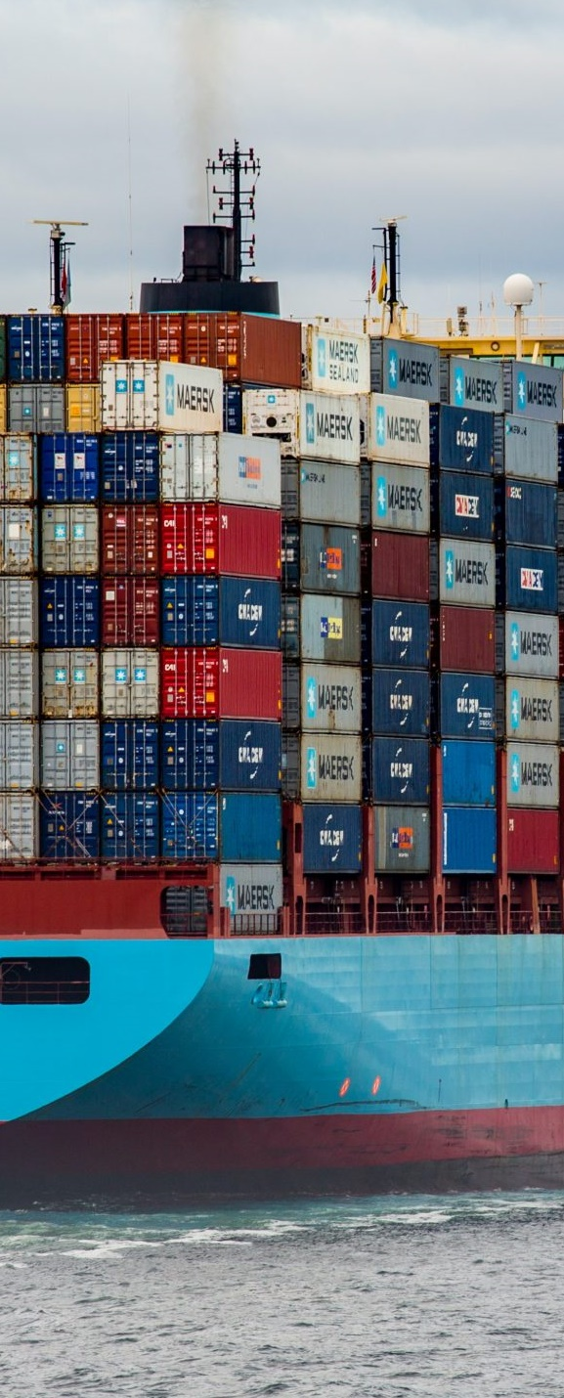
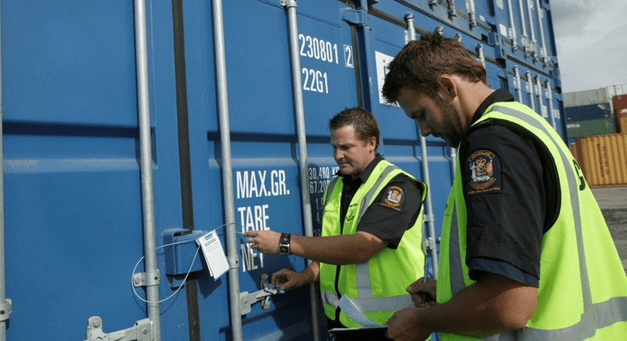
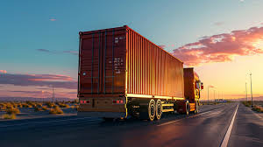
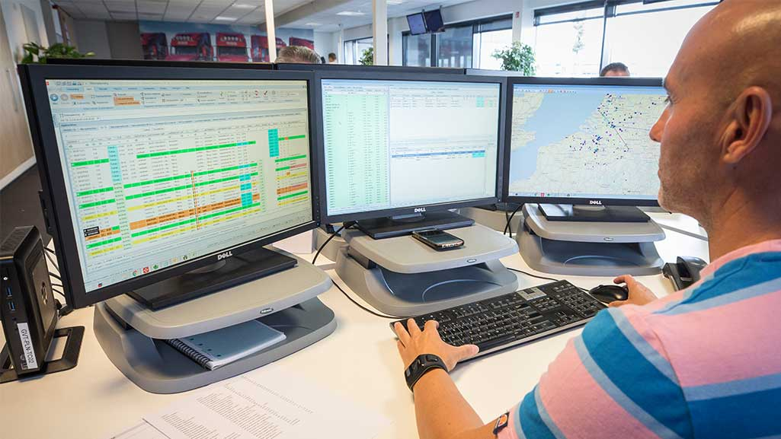
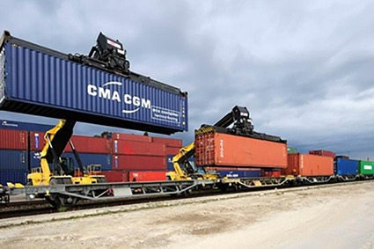
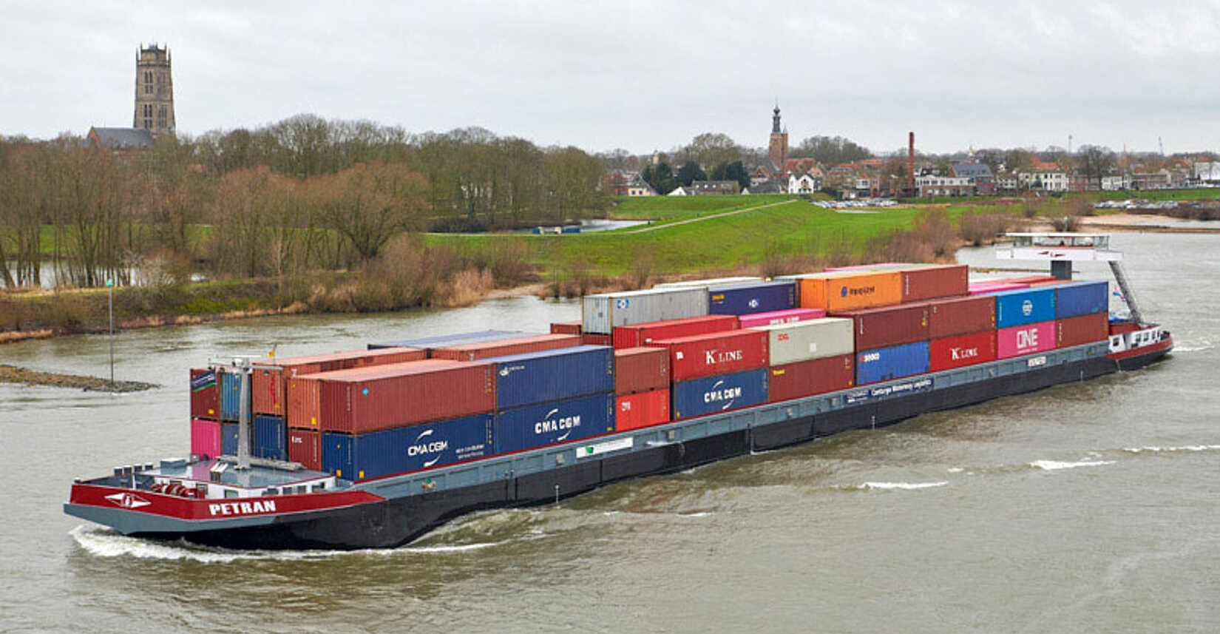

Slide 7
route planner
provider
insurance
provider
customs
shipper
inland
terminal
seamless
transport
experience
transport
orchestrator
inland
transporter
deep sea
transporter
deep sea
terminal

Slide 8
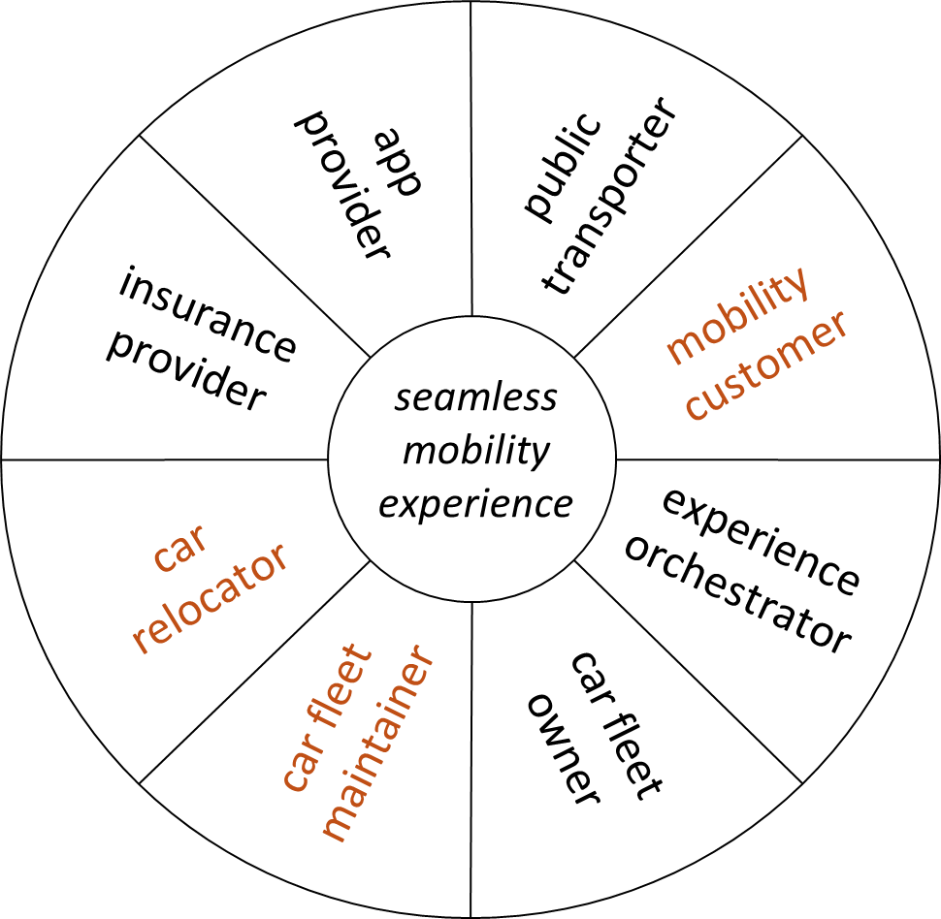
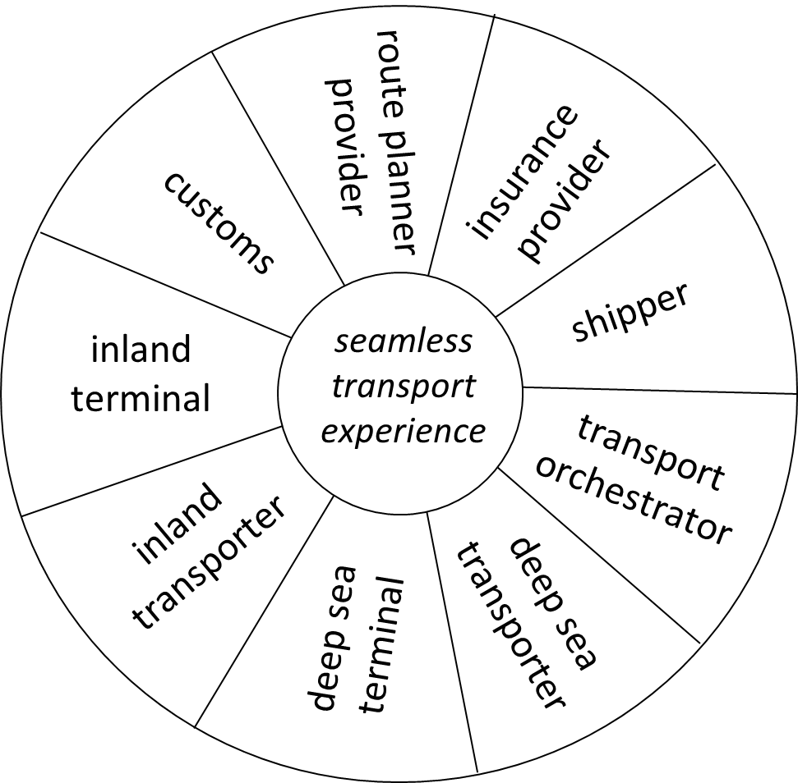
Dynamic Communication and Synchronisation
Dynamic Communication and Synchronisation
Cooperative Information Systems
for Networked Business Support

Slide 9
Networked Business Support
The why, what, how and with what
The business and research perspectives
The network of concepts for networks

Slide 10
business strategy
business strategy
business strategy
business strategy
why?
collaborative / networked
business model(s)
what?
inter-organizational / networked
business process(es)
how?
cooperative / networked
information systems
with what?

Slide 11
↓ business perspective ↓
business strategy
business strategy
business strategy
business strategy
collaborative / networked
business model(s)
↓ research perspective ↓
inter-organizational / networked
business process(es)
cooperative / networked
information systems

Slide 12
Grefen, P. (2015). Service-Dominant
Business Engineering with BASE/X:
Business Modeling Handbook
← is
in
Market
Business
Organization
has ↓
Business
Strategy
← takes place in
← serving
← fits in
← operated by
← operated by
Business
Collaboration
Business
Model
← enacted by
← fits in
← offered by
Orchestration Platform
Service
Composition
← executed on
Service
Platform
Business
Service
← executed on

Slide 13
The BASE/X Framework
Service-dominant, networked business
Bi-speed development
Business models to business processes
Business processes to information systems

Slide 14
S
BM
SC
BS
business strategy
why?
business model
what?
service composition
how?
business service
with what?

Slide 15
Strategic Design Loop:
evolutionary alignment
of identity and capabilities
Confrontation of Goals:
alignment of identity
and market offerings
S
BM
SC
BS
Tactical Design Loop:
revolutionary conception of market offerings
Confrontation of Means:
alignment of required and available capabilities
Grefen, P. (2015). Service-Dominant Business Engineering
with BASE/X: Business Modeling Handbook

Slide 16
actor
cost/benefit
actor
coproduction activity
actor
value proposition
Actor 1:
Customer
co-produced
value-
in-use
Actor 5
Actor 2:
Orchestrator
Actor 4
Actor 3
S
BM
SC
BS

Slide 17
Customs
+ Fee + Data
- Flexibility
- Operations
Provide
Clearance
Shipper
Inland Terminal
+ Fee + Data
- Flexibility
- Operations
Flexibility Priority
+ Fast Delivery - Express Fee
- Data
Handle
Containers
Priority
Order
Transport
Express
Container
Delivery
Requests
Freight
Data
Integr. Network knowledge
+ Fee + Data
- Flexibility
- Operations
+ Express Fee + Branding + Data
- Data - Ops - Fees
Flexible
Capacity
Securely
Orchestrate
Transport
Containers
Priority
Priority
LSP
Inland Operator
+ Branding
- Operations
+ Fee + Data
+ Market Share
- Operations
Organize
Loading
Handle
Containers
S
BM
SC
BS
Deep-Sea Terminal
Shipping Line

Slide 18
Business Service Catalog
(capabilities)
Customer Experience
(control flow)
Business Model
(actors, activities)
Service Composition
(conceptual process model)
Service Dominant Business Model Operationalization Method (SDBMOM)
S
BM
SC
BS
Suratno, B. et al. (2018). A Method for Operationalizing Service-Dominant
Business Models into Conceptual Process Models. In: Procs. BMSD 2018.

Slide 19
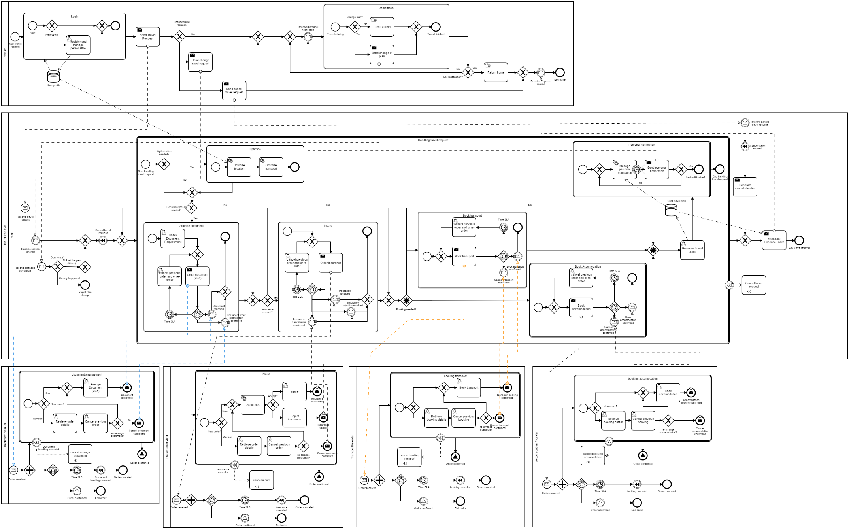
S
BM
SC
BS

Slide 20
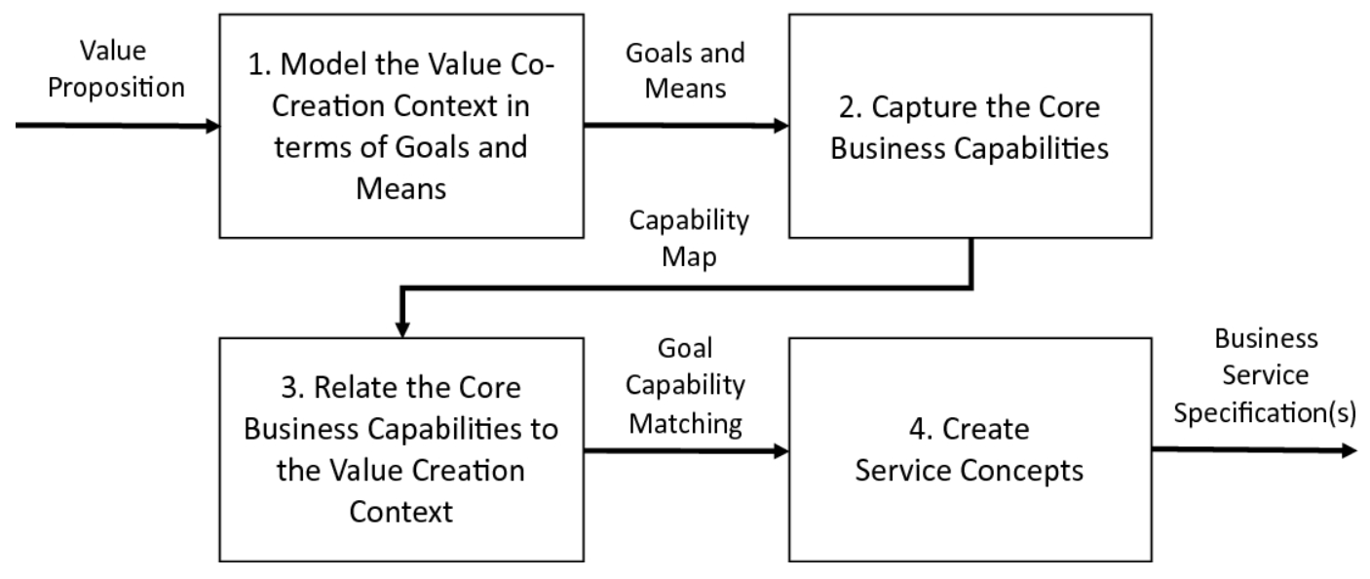
S
BM
SC
BS
Adali, O.E. et al. (2020). A Multi-concern Method for Identifying Business Services:
A Situational Method Engineering Study. In Procs. BPMDS and EMMSAD 2020.

Slide 21
core service
Always internal with full QoS management
Internal if not externally available with right SLA
Preferably internal with light QoS management
Always external (with best SLA available)
differentiating
service
commodity
service
S
BM
SC
BS
enriching service

Slide 22
S
BM
SC
BS
S
BM
SC
BS
S
BM
SC
BS
S
BM
SC
BS
platform
operations
business

Slide 23
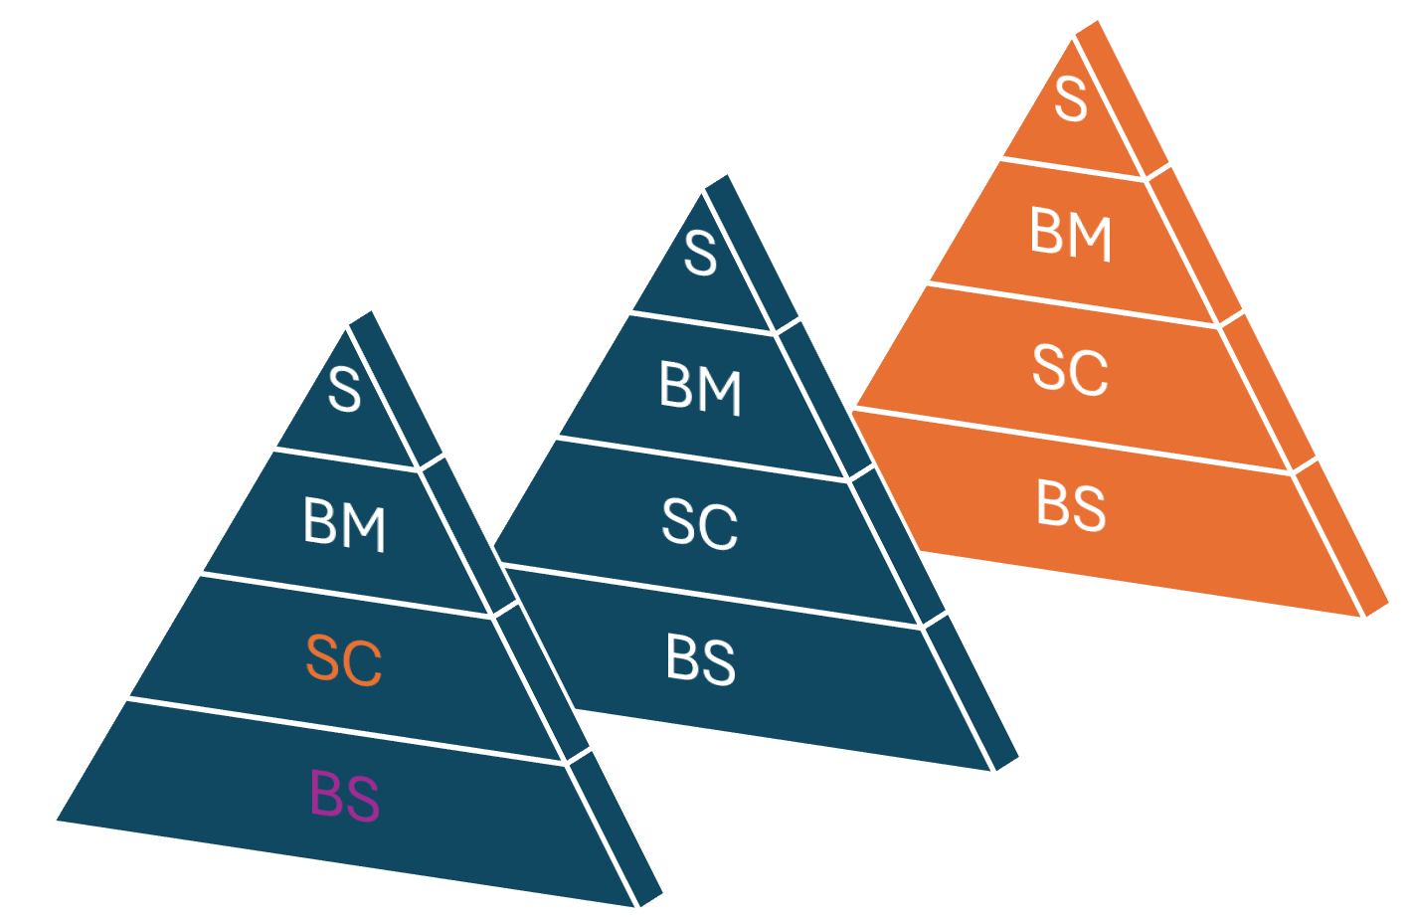
S
Strateg. DSS
T-DW
S-ETL
S-EDS
BM
Dash-board
Tactic DSS
T-DW
T-ETL
T-EDS
SC
BPMS
DCMS
DBMS
ODS
BS
Enterprise Service Bus (ESB)
External ESB
MSP
Internal
BusServ
Internal
BusServ
Internal
BusServ
Internal
BusServ
External BusServ
External BusServ

Slide 24
The BASE/X Experience
Business
Science

Slide 25
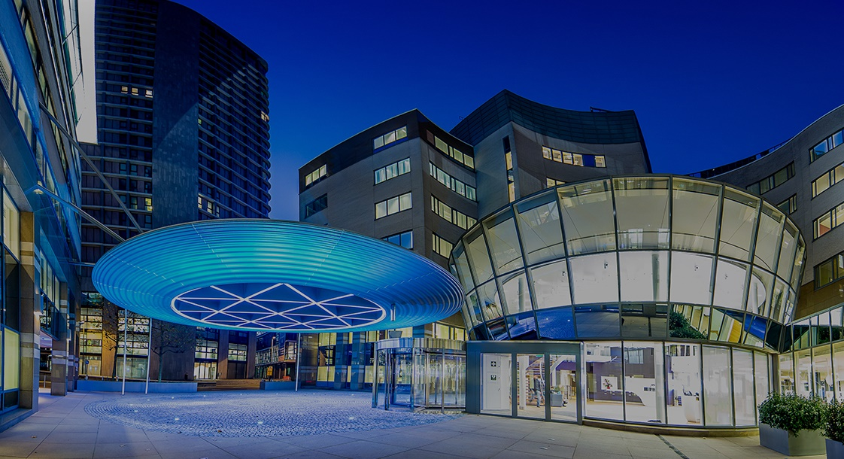

Slide 26
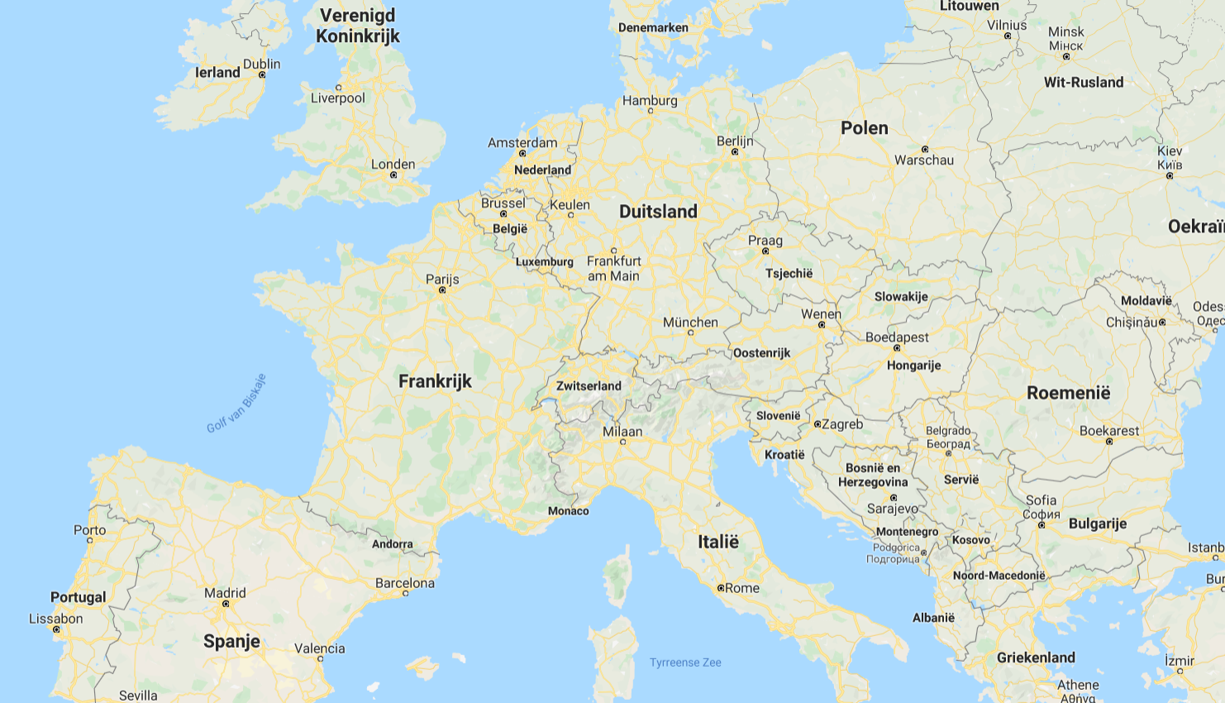
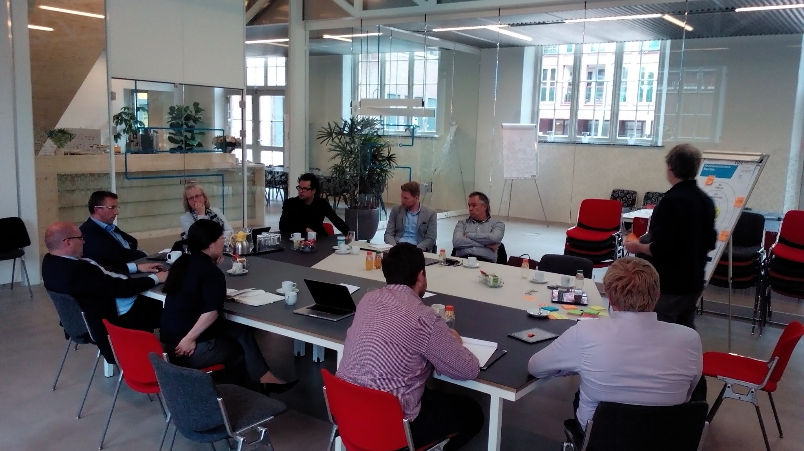

Slide 27
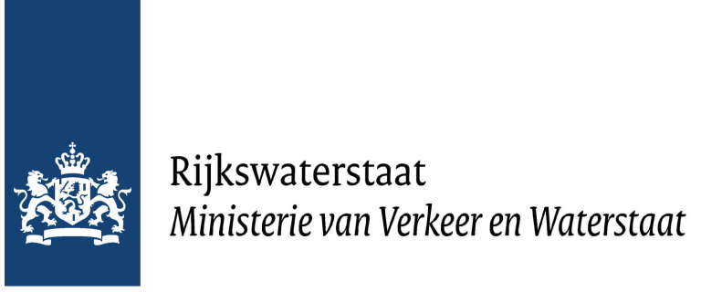
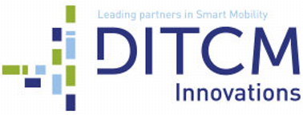
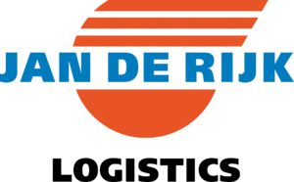
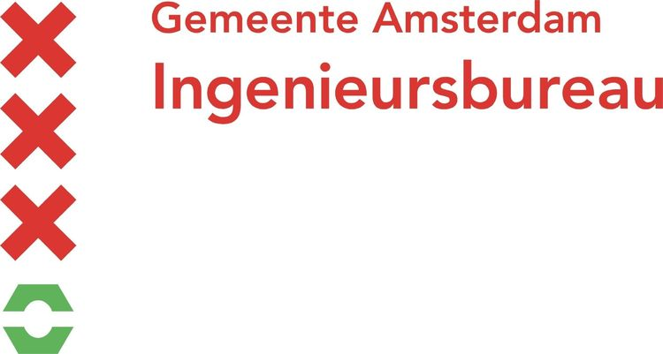

Slide 29
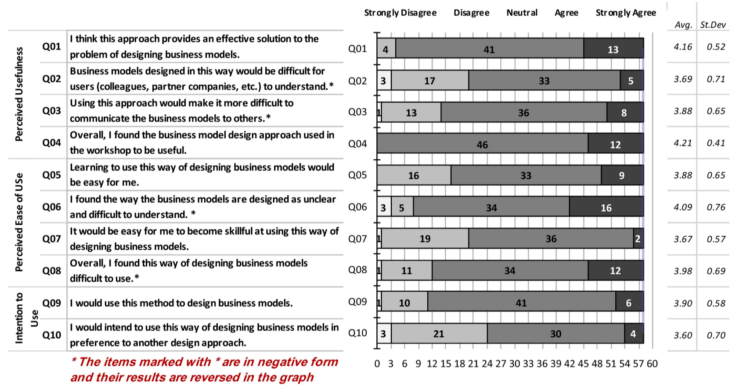
Turetken, O. et al. Service-Dominant Business Model Design
for Digital Innovation in Smart Mobility. Bus Inf Syst Eng 61, 9–29 (2019)

Slide 30
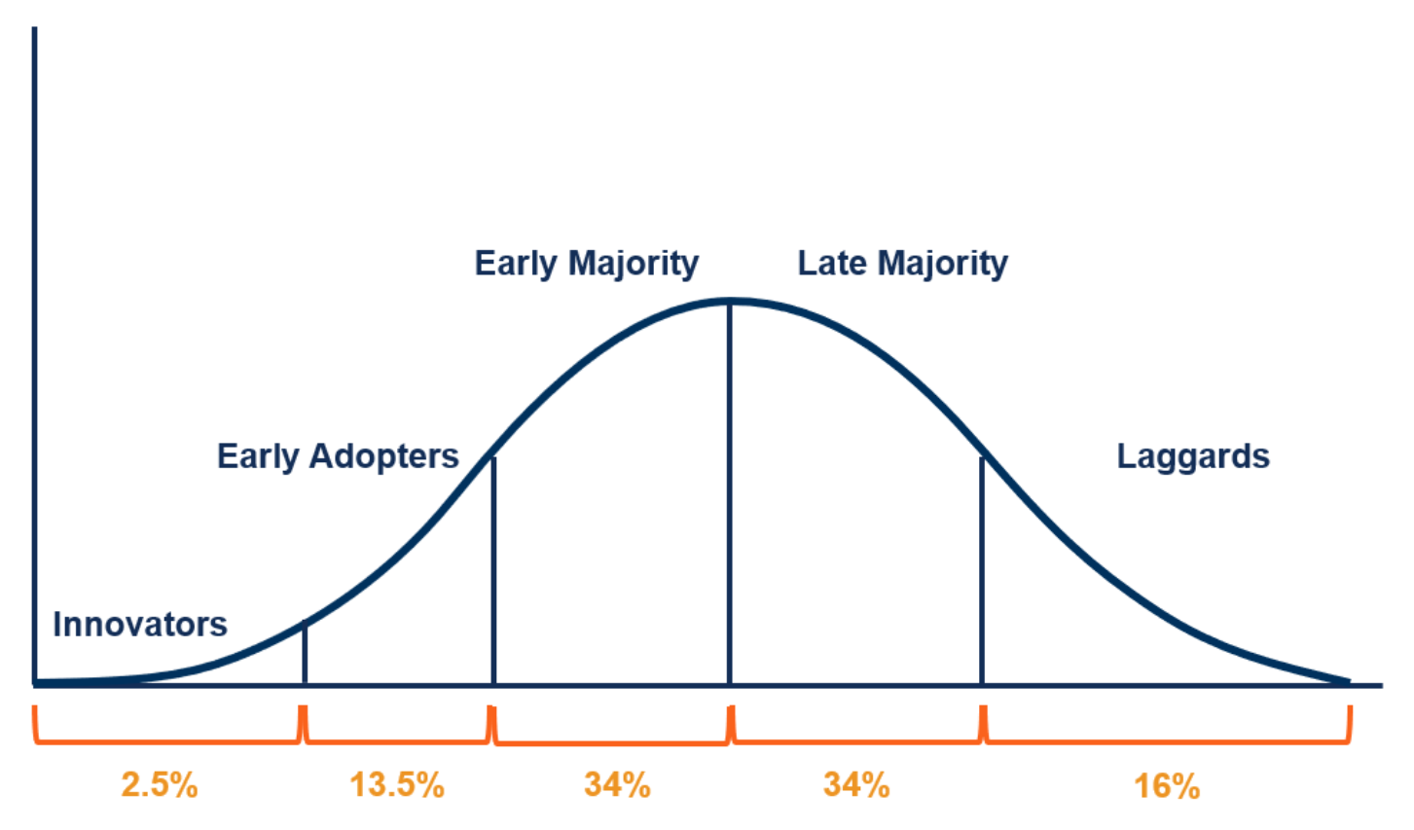
Diffusion of Innovation Model (Rogers, 1962)
Figure from corporatefinanceinstitute.com

Slide 31
The Learnings
Trying to build adventurous bridges
Trying to make digital concrete fluid

Slide 32
what is the ROI in say 3 months from now?
do you have longitudinal implementation studies?
WORLDS
OF
BIZZ
we have an agile service-dominant framework
we have no clue what that is – we use ERP and CRM
WORLDS
OF
Tech
we have no clue what that is
WORLDS OF SCI
WORLDS OF COMM

Slide 33
WORLDS
OF
BIZ
WORLDS
OF
Tech
WORLDS OF SCI
WORLDS OF COM

Slide 34
My Matrix for Research Impact
high
some chance of
great impact on
small problems
tiny chance of
great impact on
large problems
networked service-based
business support
hard to find
sweet spot?
innovation level targeted →
high chance of
tiny impact on
small problems
some chance of
small impact on
large problems
low
complexity of problem domain →

Slide 35
Networked business is growing (or needs to grow), e.g.:
Smart Industry (Industry 4.0/5.0, Smart Manufacturing, Smart Logistics)
Integrated Healthcare (Healthcare Service Networks)
Seamless Entertainment (Multi-channel, Multi-media, Multi-device)
Single-Window G2C and G2B E-Government
But there are severe growing pains in practice:
Most organizations think/work inside-out, not outside-in
Networks are often sets of point-to-point connections rather than dynamic ecosystems
Proper technology adoption is slow – hindered by ignorance and legacy
Paradigm shifts are very hard to digest … but technology hypes very easy

Slide 36
Research is not always helping to cure the growing pains
We like to stay in our content niches
“I have a solution, is there a matching problem?” attitude
We like to use toy examples to illustrate our inventions (“reality is horribly complicated”)
We never loose (also failures can be published !)
Finding the right way is not easy
Practice likes simple solutions and ‘cannot read’
“at most three Powerpoint slides” attitude towards solutions
Practice likes solutions proven in practice (bootstrap problem)
Learning from (and building on) existing experience can help

Slide 37
Conclusion

Slide 38
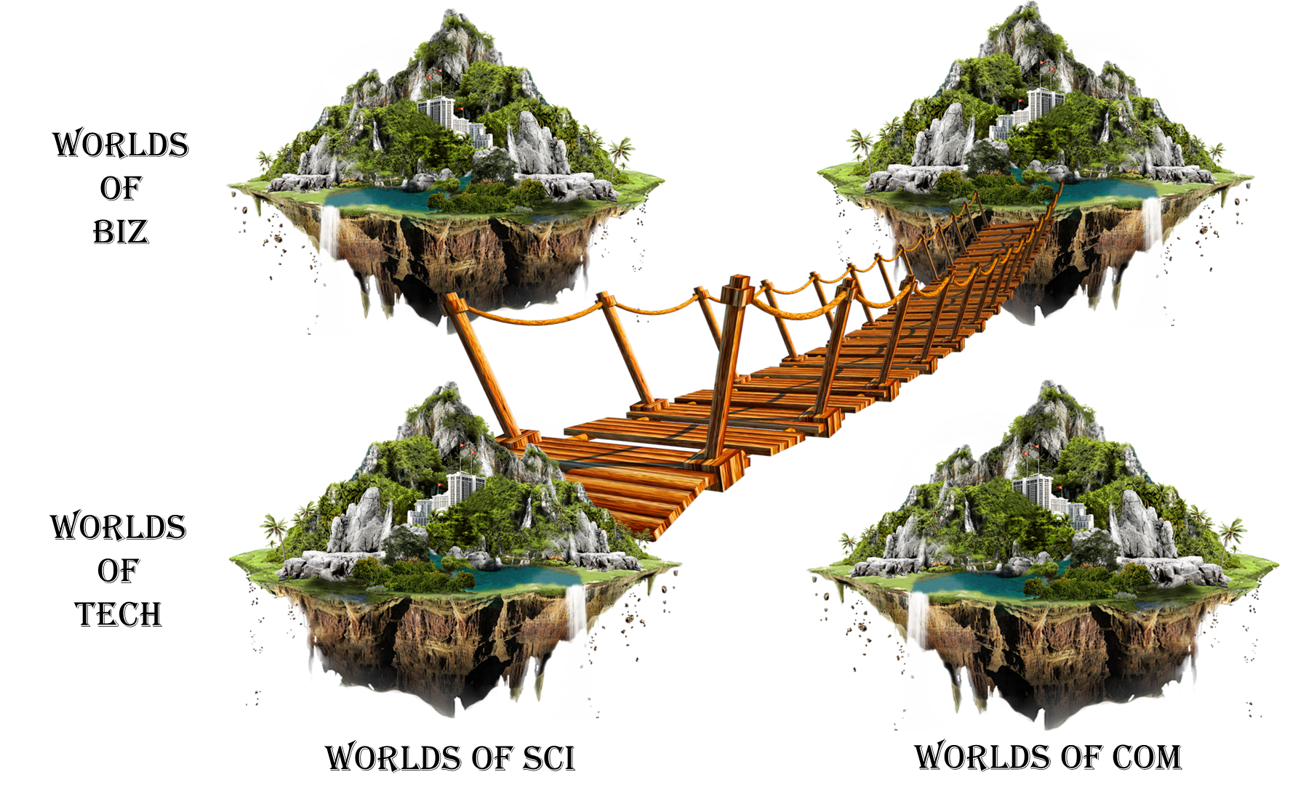
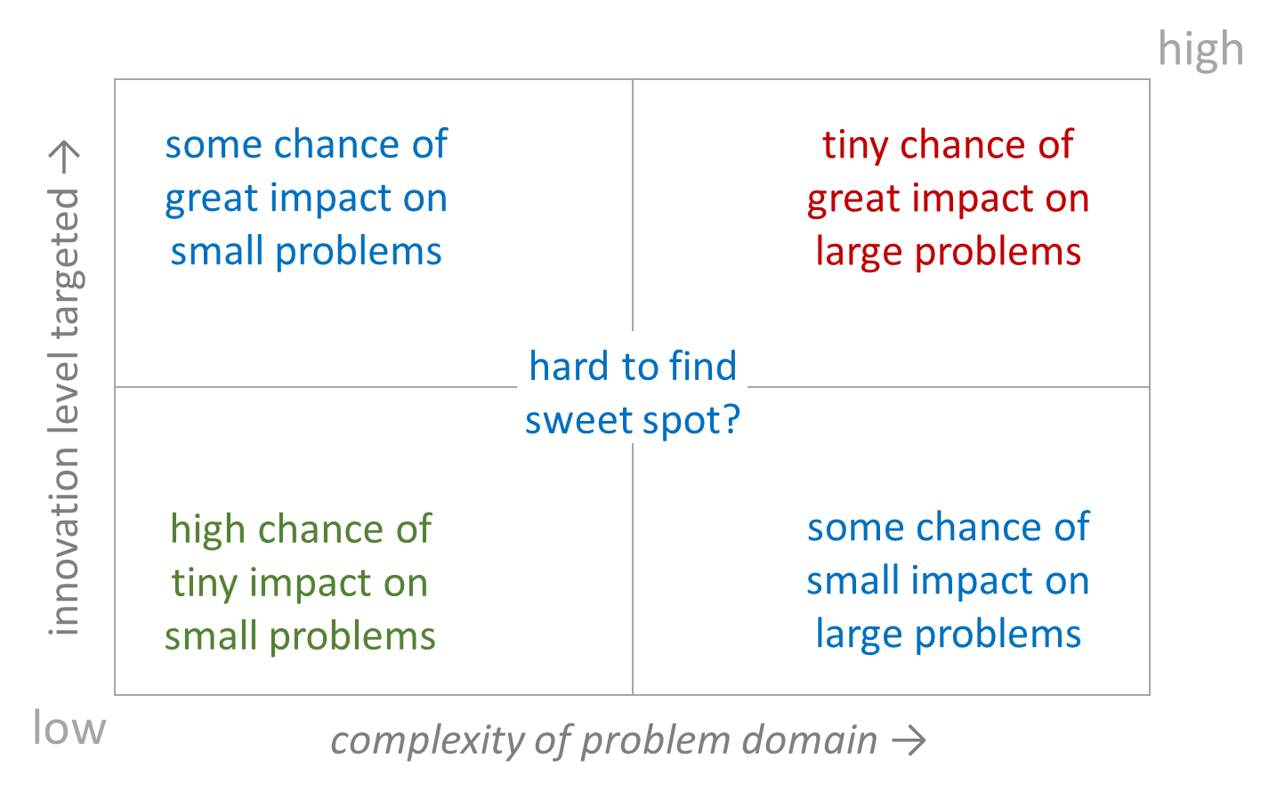
A holistic networked approach is the basis for
solving many problems and grasping many opportunities.
But it has to be positioned well.

Slide 39
Thank you!
Questions and feedback are welcome ☺
Contact:
p.w.p.j.grefen@tue.nl
paul.grefen@eviden.com
grefen.dba@outlook.com
escf@tue.nl
Paul Grefen @ LinkedIn

