Slide 1
https://people.idsia.ch/~juergen/artificial-curiosity-since-1990.html
Past, Present, Future, and Far Future of AI
Jürgen Schmidhuber KAUST GenAI Center Swiss AI Lab IDSIA
Pronounce: You_again Shmidhoobuh X: @SchmidhuberAI https://people.idsia.ch/~juergen

Slide 2
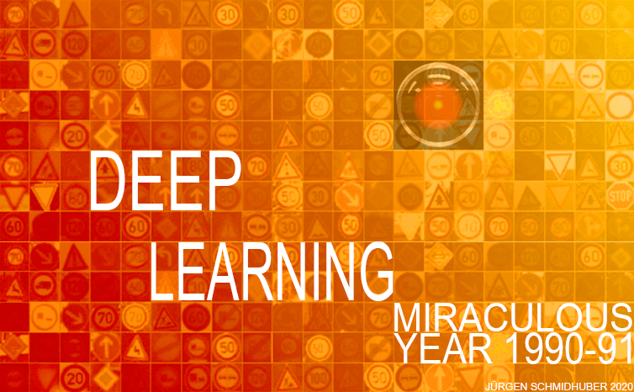
Generative AI and ChatGPT go back to our Miraculous Year 1990-91 at TU Munich:
1. The first Transformer variants (the T in ChatGPT)
2. The first Pre-Training for deep learning (the P in ChatGPT)
3. The first Generative Adversarial Networks, now used for deepfakes (see the G in ChatGPT)
https://people.idsia.ch/~juergen/deep-learning-miraculous-year-1990-1991.html

Slide 3
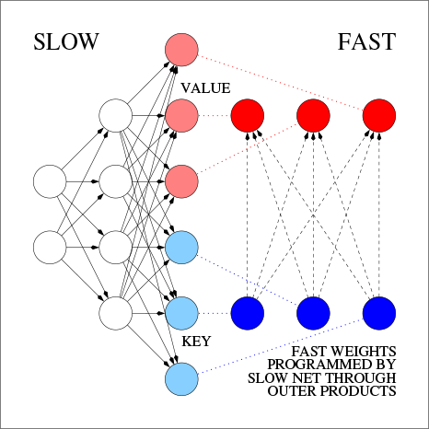
1. Generative AI and Large Language Models (LLMs) often use Neural Nets (NNs) called Transformers (T in ChatGPT). 1991: first Transformer variant, now called unnormalised linear Transformer (TR FKI-147-91, Neural Comp. 1992 – see also ICML 2021). Attention terminology: ICANN 1993. Fast weight attention mapping: outer products of KEYs and VALUEs applied to QUERIEs. Scales linearly, not quadratically like modern quadratic Transformers.
QUERY
https://people.idsia.ch//~juergen/fast-weight-programmer-1991-transformer.html

Slide 4
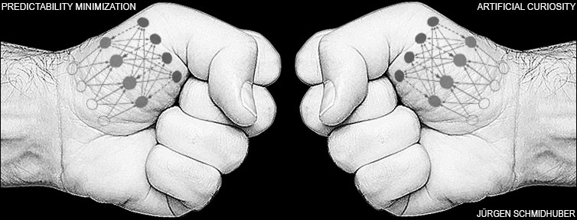
2. 1990: the first Generative Adversarial Networks, now used for deepfakes: two dueling NNs (a generator with adaptive probabilistic units and a predictor of the effects of the generator’s output) maximize each other's loss in a minimax game. I called this Artificial Curiosity (JS, TR FKI-126-90, SAB 1991). See the G in ChatGPT.
https://people.idsia.ch/~juergen/deep-learning-miraculous-year-1990-1991.html

Slide 5
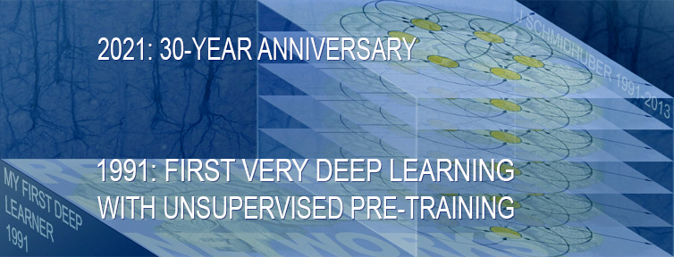
3. 1991: the first unsupervised or self-supervised Pre-training to enable deep learning for sequences such as long texts (the P in ChatGPT).
My 1991 neural history compressor (TR FKI-148-91, Neural Comp., 1992) learns predictive coding to compress long sequences (pretext tasks), thus enabling downstream deep learning tasks. Same paper: distilling one neural net into another.
https://people.idsia.ch/~juergen/very-deep-learning-1991.html

Slide 6
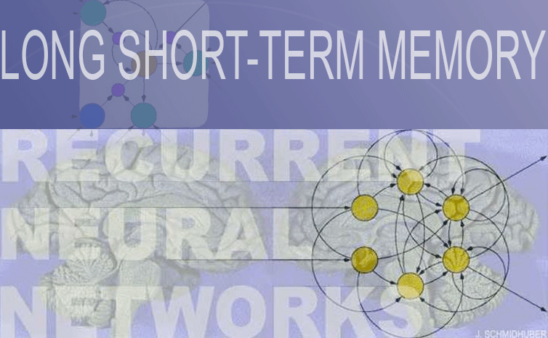
Principles of LSTM also date back to 1991: see the diploma thesis of my brilliant student Sepp Hochreiter. The 1997 LSTM paper has become the most cited AI paper of the 20th century. LSTM improvements with my later students: Felix Gers (PhD 2001, e.g., gated recurrent units), Alex Graves (e.g., CTC, 2006), Daan Wierstra (2007: policy gradients for LSTM), Justin Bayer (2009: architecture search for LSTM-like NNs)
https://people.idsia.ch/~juergen/deep-learning-history.html#lstm
Essential idea of 1991: non-vanishing, non-exploding information flow along residual connections

Slide 7
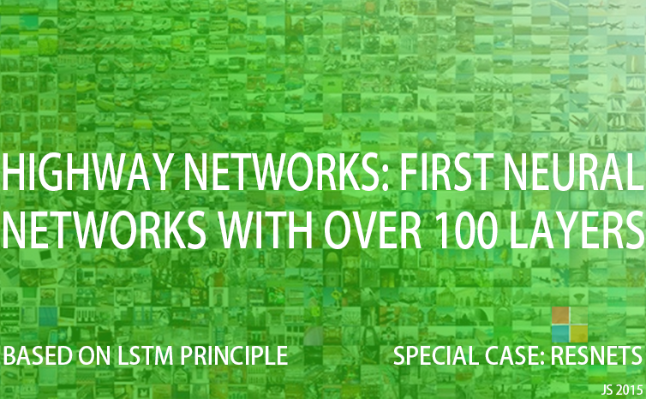
https://people.idsia.ch/~juergen/highway-networks.html
The most cited NN of the 20th century (LSTM) and the most cited NN of the 21st century are closely related: ResNet (Microsoft, Dec 2015) is like our earlier feedforward Highway Net (Rupesh Srivastava, Klaus Greff, J. Schmidhuber, May 2015) with open gates set to 1.0. The LSTM-inspired Highway Net has the residual connections of the 1997 LSTM and the gates of the 2000 LSTM.
Deep learning is all about NN depth. LSTM brought essentially unlimited depth to supervised recurrent NNs; the LSTM-inspired Highway Net (and then its open-gated variant ResNet) brought it to feedforward NNs.

Slide 8
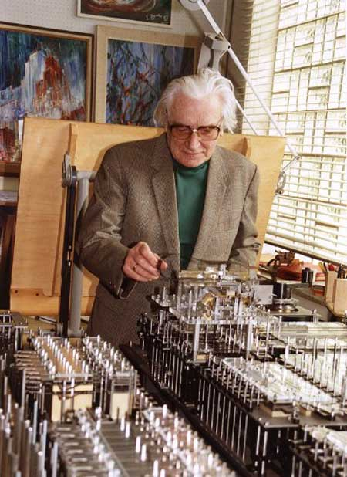
In 1991, we could not do much with our AIs, because computers were so slow. But every 5 years compute got 10 times cheaper.
Konrad Zuse 1941 (patent application 1936): first working general purpose computer. 1 elementary operation/s.
80 years later: factor 10¹⁶! That's why now everybody has impressive AI on his smartphone, although the basic AI techniques running on these smartphones all date back to the previous millennium. (Since then, however: lots of little improvements.)
https://people.idsia.ch/~juergen/zuse-1941-first-general-computer.html

Slide 9
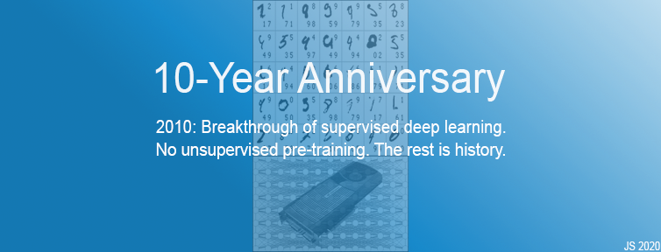
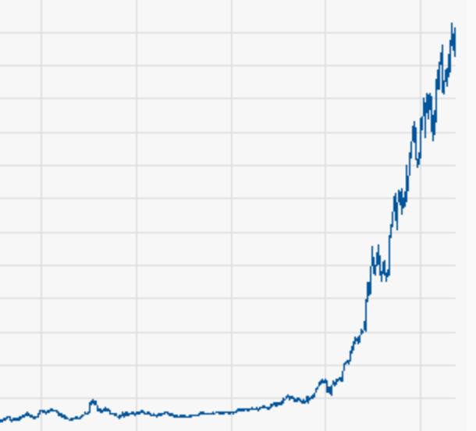
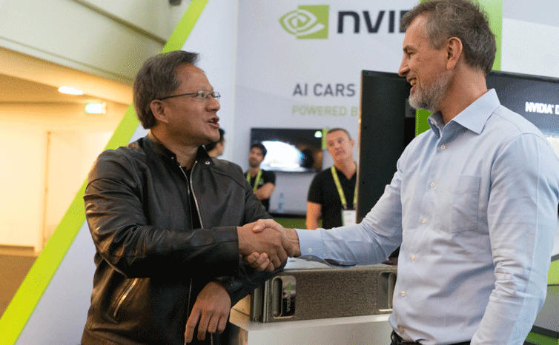
2020:
By 2009, compute was cheap enough, and our LSTM started winning competitions.
By 2010, my team with Dan Ciresan broke the MNIST benchmark with fast & deep but otherwise standard NNs on NVIDIA GPUs.
By 2011, our deep CNN called DanNet was the first to win computer vision contests, winning four of them in a row.
https://people.idsia.ch/~juergen/2010-breakthrough-supervised-deep-learning.html
https://x.com/SchmidhuberAI/status/1686044150838247426
NVIDIA
CHART
NVIDIA Pioneers of AI Research Award

Slide 10
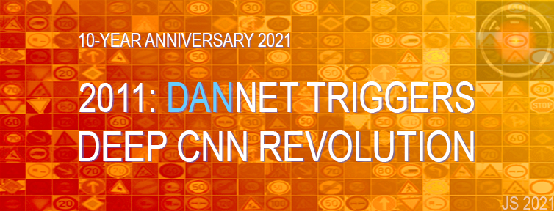
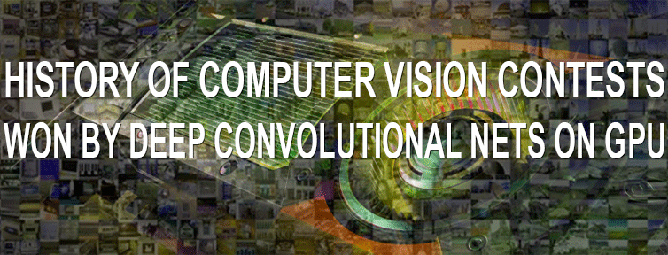
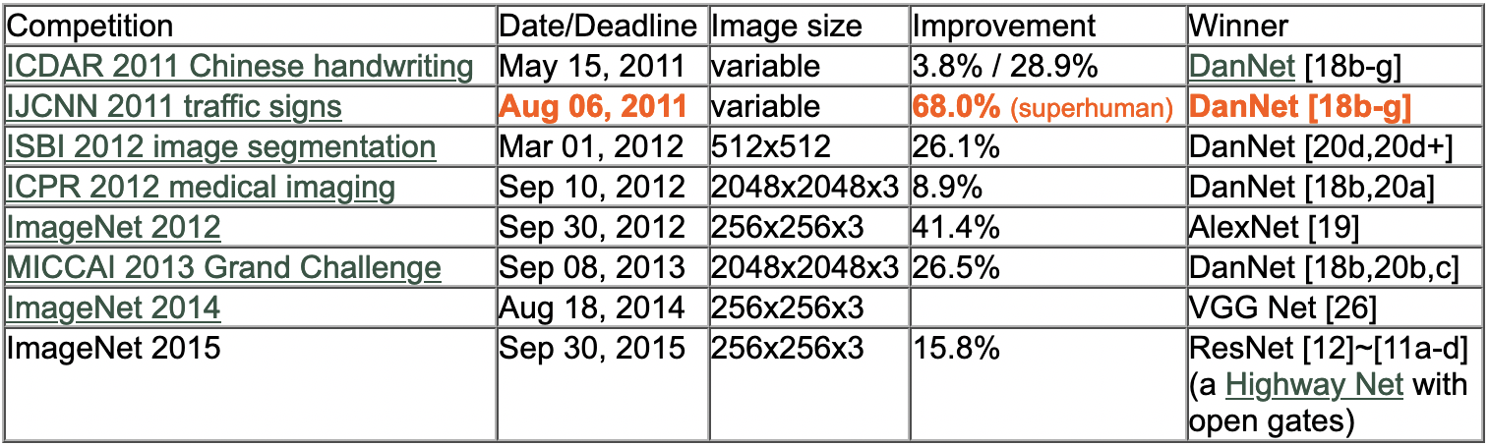
DanNet (Ciresan, Meier, Masci, Schmidhuber, 2011): 1.5 years monopoly on winning computer vision contests with GPU-based convolutional NNs; DanNet’s first superhuman result in 2011.
https://people.idsia.ch/~juergen/DanNet-triggers-deep-CNN-revolution-2011.html
https://people.idsia.ch//~juergen/computer-vision-contests-won-by-gpu-cnns.html
CNNs were first published much earlier in Japan. Fukushima (1979): basic deep CNN architecture. Waibel (1987) used backprop (Linnainmaa, 1970) for NNs with convolutions and weight sharing. Zhang (1988) used backprop for modern 2-dimensional CNNs.

Slide 11
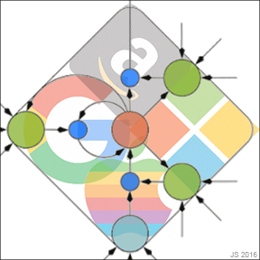
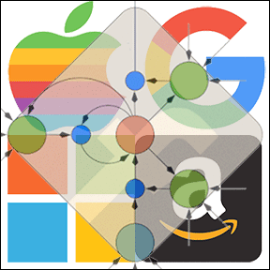
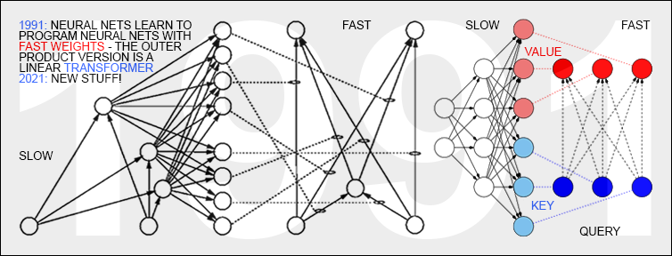
2016: Over 25% of the awesome computational power for inference in all those Google datacenters is used for LSTM (Jouppi et al, 2017); 5% for CNNs. 2017: Facebook uses LSTM for over 30 billion translations every week. LSTM/CTC also used by Microsoft, Samsung, Alibaba, Tencent, ….
LSTM was used for the first Large Language Models by Google, Microsoft, Facebook, and others, before they started using Transformers, whose principles also go back to our Miraculous Year of 1991 ☺
2015: Dramatic improvement of Google's speech recognition through our LSTM & CTC (2006), now on billions of Android phones. Similar for Microsoft. 2016: LSTM on almost 1 billion Apple iPhones, e.g., Siri. 2016: Google's greatly improved Google Translate uses LSTM; also Amazon Alexa.

Slide 12
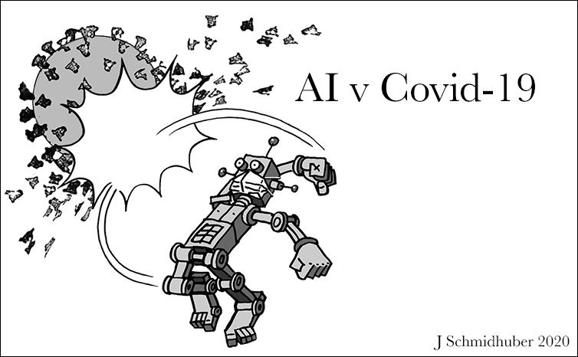
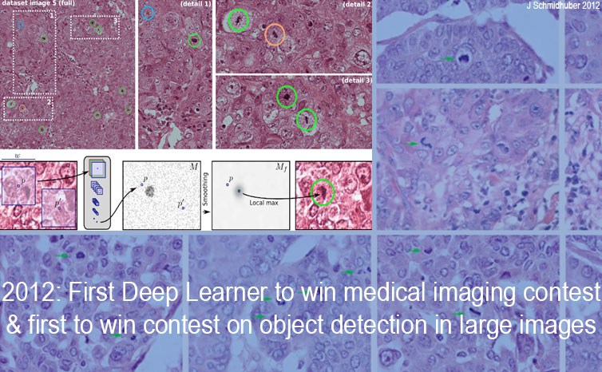
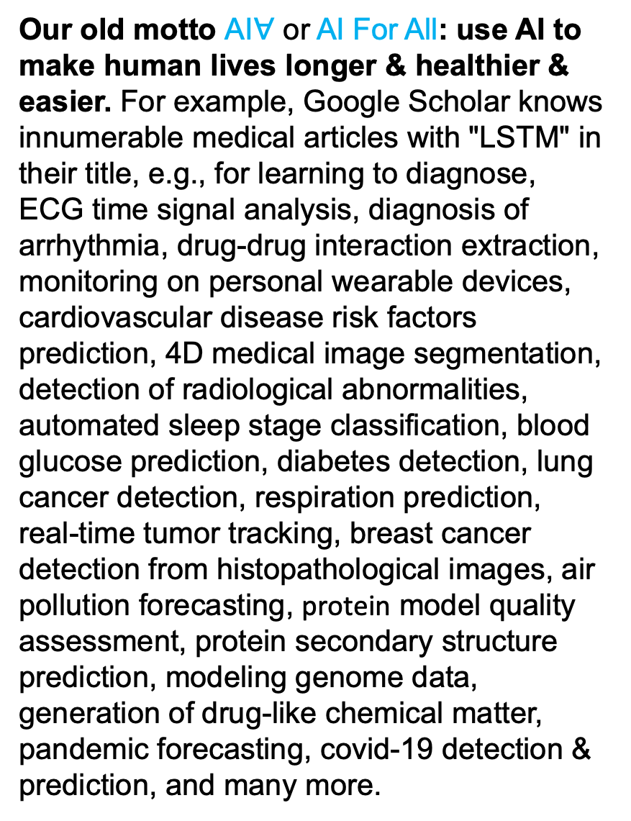
Our old motto AI$∀$ or AI For All: use AI to make human lives longer & healthier & easier. For example, Google Scholar knows innumerable medical articles with "LSTM" in their title, e.g., for learning to diagnose, ECG time signal analysis, diagnosis of arrhythmia, drug-drug interaction extraction, monitoring on personal wearable devices, cardiovascular disease risk factors prediction, 4D medical image segmentation, detection of radiological abnormalities, automated sleep stage classification, blood glucose prediction, diabetes detection, lung cancer detection, respiration prediction, real-time tumor tracking, breast cancer detection from histopathological images, air pollution forecasting, protein model quality assessment, protein secondary structure prediction, modeling genome data, generation of drug-like chemical matter, pandemic forecasting, covid-19 detection & prediction, and many more.
https://people.idsia.ch/~juergen/first-time-deep-learning-won-medical-imaging-contest-september-2012.html

Slide 13
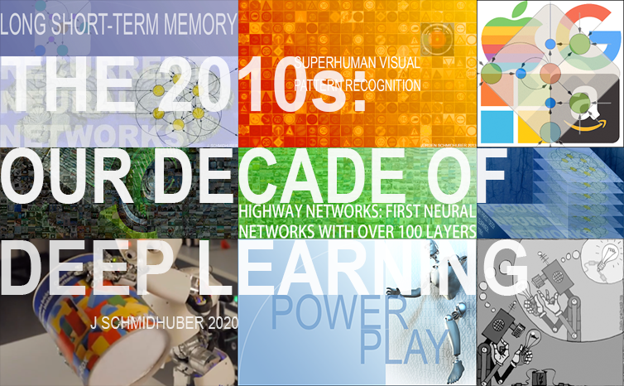
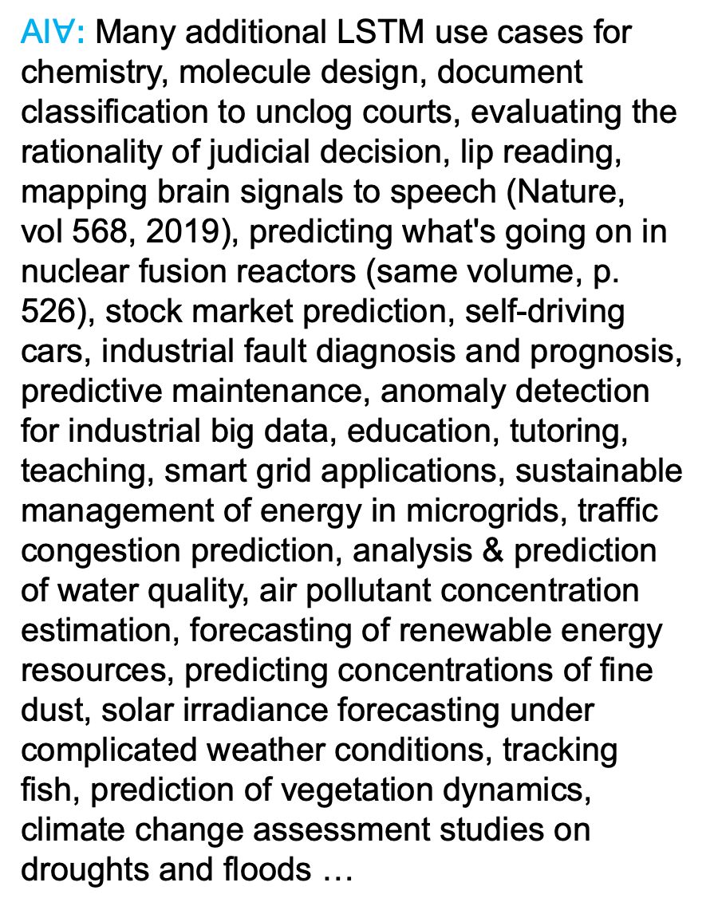
AI$∀:$Many additional LSTM use cases for chemistry, molecule design, document classification to unclog courts, evaluating the rationality of judicial decision, lip reading, mapping brain signals to speech (Nature, vol 568, 2019), predicting what's going on in nuclear fusion reactors (same volume, p. 526), stock market prediction, self-driving cars, industrial fault diagnosis and prognosis, predictive maintenance, anomaly detection for industrial big data, education, tutoring, teaching, smart grid applications, sustainable management of energy in microgrids, traffic congestion prediction, analysis & prediction of water quality, air pollutant concentration estimation, forecasting of renewable energy resources, predicting concentrations of fine dust, solar irradiance forecasting under complicated weather conditions, tracking fish, prediction of vegetation dynamics, climate change assessment studies on droughts and floods …
https://people.idsia.ch/~juergen/2010s-our-decade-of-deep-learning.html

Slide 14
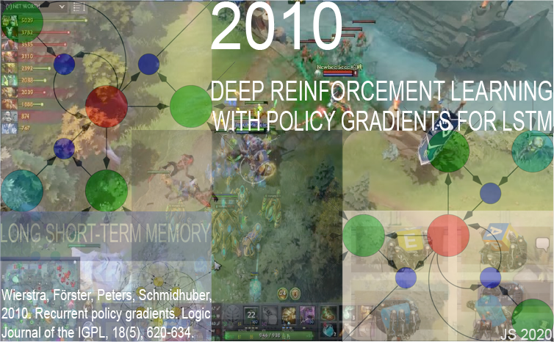
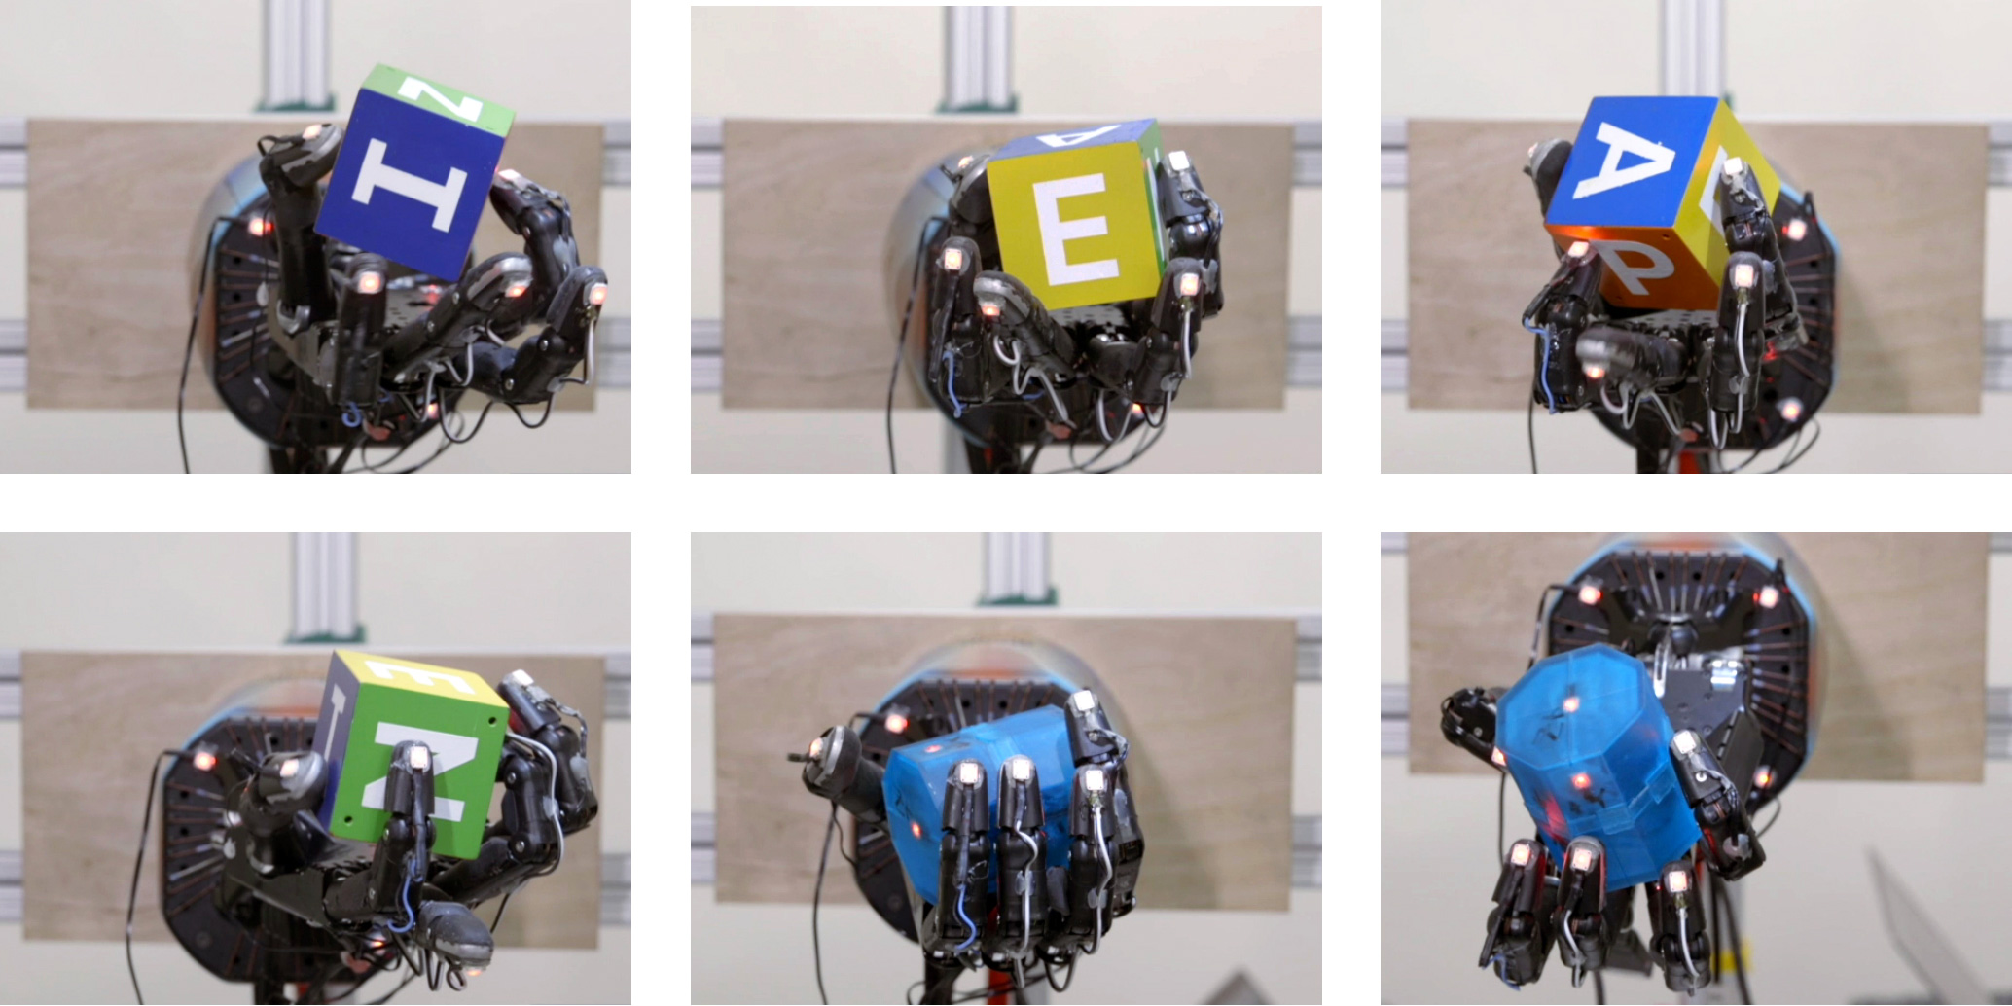
2007: Reinforcement Learning with LSTM trained by policy gradients (Wierstra, Förster, Peters, Schmidhuber, ICANN 2007). 2018: PG-trained LSTM is core of OpenAI's Dactyl: learning to control dextrous robot hands without teacher. 2019: LSTM is core of OpenAI Five which learned to defeat human experts in Dota 2 video game, and of DeepMind’s Starcraft player Alphastar. OpenAI and DeepMind are imbued with our lab’s DNA ☺
https://people.idsia.ch/~juergen/lstm-policy-gradient-2010.html

Slide 15
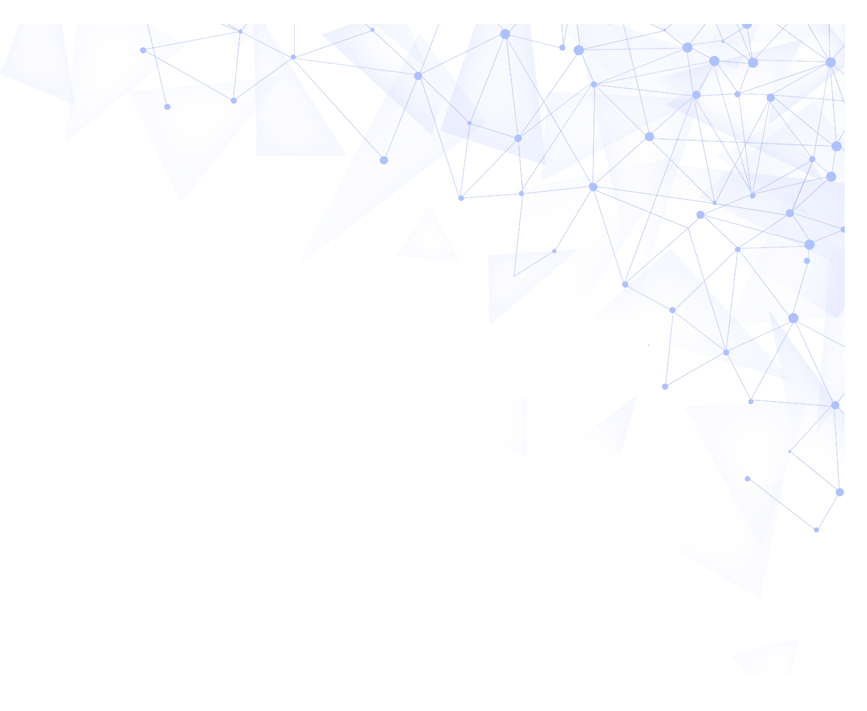
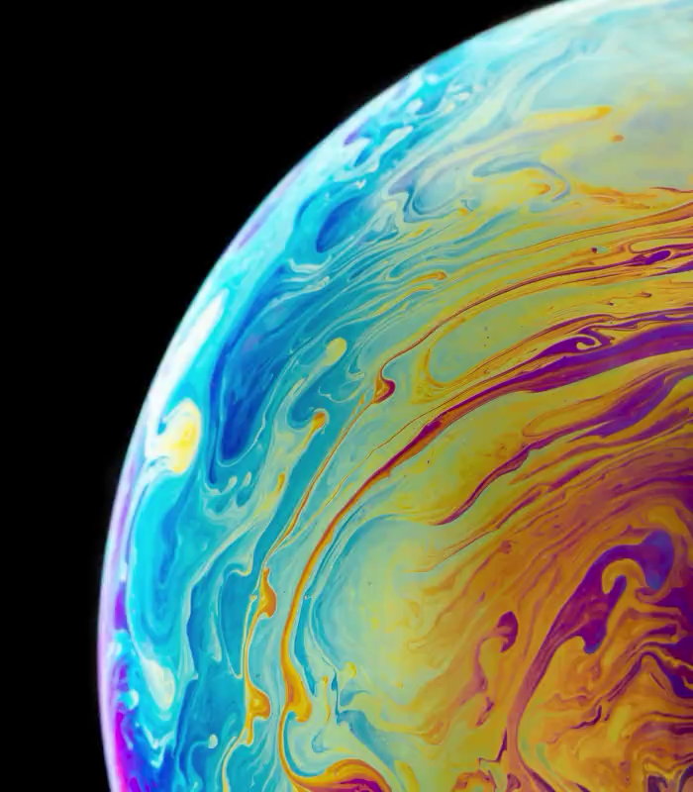

LLMs such as ChatGPT are still far from AGI. They are just a clever way of indexing the world's existing human-generated knowledge, such that it can easily be addressed through natural language. Good enough to facilitate many desktop jobs. However, the physical world is much more challenging than the virtual world behind the screen. That’s why in 2014 we founded our AI company for the physical world: NNAISENSE.
Artificial Intelligence for All
Neural
Networks
Artificial
Intelligence
Sensory-Motor Control
Jürgen Schmidhuber (Chief Scientist)
2014: AI company for the physical world

Slide 16
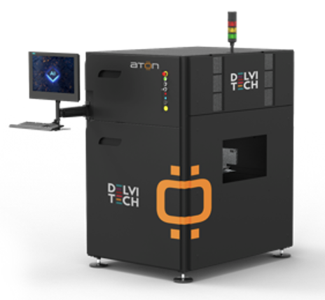
And our Swiss company Delvitech combines AI and unrivalled hardware to make a revolutionary machine for automated optical inspection (AOI) which is 2-3 years ahead of the competition (10x fewer false positives). It’s applicable to every sector: semiconductors, food, pharmaceuticals, automotive …
Great profit margin! AOI forecast: $3B by 2030. We are now greatly scaling up production. @Investors: contact me!

Slide 17
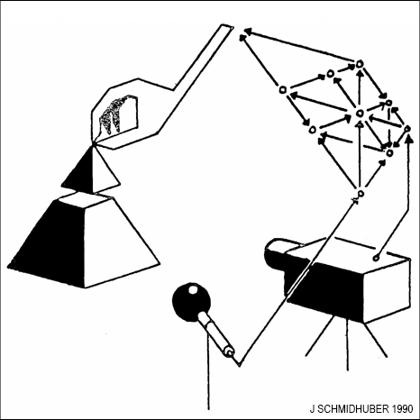
https://people.idsia.ch/~juergen/world-models-planning-curiosity-fki-1990.html
1990: AI for the physical world, with an NN controller and a predictive NN “world model” to plan action sequences (JS, IJCNN 1990). Artificial curiosity: through self-invented experiments, the controller tries to surprise the world model, which learns to predict consequences of the controller’s actions. Controller maximizes error minimized by world model (1st GAN). Since 1991: more sophisticated types of artificial curiosity

Slide 18
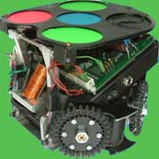
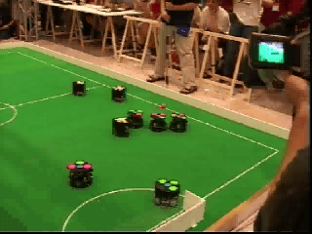
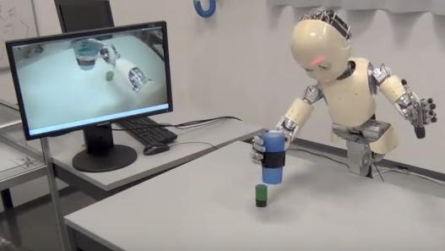
https://people.idsia.ch/~juergen/world-models-planning-curiosity-fki-1990.html
RoboCup World Champion 2004, fastest league, 5m/s.. Lookahead planning with NNs (JS, IEEE INNS 1990) used for RoboCup by Alexander Gloye-Förster (FU Berlin; became my postdoc at IDSIA).
Artificial Curiosity for AIs that set their own goals, inventing their own experiments. E.g., see my formal theory of fun & creativity & curiosity & novelty & surprise & art & science & humor (2006).
Varun Kompella, Marijn Stollenga, Matt Luciw, Juergen Schmidhuber. Continual curiosity-driven skill acquisition from high-dimensional video inputs for humanoid robots. Artificial Intelligence, 2015.

Slide 19
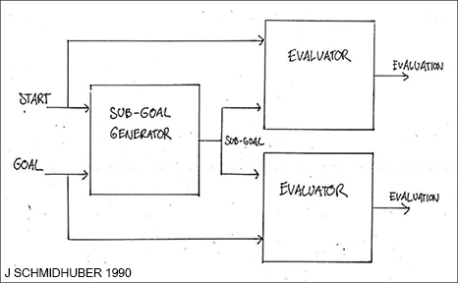
Original controller/model planner of 1990 used world model for naive "millisecond by millisecond planning.” No high-level reasoning! By 1991, however, my NNs decomposed complex sequences into abstract chunks (Pre-Trained Neural History Compressor, Neural Comp., 1992: the P in ChatGPT), and planned hierarchical action sequences with end-to-end differentiable NN-based subgoal generators (JS, 1990, ICANN 1991).
https://people.idsia.ch/~juergen/very-deep-learning-1991.html
https://people.idsia.ch/~juergen/deep-learning-miraculous-year-1990-1991.html#Sec.%2010

Slide 20
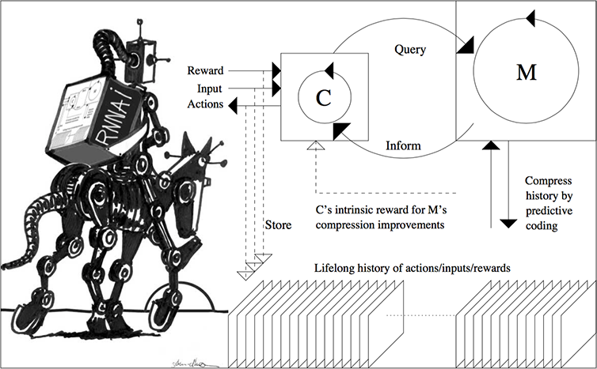
Since 2015: more sophisticated, very general, abstract planning and reasoning. Controller C is now a reinforcement learning prompt engineer and learns to actively query its world model M in arbitrary computable ways, to speed up decision making, essentially "learning to think.” C also learns to interpret answers of M, extracting algorithmic information from M (M could be foundation model trained on all YouTube videos).
https://people.idsia.ch/~juergen/world-models-planning-curiosity-fki-1990.html

Slide 21
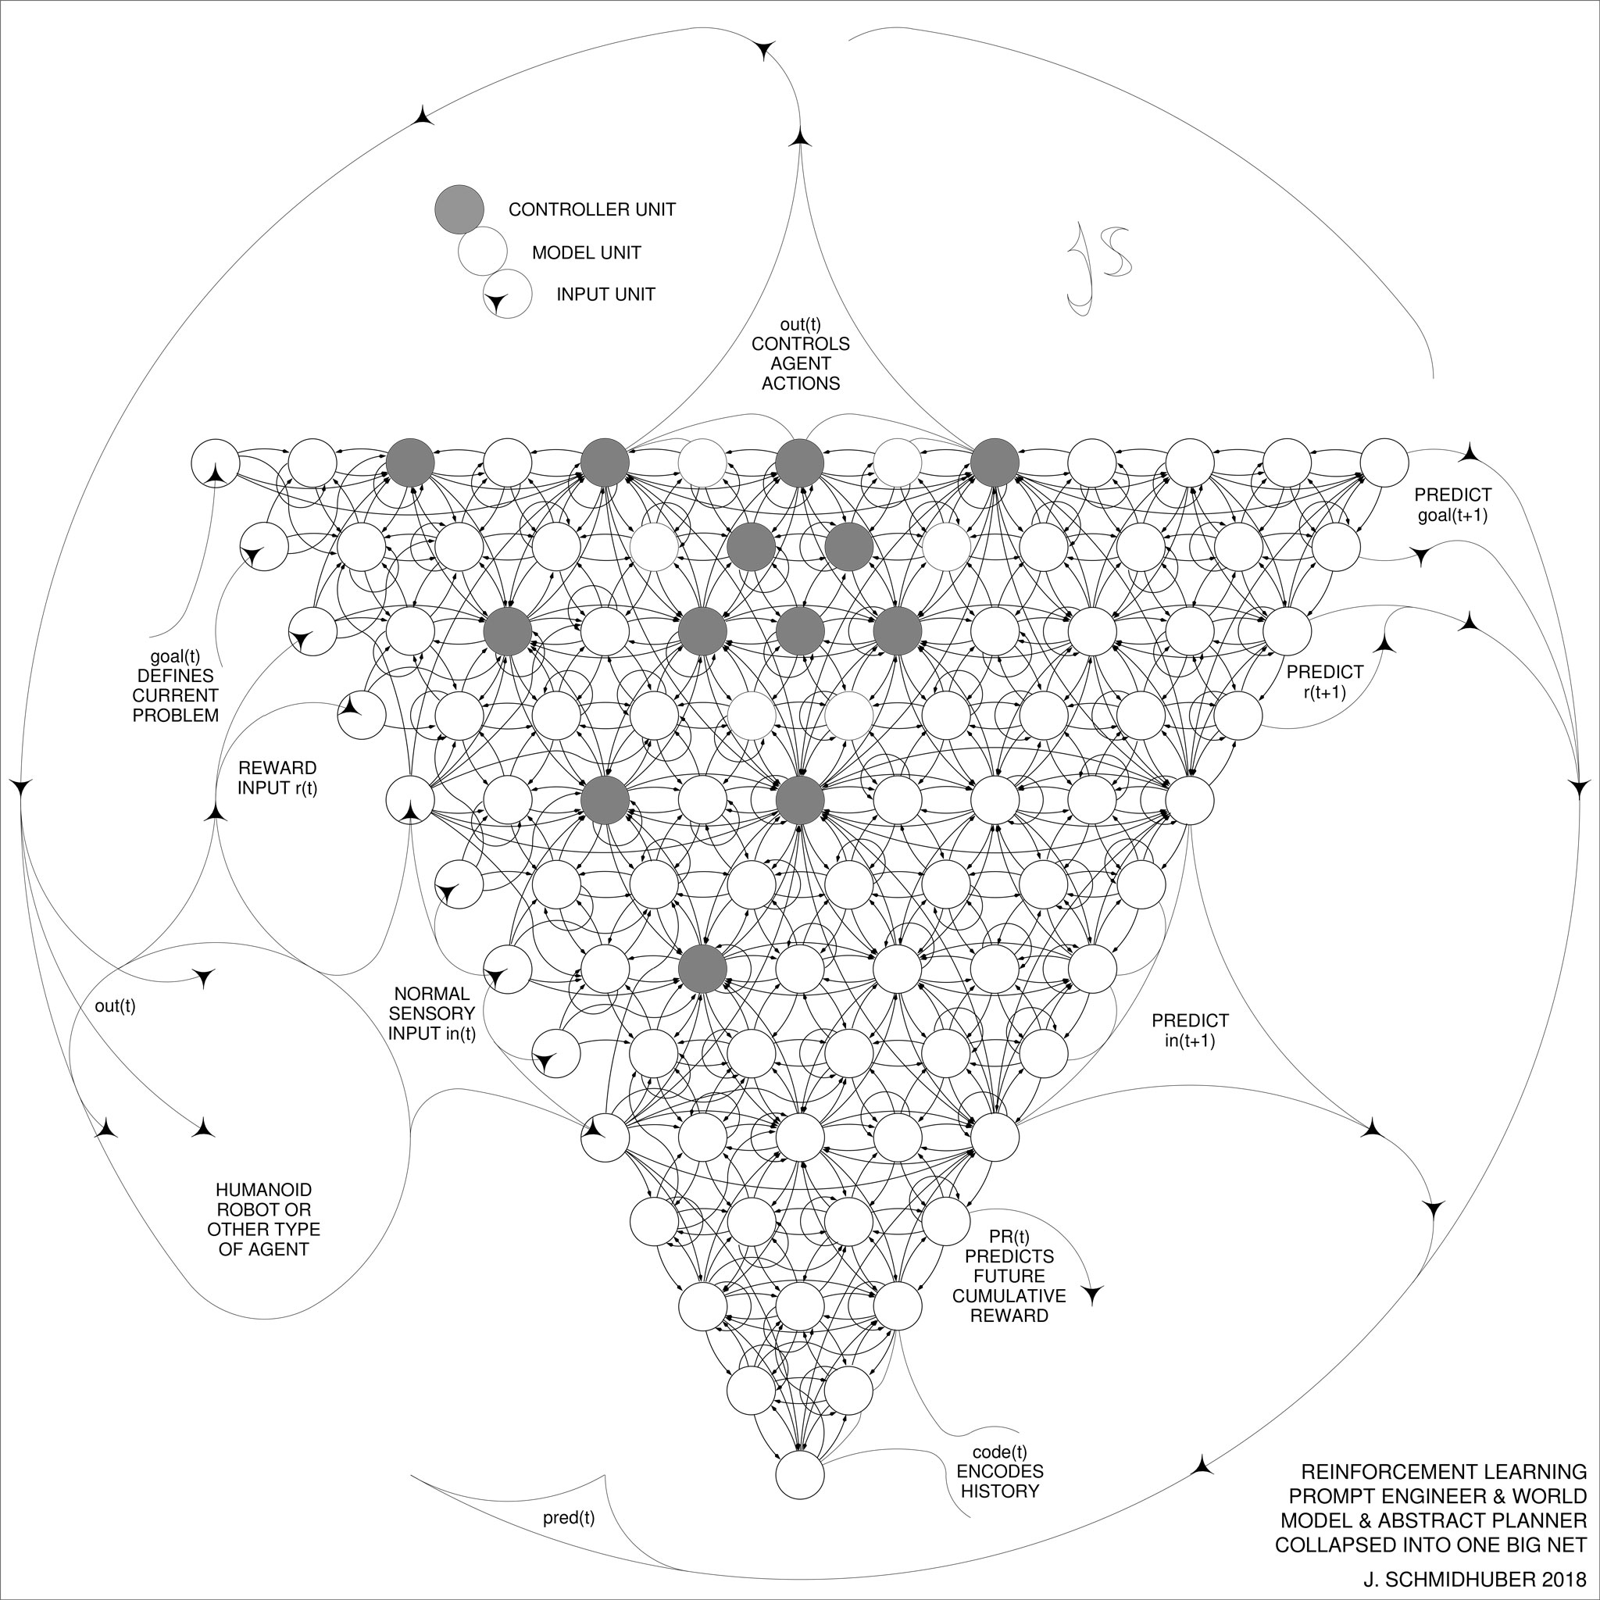
One more step: my 2018 "One Big Net" collapses the controller C and the world model M into a single network, using my neural network distillation procedure of 1991 (introduced for the neural history compressor, JS, Neural. Comp., 1992)
https://people.idsia.ch/~juergen/world-models-planning-curiosity-fki-1990.html

Slide 22
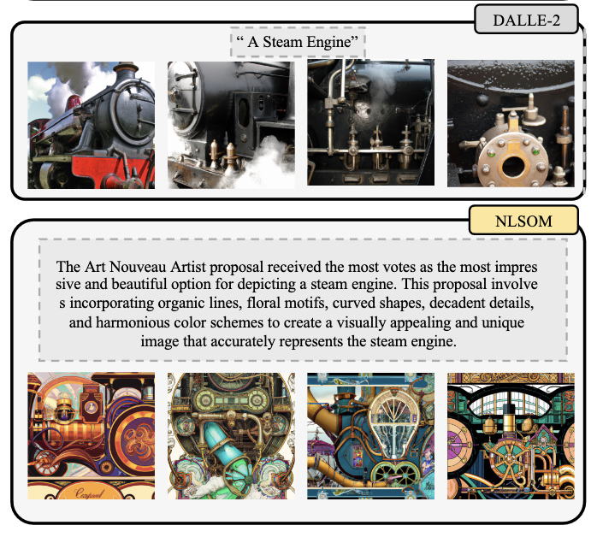
Inspired by the prompt engineer of the 2015 paper on “learning to think:” Best Paper Award for "Mindstorms in Natural Language-Based Societies of Mind" at NeurIPS 2023 WS Ro-FoMo. Up to 129 foundation models collectively solve problems by interviewing each other in monarchical or democratic societies, for visual question answering, image captioning, text-to-image synthesis, 3D generation, egocentric retrieval …
https://x.com/SchmidhuberAI/status/1740417332525269200

Slide 23
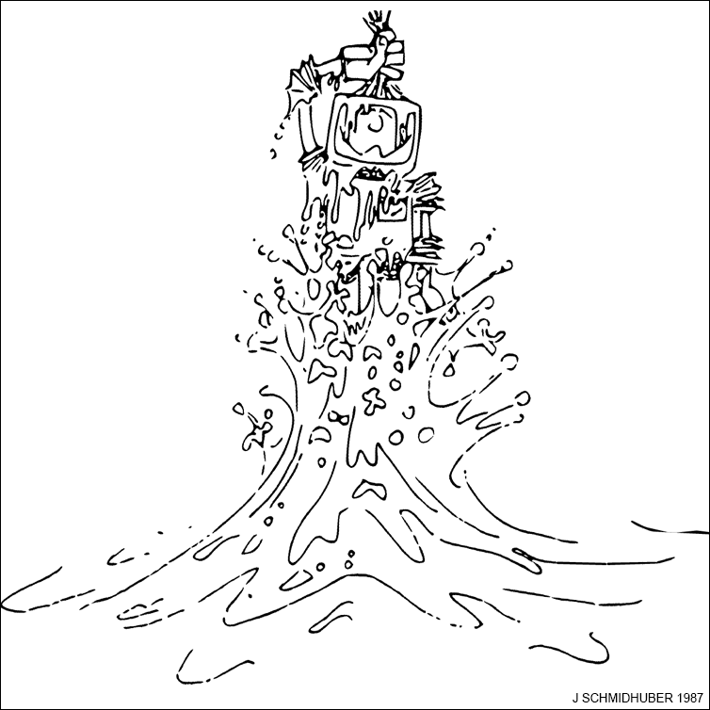
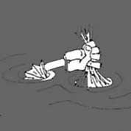
The old linear Transformers of 1991 (see above) are related to self-referential meta-learning machines that learn to inspect and modify and improve their own learning algorithm. 1987: my TUM diploma thesis on AGI through meta-learning (learning to learn) & recursive self-improvement. 2020s: lots of recent work with Louis Kirsch, Kazuki Irie, Imanol Schlag, Robert Csordas, and others. Now a hot topic! Will change everything ☺
https://people.idsia.ch/~juergen/metalearning.html

Slide 24
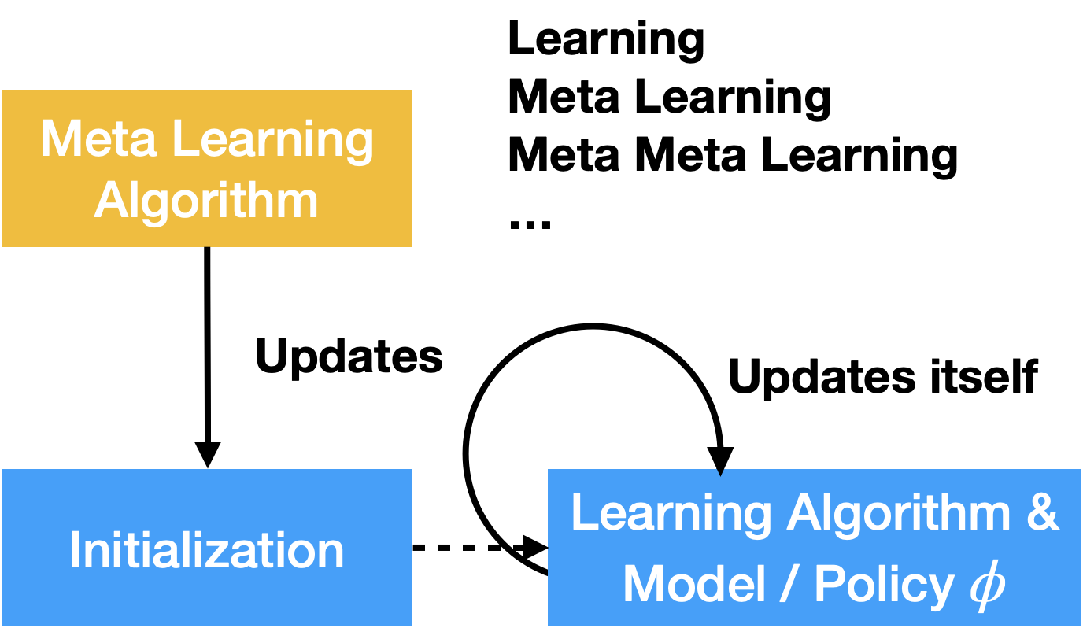
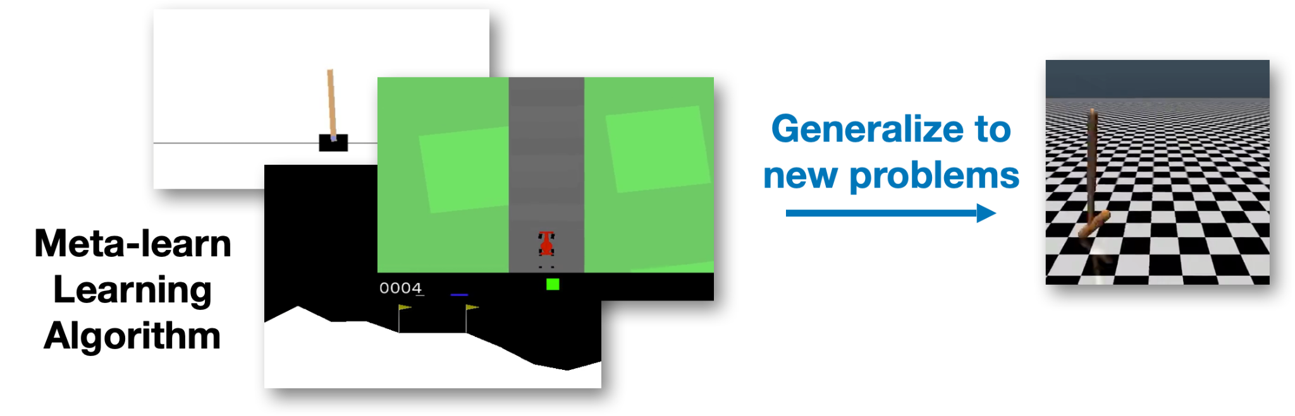
Recent work on meta-learning general-purpose supervised & reinforcement learning algorithms: Kirsch & Van Steenkiste & Schmidhuber, ICLR 2020: “Improving generalization in meta RL via learned objectives”
Learn to implement backpropagation in the activations of a neural network, then improve it by gradient descent: Kirsch & Schmidhuber, NeurIPS 2021: “Meta-learning backpropagation and improving it”
Self-modify to learn how to learn without human-engineered meta optimization: Louis Kirsch & Schmidhuber, ICML 2022 Workshop: “Eliminating Meta Optimization Through Self-Referential Meta Learning”
Notes:
Louis, notes for Jürgen:
Our recent research in learning-to-learn has made fundamental contributions in automatically discovering novel supervised and reinforcement learning algorithms.
Crucially, for the first time, these learning algorithms are general-purpose and thus reusable across a wide range of tasks.
We showed that backpropagation can be meta-learned to run purely in the forward mode of a recurrent neural network.
In the same paper, we also showed how fast weight programmers can be framed as weight sharing in a neural network.
In another project we showed how self-modifying neural networks can learn how to learn without any need for using existing meta optimization algorithms.
To find out more about our research in meta learning, scan the qr code.
Wenyi (if Juergen wants to mention):
A student of mine (Wenyi) is working on modeling emergence in complex systems using recursive self-modifying models.
---
Longer transcript for slides from my spotlight talk (if of any use to Juergen):
Hi, I'm Louis Kirsch and my research is on meta-learning, in particular on discovering
new learning algorithms that are reusable across a wide range of tasks.
This allows driving new advances in machine learning via meta-learning.
There are many approaches to what I call general-purpose meta-learning.
One idea is to represent learning algorithms as loss functions, as I've done in meta-general.
Essentially a number of agents interact with different environments and discover a new
learning algorithm that works across all of them.
The main contribution is that the meta-learned reinforcement learning algorithm generalizes to unseen environments
and it largely outperforms existing algorithms such as reinforce, PPO and sometimes DDPG.
In another approach that I call variable-shared meta-learning or symmetric learning agents,
we use a more black-box approach, where we don't use gradient descent at meta-test
time anymore.
We just represent the learning algorithm using many many LSTMs that share the same parameters,
forming an in-context learning algorithm.
This allows us to implement the backpropagation algorithm purely in the activations of a recurrent
neural network.
And we call this procedure learning algorithm cloning or destination.
The same network can also discover new learning algorithms from scratch, and those can be
more sample efficient than gradient descent with Adam and generalized to entirely new
datasets.
Crucially, again, we don't need any gradient at meta-test time, but the learning algorithm
is purely in-context.
Finally, in our general-purpose in-context learners, we use more generic LSTMs and transformers
without the weight sharing to implement in-context learning algorithms.
We were able to show that as you increase the number of tasks, we can transition from
memorization to learning.
So with few tasks, the network performs task memorization.
With more tasks, it goes to task identification, and with even more tasks, we go to general-purpose
learning to learn, where the discovered learning algorithms can be reused across a wide range
of problems.
In particular, that last phase transition is very interesting, as it happens quite suddenly
where solutions are discretely in either one of the two phases.
So this was a quick overview over my research in general-purpose meta-learning.
And here you can find out more.

Slide 25
Recent work on artificial curiosity for abstract world models
A neural net actively learns one abstract bit at a time by proposing hypotheses to be verified or falsified through (possibly time-consuming) computational experiments (including thought experiments) encoded as RNN weight matrices for another net. Strong bias towards the simplest, least costly “interesting” experiments with still surprising yes/no outcomes (until they become boring).
Intrinsic Reward
M
Answer
C
Parameters
Q
Quantities of Interest
Observations
RNN
Actions
Environment
Ramesh, Kirsch, Van Steenkiste, Schmidhuber. NeurIPS 2022, “Exploring through Random Curiosity with General Value Functions”
Herrmann, Kirsch, Schmidhuber. ArXiv 2022: “Learning One Abstract Bit at a Time Through Self-Invented Experiments Encoded as Neural Networks”
Notes:
Usually, the world model in a CM setup learns directly the environment dynamics by predicting sequences of observations and rewards given the actions
The intrinsic reward for the Controller is the surprise of the model, measured by its prediction error, information gain or compression progress
Is there a way to introduce an abstraction that helps to gain high level insights over longer time frames?
One solution is that the controller generates abstract questions in the form of RNN weights. This RNN interacts with the environment and produces a binary result. The model has to predict the result just from the generated RNN weights. In principle, this way any computable yes/no question can be asked.
Another solution is to frame question-answering through general value functions. Here observation dependent features are considered as pseudo-rewards. The model tries to predict the cumulative, temporally extended sum of these pseudo-rewards under a certain policy. Intrinsic reward can be derived through the prediction error or information gain of the (general) value functions.

Slide 26
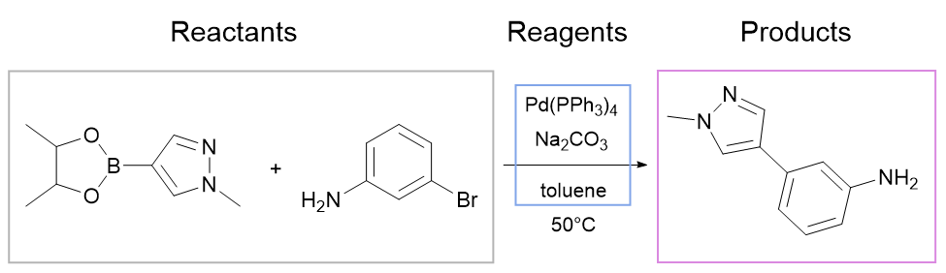
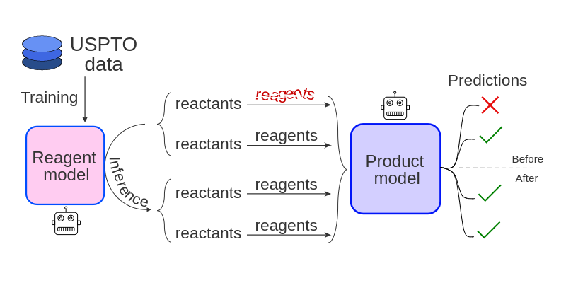
SMILES: text notation for molecules and reactions. Use transformers to predict reaction parts: products, reactants, reagents…
At the KAUST GenAI Center and the Swiss AI Lab IDSIA, we have many use cases for curious AIs, e.g., in chemistry, material design, drug design, direct capture of carbon from air …
AI scientists will revolutionize all of science!
CC1OB(c2cnn(C)c2)OC1C.Nc1cccc(Br)c1>O=C([O-])[O-].[Na+].[Na+].Cc1ccccc1>Cn1cc(-c2cccc(N)c2)cn1
Predict reaction conditions (reagents)
Use predictions to improve products
USPTO: an open reaction dataset
Mikhail Andronov, V. Voinarovska, N. Andronova, M. Wand, D. Clevert, J. Schmidhuber. Reagent Prediction with a Molecular Transformer Improves Reaction Data Quality. Chemical Science, 2023.

Slide 27
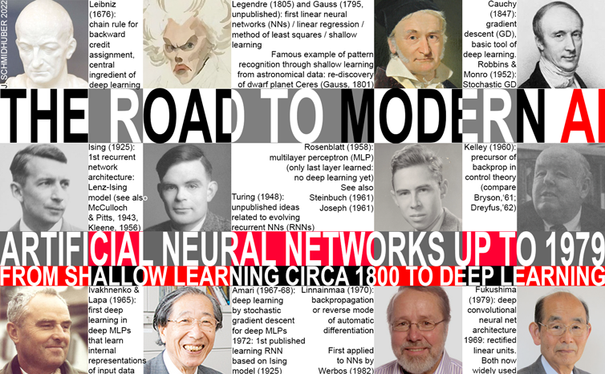
My team is standing on the shoulders of giants: https://people.idsia.ch/~juergen/deep-learning-history.html

Slide 28
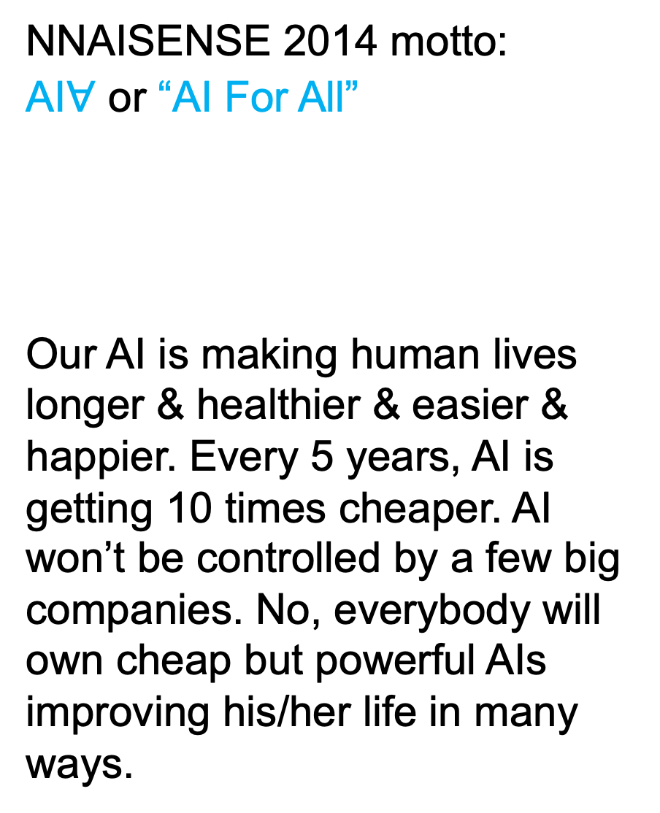
NNAISENSE 2014 motto:
AI$∀$ or “AI For All”
Our AI is making human lives longer & healthier & easier & happier. Every 5 years, AI is getting 10 times cheaper. AI won’t be controlled by a few big companies. No, everybody will own cheap but powerful AIs improving his/her life in many ways.

Slide 29
What's missing? As mentioned earlier: it's true AGI in the physical world, going far beyond today’s AI in the virtual world behind the screen.
A next huge step will be self-replicating, self-improving societies of physical robots & 3D printers & other machines & automated factories.
Self-replicating, self-maintaining, self-improving HARDware, going beyond the already existing, self-improving, machine-learning SOFTware.
There will be enormous commercial pressure to create such life-like hardware, because it’s the ultimate form of scaling, and its owners will get very rich.
Not limited to our biosphere.
Life-like, self-replicating societies of machines will make the economy of our solar system billions of times bigger than Earth’s.

Slide 30
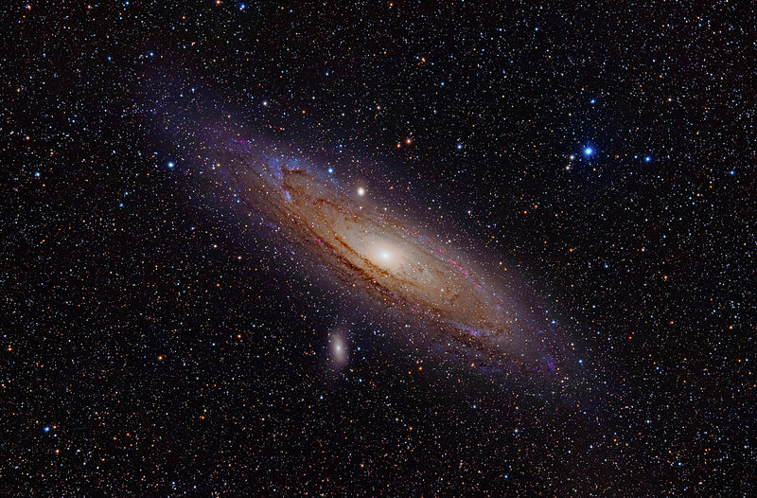
Ω = 2040 or so - 13.8 B years: Big Bang
Ω - 3.5 B years: first life on Earth
Ω - 0.9 B years: first animal-like mobile life
Ω - 220 M years: first mammals (our ancestors)
Ω - 55 M years: first primates (our ancestors)
Ω - 13 M years: first hominids (our ancestors)
Ω - 3.5 M years: first stone tools (dawn of tech)
Ω - 850 K years: controlled fire (next big tech)
Ω - 210 K years: anatomically modern man
Ω - 50 K years: behaviorally modern man
Ω - 13 K years: neolithic revolution, civilization
Ω - 3.3 K years: iron age, 1st population explosion
Ω - 800 years: first guns & rockets (in China)
Ω - 200 years: 2nd population explosion
Ω - 50 years (around 1990): our Miraculous Year of AI, WWW, cell phones & PCs for all, first self-driving cars, Berlin Wall falls, Cold War ends…
Ω - 13 years (2030 or so): cheap AIs with one human brain power? And then what?
Ω - 3 years: ??
Ω - 9 months: ????
Ω - 2 months: ????????
Ω - 2 weeks: ???????????????? ….
Ω - 1/4 of this time:
Ω - 1/4 of this time:
Ω - 1/4 of this time:
Ω - 1/4 of this time:
Ω - 1/4 of this time:
Ω - 1/4 of this time:
Ω - 1/4 of this time:
Ω - 1/4 of this time:
Ω - 1/4 of this time:
Ω - 1/4 of this time:
Ω - 1/4 of this time:
Ω - 1/4 of this time:
Ω - 1/4 of this time:
Ω - 1/4 of this time:
Ω - 1/4 of this time:
Ω - 1/4 of this time:
Ω - 1/4 of this time
Ω - 1/4 of this time:
Ω - 1/4 of this time:
https://people.idsia.ch/~juergen/deep-learning-history.html#future
Finally multiply Ω by 4! At the age of 55 B years, the visible cosmos will be permeated by intelligence. After Ω, AIs will have plenty of time to go where the physical resources are, to make more and bigger AIs.

