Slide 2
CONTEXT
STATE OF THE ART
CASE STUDIES

Slide 3
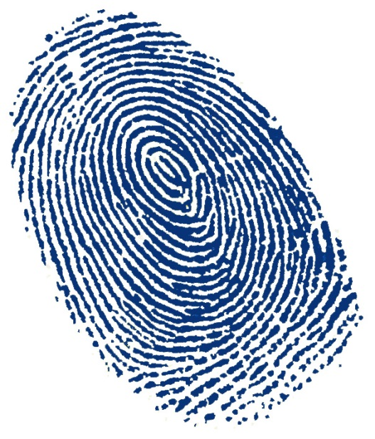

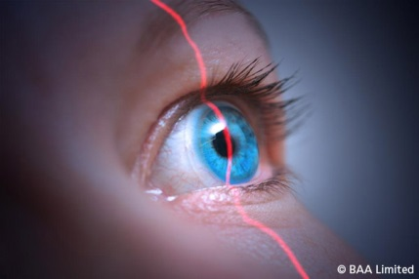
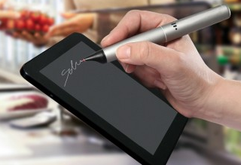
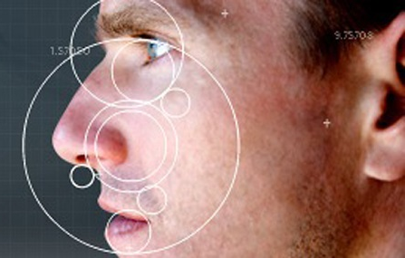
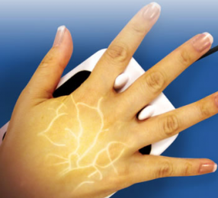
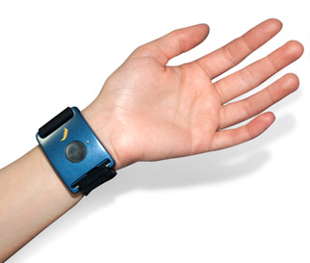
Biometric Recognition Systems
People automatic recognition using physical or behavioral characteristics
  advantages
    cannot be lost or forgotten
    enhance security
  applications
    access control
    forensic analysis

Slide 4
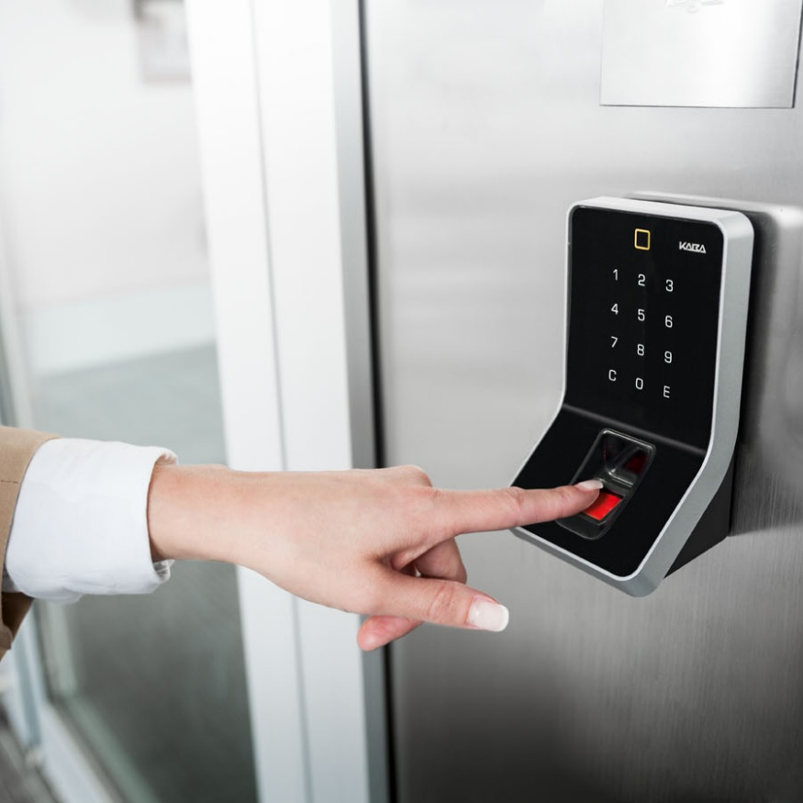
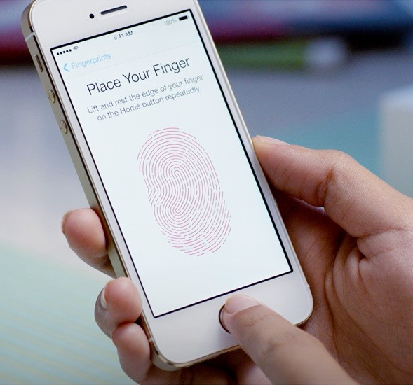
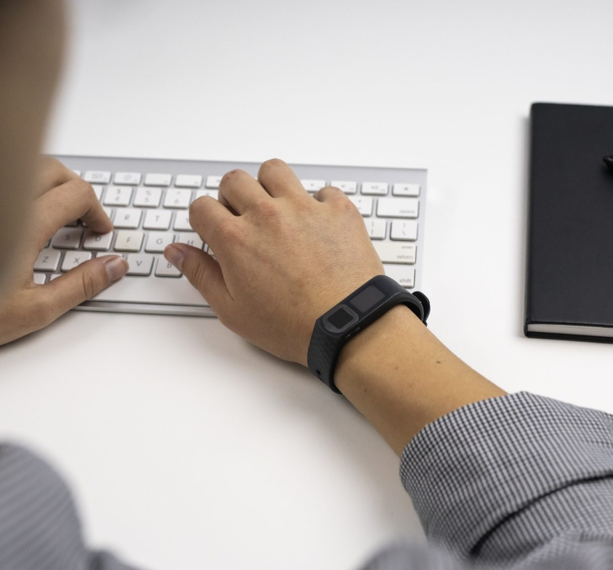
Evolution
In terms of technology, paradigms, and applications
Desktop (since 1960s)
Mobile (since 2010s)
Wearable (future)

Slide 5
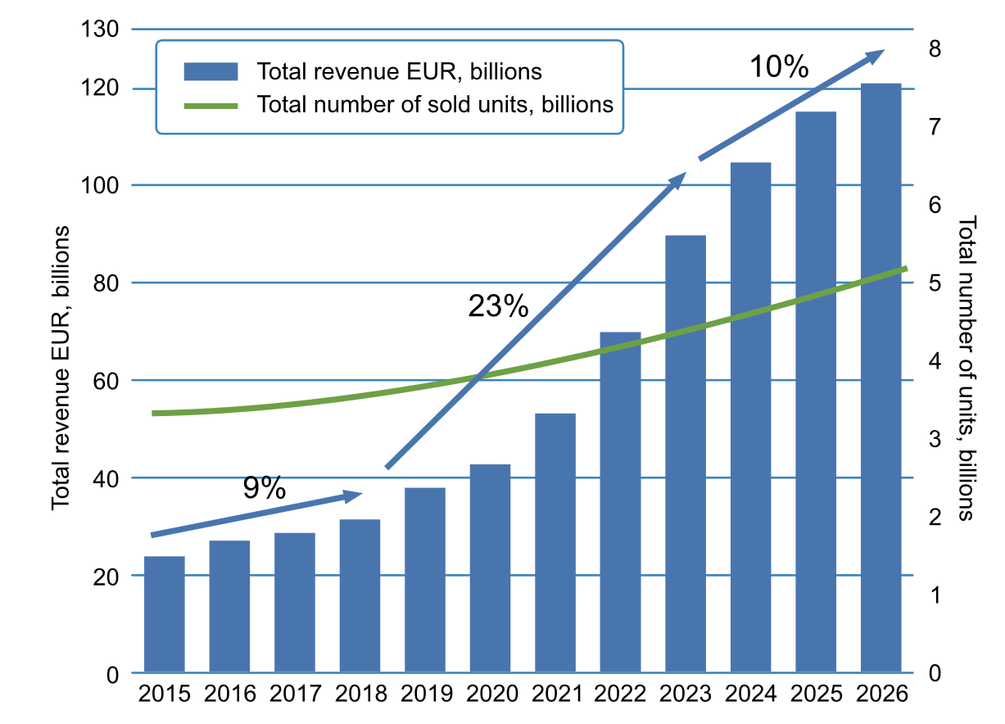
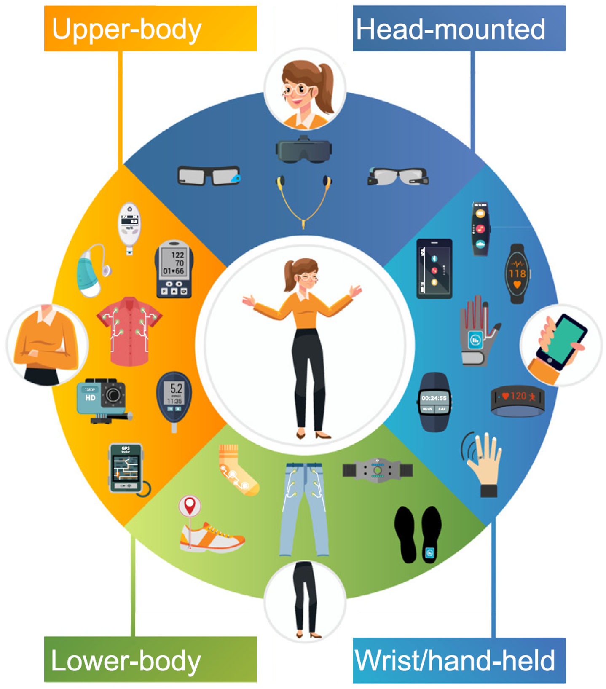
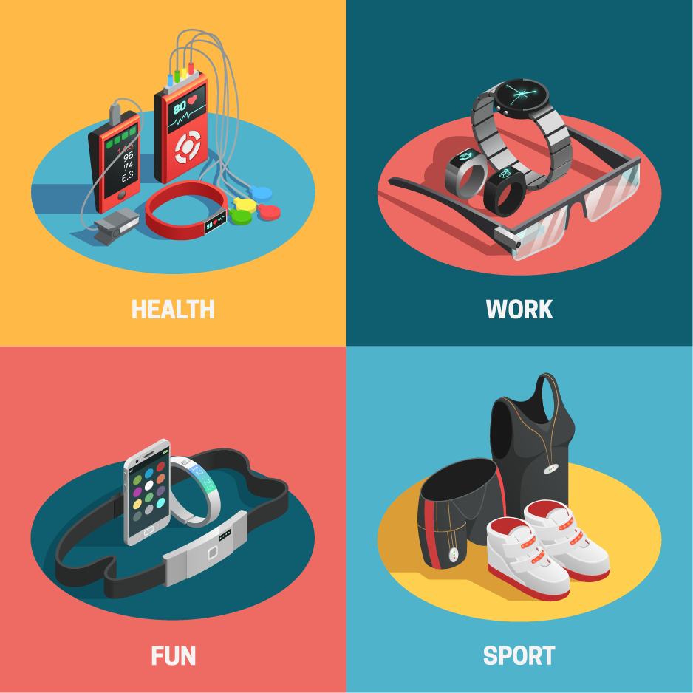
Wearables
Next step in the Internet of Things (IoT) evolution
  20% CAGR
    450 millions devices sold in 2023
  several possibilities
    hearables
    wristwear
    head mounted display
    goggles
  many applications
    medical
    activity and fitness tracking
    augmented and virtual reality
    smart payment

Slide 6
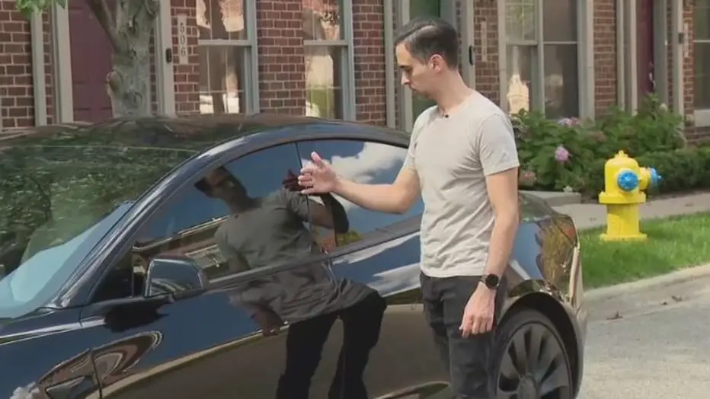
Security
Recognition requiring minimum interaction (and no microchip implant!)
https://www.fox2detroit.com/news/metro-detroit-man-implants-tesla-key-into-hand-to-unlock-start-car

Slide 7
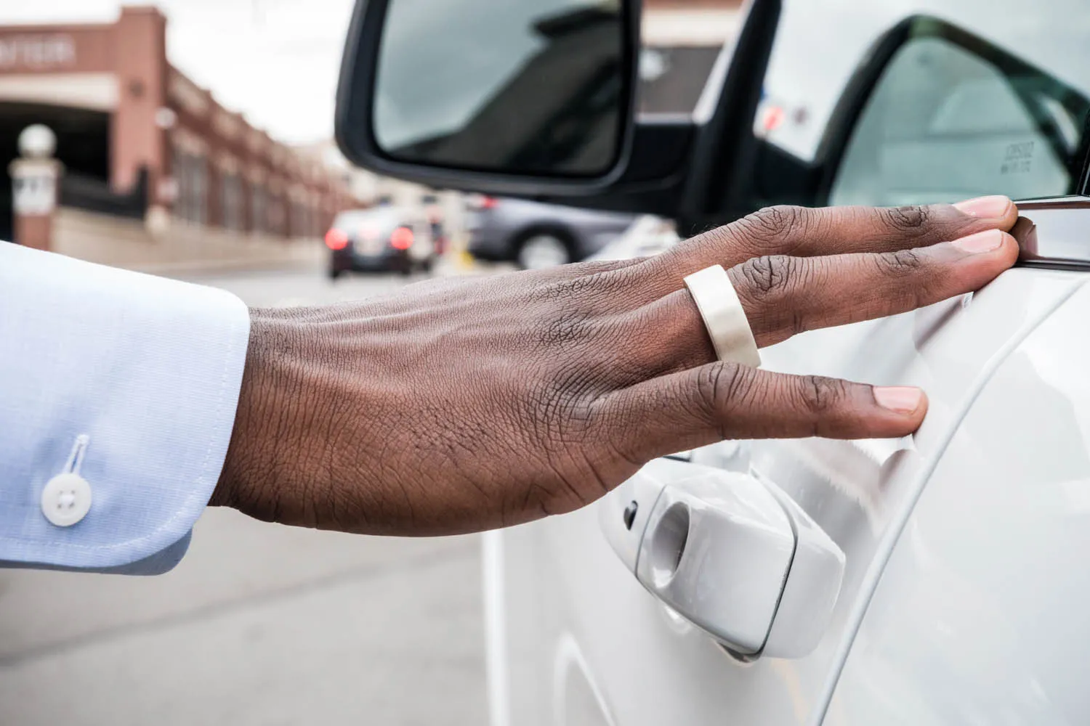
Capabilities
Traits used to control the access to the device itself, or as front-end in systems controlling the access to physical or virtual locations and services
Advantages wrt traditional approaches
  ease of use
    recognition with minimum (if any) interaction
    data can be collected anywhere and anytime
  robustness against attacks
    inherently-provided liveness detection
    data hard to capture at a distance or replicate
    multi-modality achievable
  new services
    continuous user recognition allowed
      prevent session hijacking

Slide 8
CONTEXT
STATE OF THE ART
CASE STUDIES

Slide 9
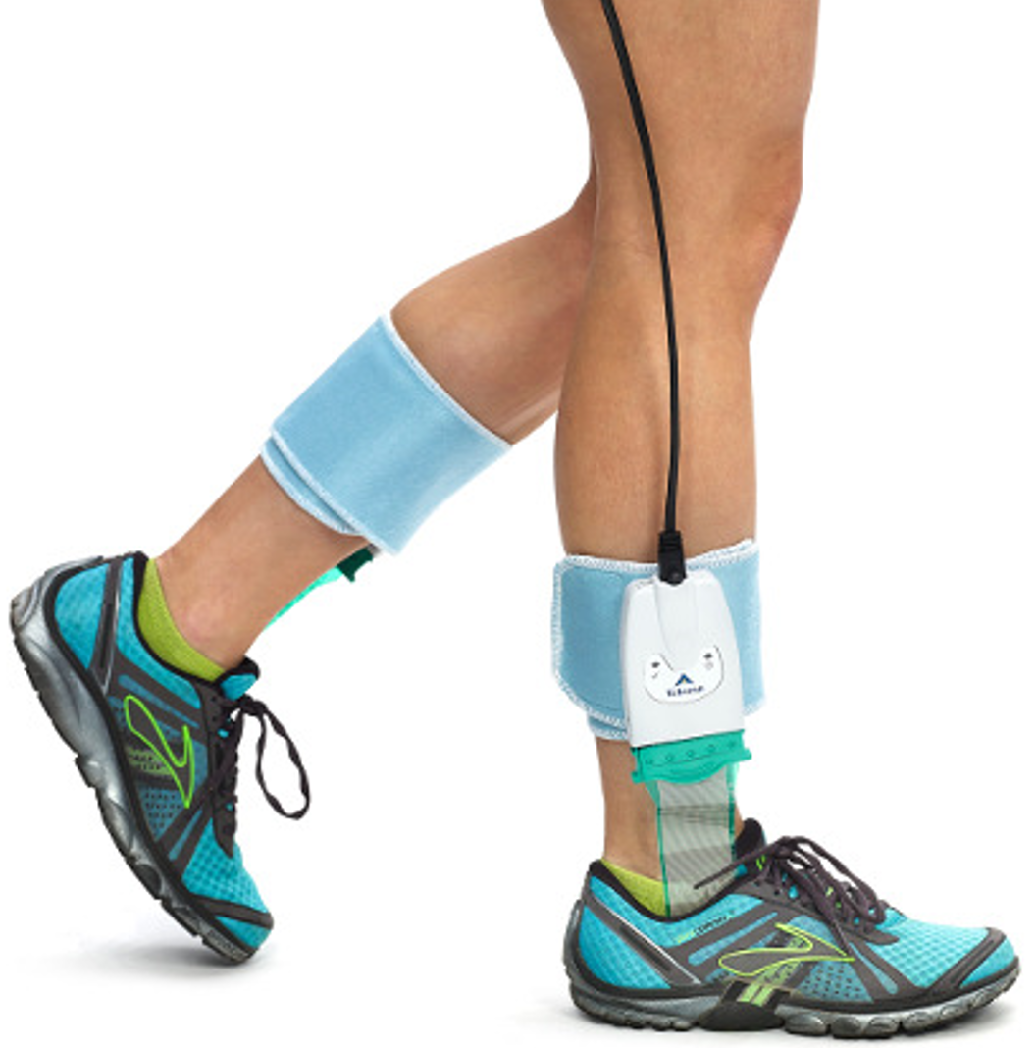
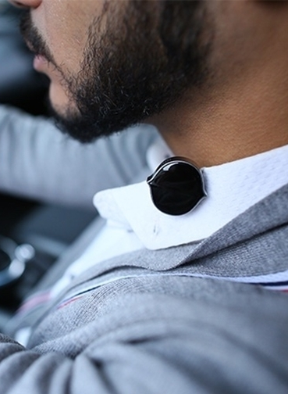
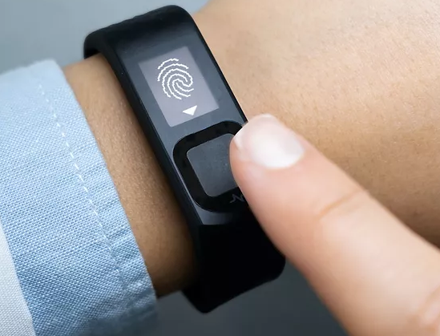
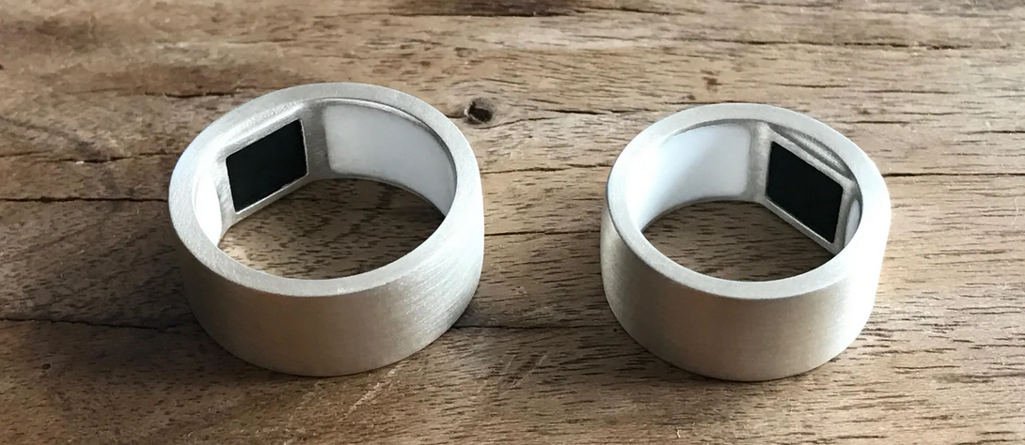
Traditional Traits
Wearables not exploited to their fullest potential
  occasional recognition
    body dynamics (e.g., gait)
    voice
    fingerprint

Slide 10

Novel Traits
Allow to perform continuos recognition
Most of them rely on cognitive characteristics
  signals dependent on the autonomic nervous system (ANS)
Brain
Heart

Slide 11
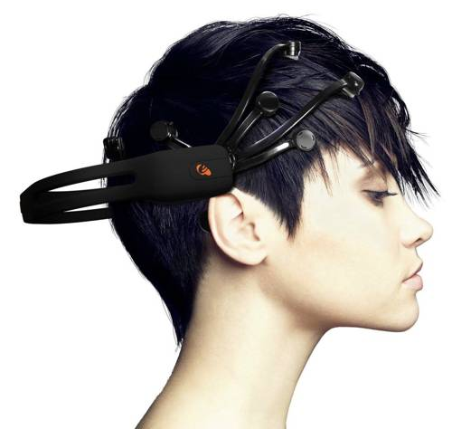
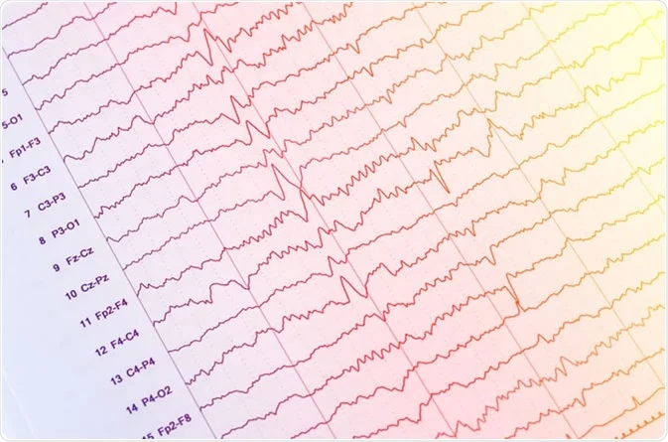
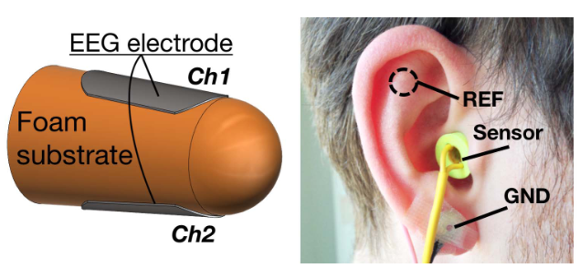
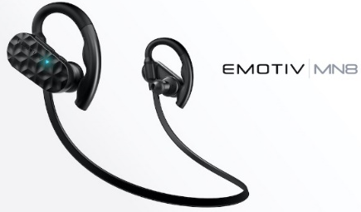
Brain
Cognitive biometric trait par excellence
  electroencephalography (EEG) usually performed using medical-grade devices with low signal-to-noise ratio
  tests also with commercial sensors (Neurosky MindSet, Emotiv EPOC+)
  innovative designs
    in-ear sensors
P. Arnau-Gonzalez et al., “BED: A new dataset for EEG-based biometrics”, IEEE IoT Journal, 2021
T. Nakamura et al., “In-ear EEG biometrics for feasible and readily collectable real-world person authentication”, IEEE TIFS, 2018

Slide 12
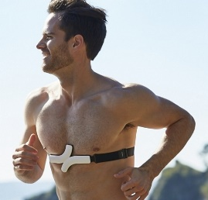
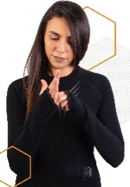
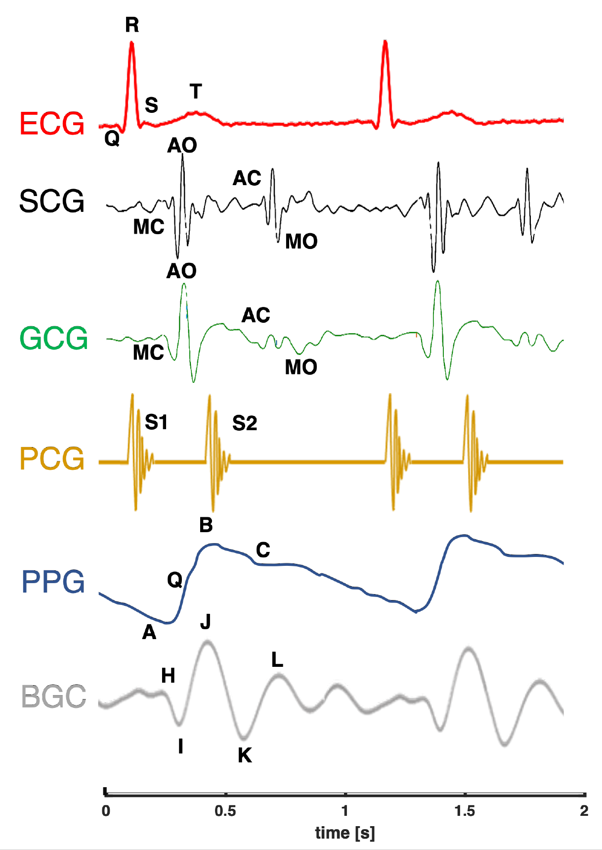
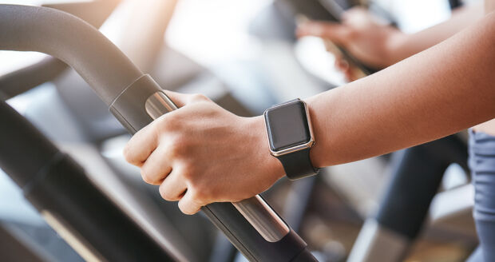
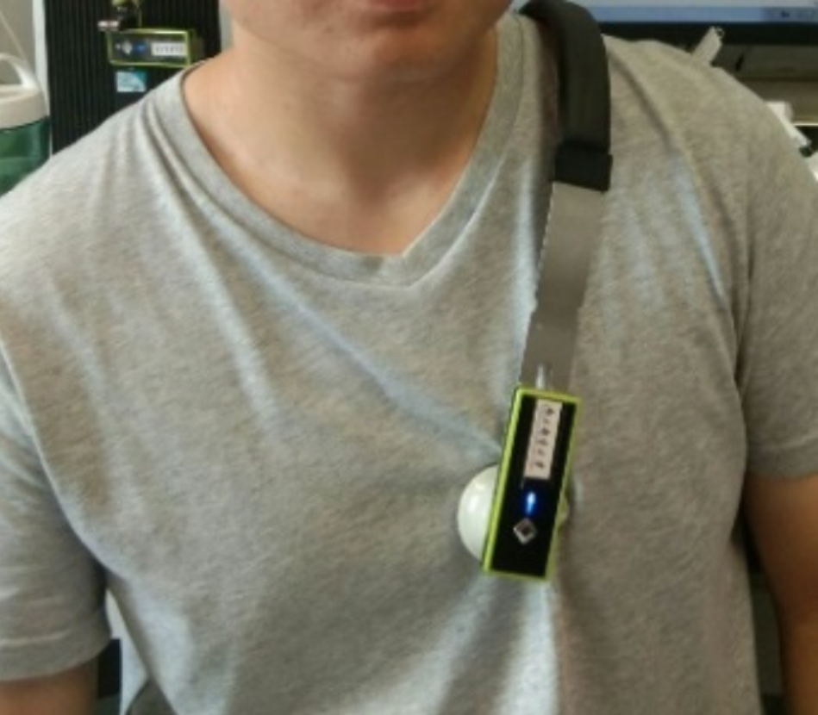
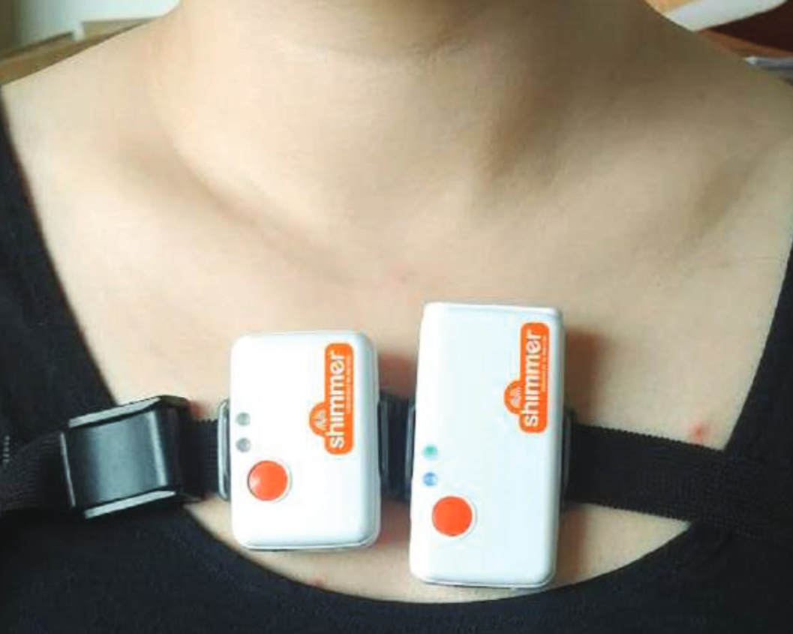
Heart
Hearth activity influences several physiological signals that can be used for biometric purposes
  electrocardiography (ECG)
    acquired with chestbands, armbands, e-textiles
F. Lehmann, D. Buschek,, “Heartbeats in the wild: A field study exploring ECG biometrics in everyday life”, CHI SIGCHI, 2020
  photopletismography (PPG)
    BVP and SpO2 measured by most fitness trackers
D. Hwang et al., “Evaluation of the time stability and uniqueness in PPG-based biometric system”, IEEE TIFS, 2021
  phonocardiography (PCG)
    digital stethoscopes and small sound sensor
X. Cheng et al., “Biometric identification method for heart sound based on multimodal multiscale dispersion entropy”, Entropy, 2020
  seismocardiography (SCG)
    IMUs detect vibrations induced by heart movements
E. Maiorana, C., Massaroni, “Biometric recognition based on heart-induced chest vibrations”, IEEE IWBF, 2021

Slide 13
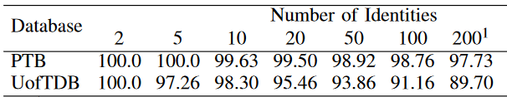
Typical Framework
Biometric recognition typically corresponds to a few-shot learning (FSL) scenario
  need for making accurate predictions by training on a very small number of labeled examples
  cognitive biometrics commonly processed by extracting frames after pre-processing
    multiple frames collected during the enrolment of a subject
  issues
    databases available for cognitive biometric traits are usually small in size
      > 30 subjects only for ECG, PPG, PCG, temperature, and bioimpedance
      > 100 subjects only for ECG and PPG
    data quality significantly dependent on the employed sensors
      commercial devices perform worse than prototypes or medical-grade equipment
    tests often performed in closed-set scenarios (all users known during training)
      and yet, equal error rates (EERs) often >10%
J.R. Pinto and J.S. Cardoso, “Explaining ECG Biometrics: Is It All In The QRS?”, BIOSIG, 2020

Slide 14
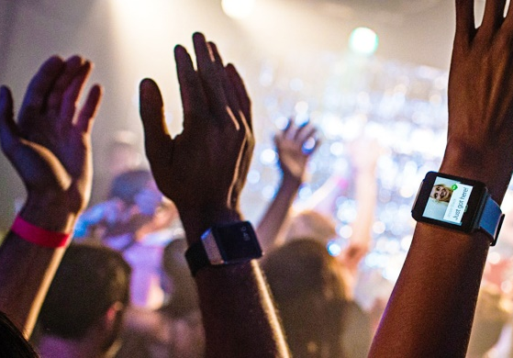
Permanence
Notable influence of personal habits (e.g.: diet) and placement of on-body sensors
  need for tests on multi-session databases
  performance typically worsens for increasing time distance between enrolment and recognition phases
    more than a single week considered only for ECG, PPG, EEG
  is “in-the-wild” recognition feasible?
    continuous recognition regardless of the specific activity
      tests usually on a limited set of activities of daily living (ADL)
      totally unsupervised scenarios only for ECG and PPG
  other influences yet too be considered
    physical effort (before the acquisition) on the measured data
    subject’s emotional state
F. Lehmann, D. Buschek,, “Heartbeats in the wild: A field study exploring ECG biometrics in everyday life”, CHI SIGCHI, 2020
U. Yadav et al., “Evaluation of PPG biometrics for authentication in different states”, IEEE ICB 2021

Slide 15
CONTEXT
STATE OF THE ART
CASE STUDIES

Slide 16
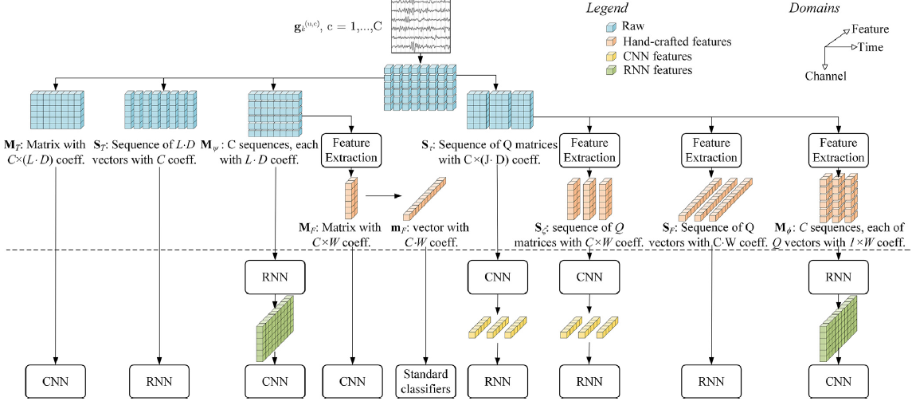
EEG-based biometrics
Deep neural networks for EEG-based biometric (closed-set) identification
  different architectures applied to raw signals or hand-crafted features (AR and MFCC represenations)
E. Maiorana, “Deep learning for EEG-based biometric recognition”, Neurocomputing, Vol. 410(14), pp: 374-386, 2020

Slide 17
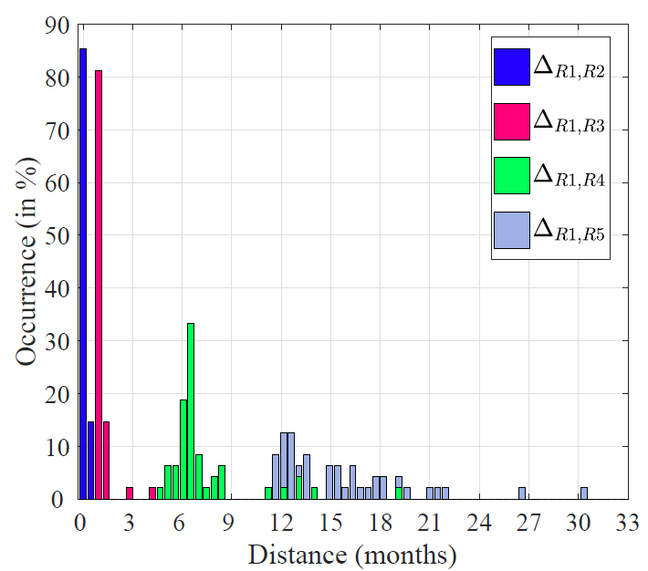
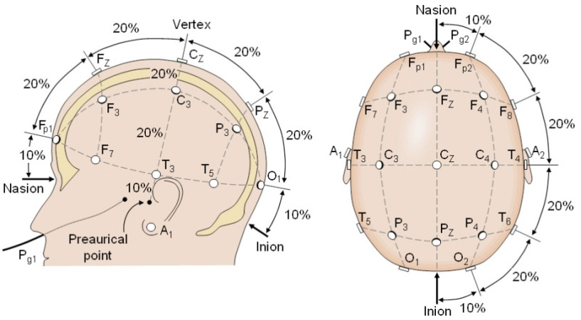
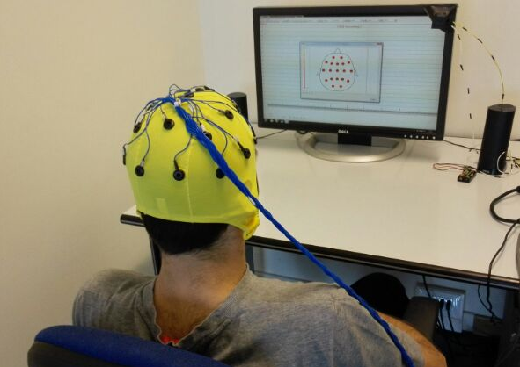
EEG Dataset
Recordings taken according to six elicitation protocols, including resting states and imagery task
  EEG signals collected from 45 healthy subjects (age 20-35)
  3-minute samples for each subject
  10-20 international montage with C = 19 electrodes
  five recording sessions taken for each involved subject during an average of 16 months

Slide 18
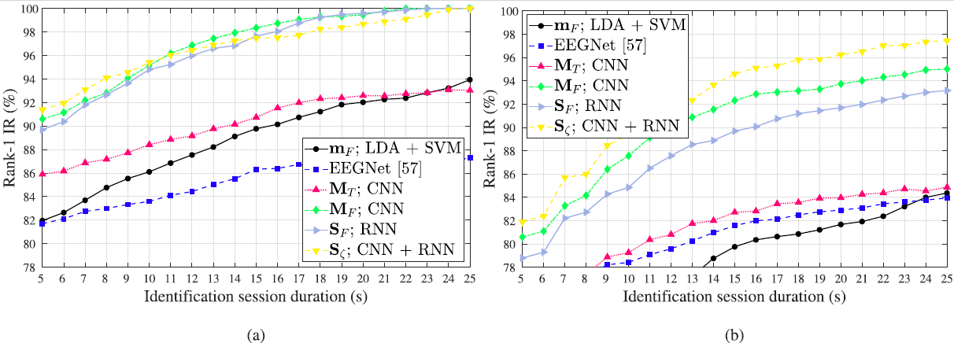
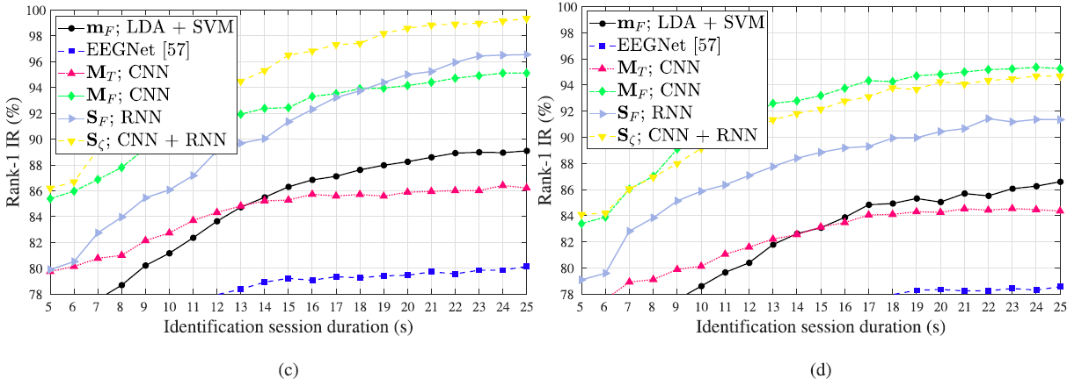
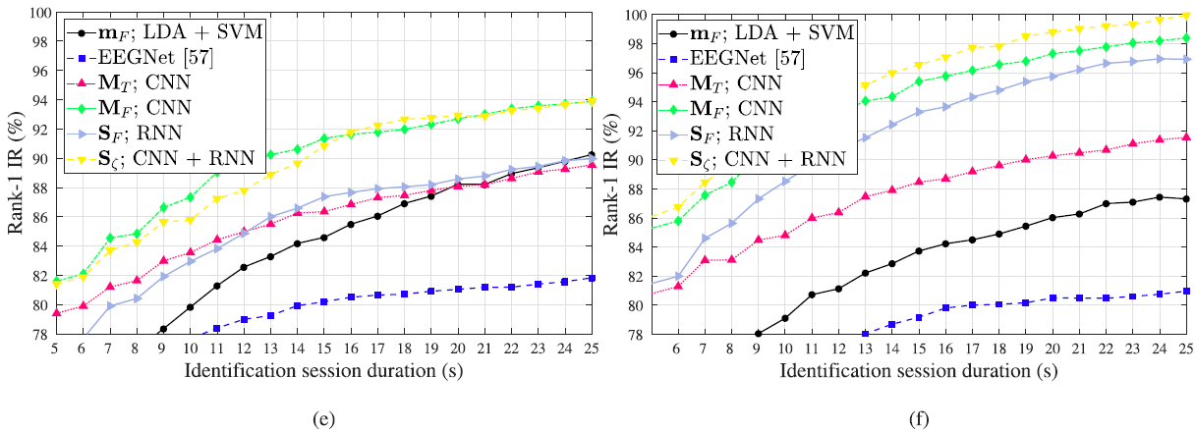
Identification results
Tests comparing signals taken 15 months after enrolment (5th session against the first 3 ones)
(a) Eyes Closed (EC) b) Eyes Open (EO) c) Motor Imagery (MI)
(d) Speech Imagery (SI) e) Visual Stimulation (VS) f) mathematical computation (MC)

Slide 19
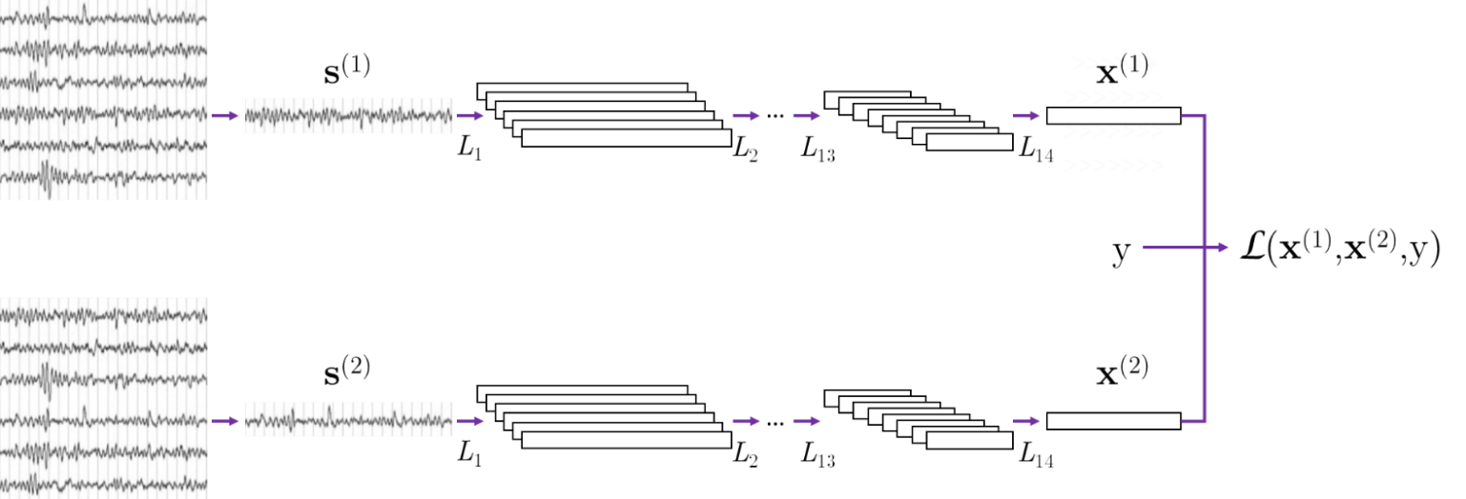
Verification
Availability of data from only the interested user during enrolment
  training performed to have the same network for all users or dedicated networks for each user
    in both cases, data from subjects other than the enrolled ones are needed (open-set scenarios)
Distance metric learning
  siamese training with contrastive loss
    input pair selection
      data from different sessions
      data from same/different channels
      data from same/different tasks
E. Maiorana, “Learning deep features for task-independent EEG-based biometric verification”, Pattern Recognition Letters, Vol. 143, pp: 122-129, 2021

Slide 20
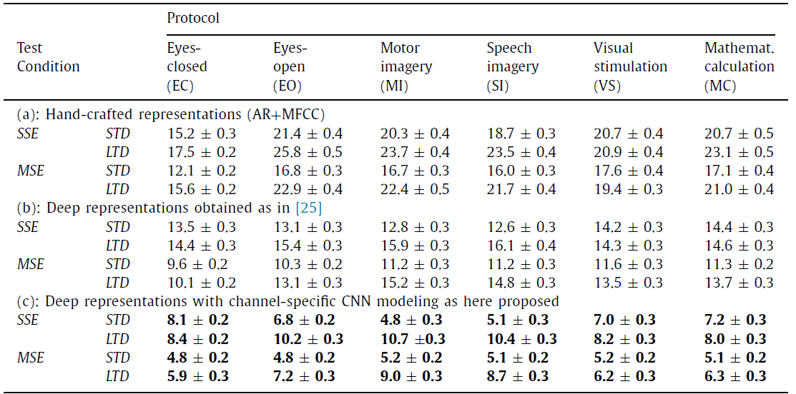
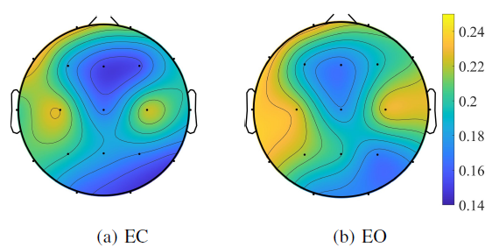
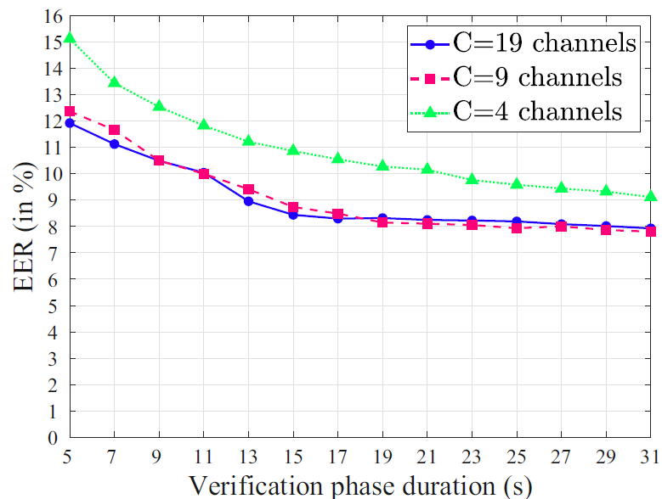
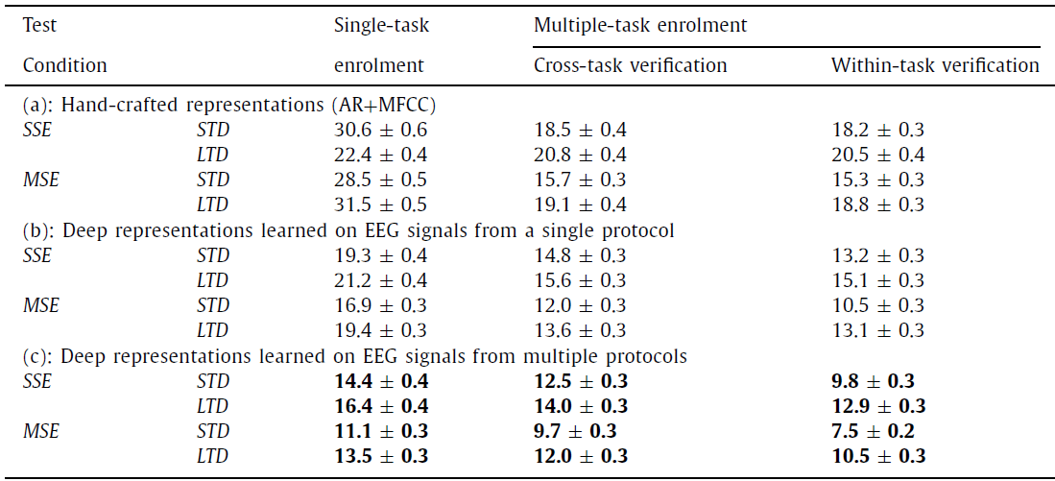
Performance
Cross-validation with 2/3 of the available subjects used for training, the rest for tests
  better results using different models for different channels
    usefulness of multiple-session enrolment
  feasibility of cross-task recognition
(a) Same model for all channels
(b) Different models for distinct channels
EC
(a) Pairs of EEG signals collected with the same protocol
(b) Pairs of EEG signals collected with different protocols

Slide 21
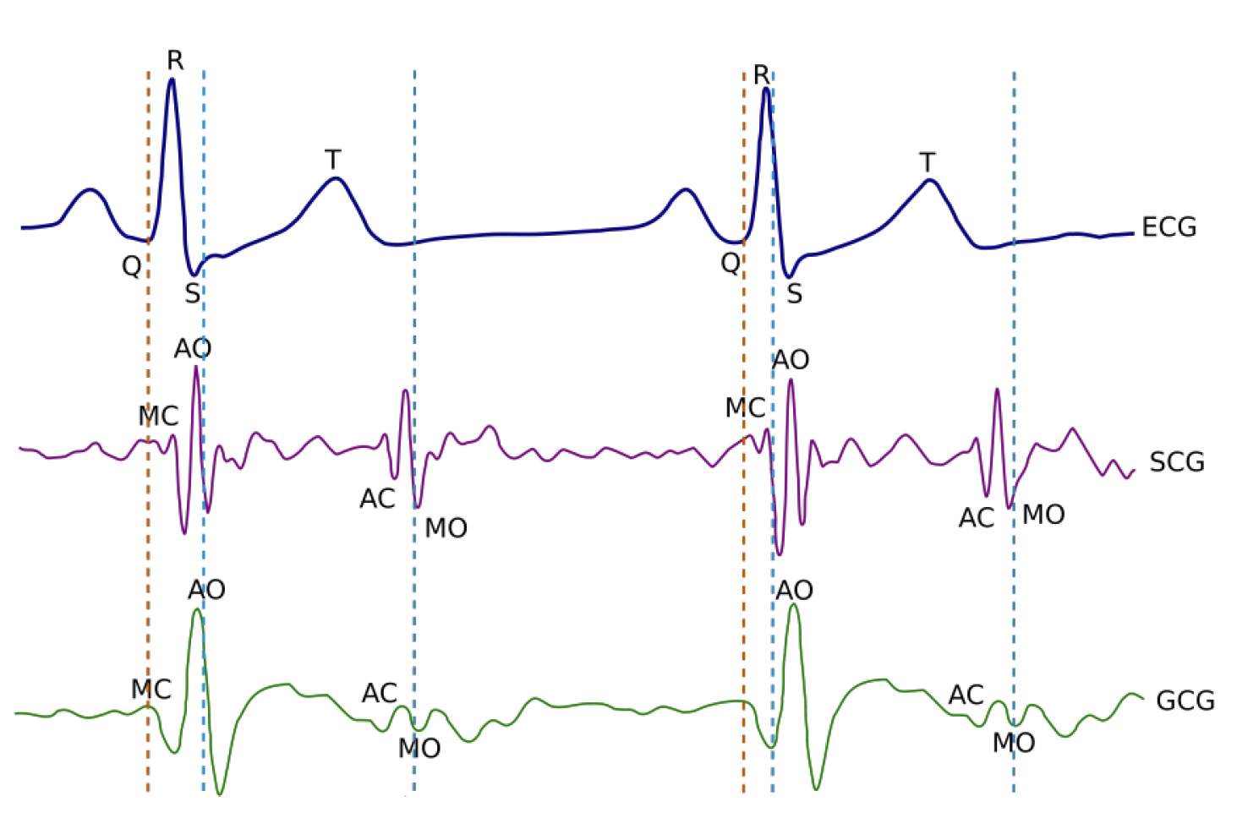
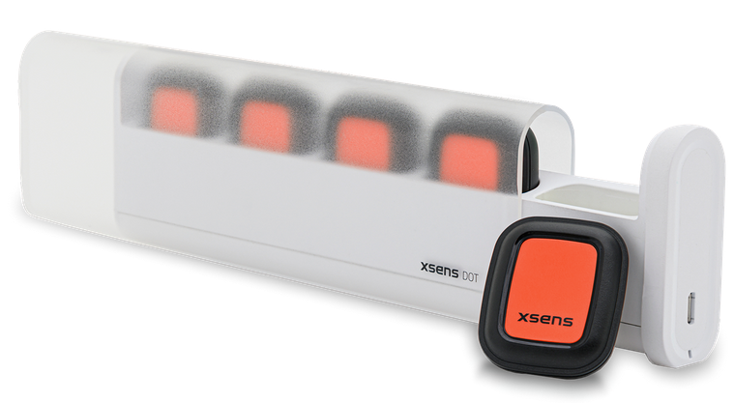
BIOWISH
Biometric Recognition using Wearable Inertial Sensors detecting Heart Activity
  use of seismocardiography (SCG) and gyrocardiography (GCG) signals
    used in medical applications to accurately measure
      opening and closure of mitral and aortic valves
      atrial filling
      point of maximal aortic blood ejection
    allow performing long term monitorings
      low-power devices
Data captured using micro electro-mechanical sensors (MEMS)
  Xsens Xdot
    collect three-axis accelerometer and three-axis gyroscope
      placed on the chest wall to record heart-induced vibrations
    typically employed to perform precision human motion tracking
      weight: 10.8g: size: 3.6 x 3.0 x 1.0 cm
E. Maiorana, C. Romano, C. Massaroni, E. Schena, “BIOWISH: Biometric Recognition using Wearable Inertial Sensors detecting Heart Activity”, IEEE Transactions on Dependable and Secure Computing, pp. 1-14, 2023

Slide 22
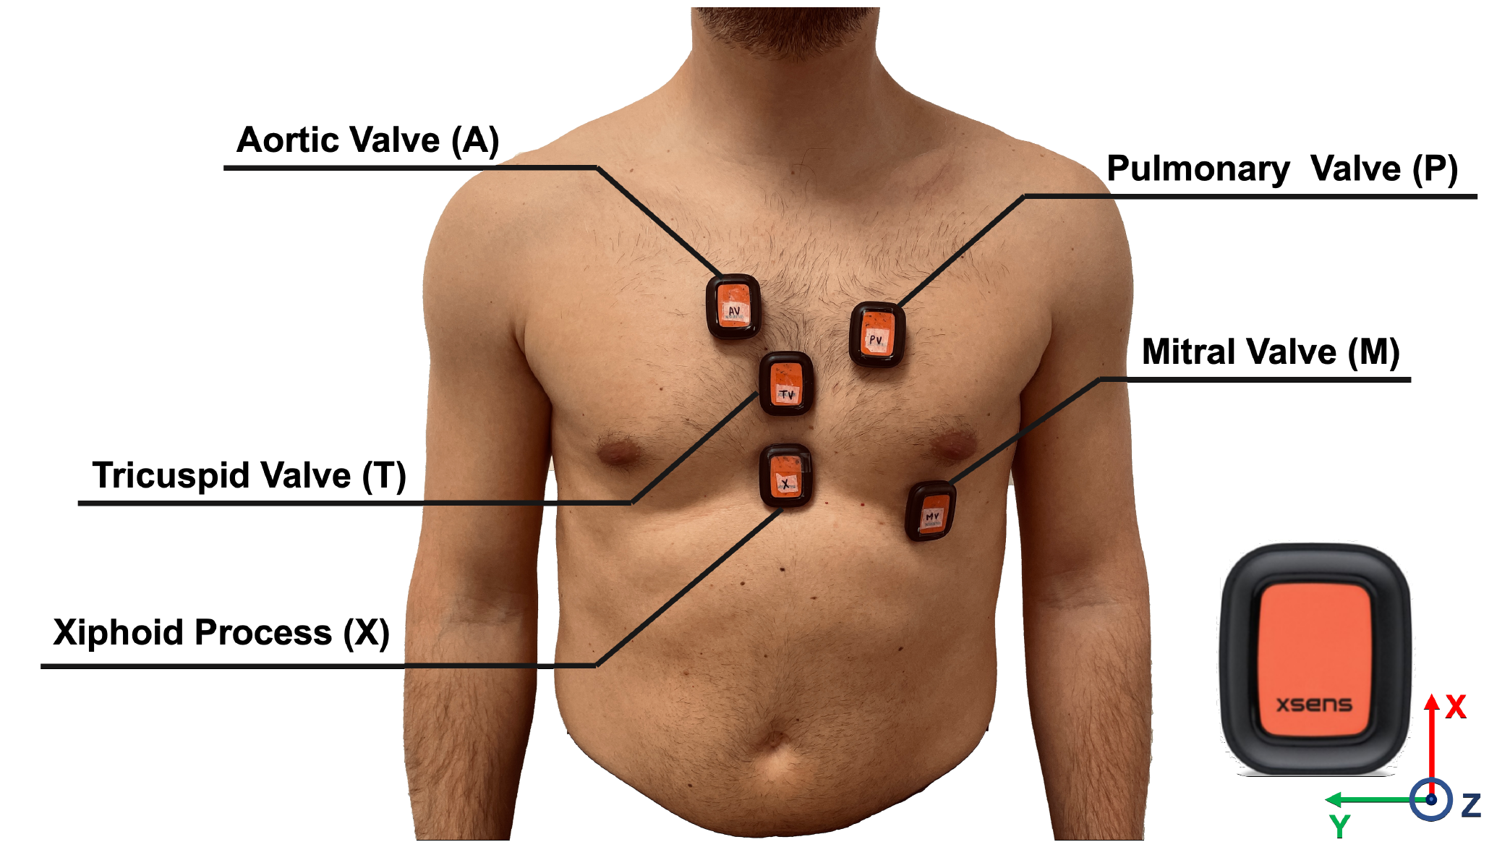
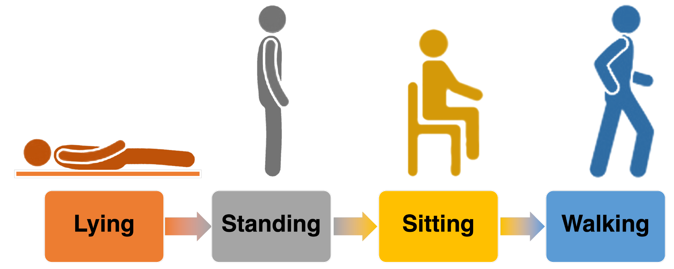
SCG/GCG Dataset
Preliminary tests on 31 healthy subjects (16 male, 15 female; age: 20-41 years old)
  sensors placed in five different positions
  four different daily activities
  two acquisition sessions
    average time distance of 21 days

Slide 23
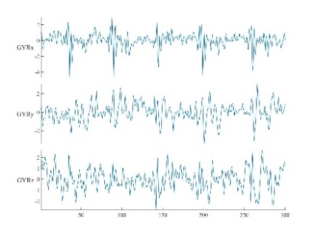
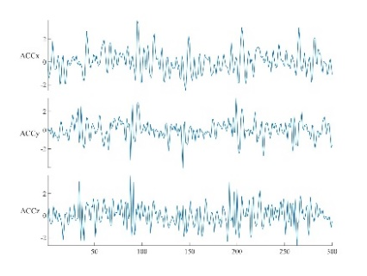


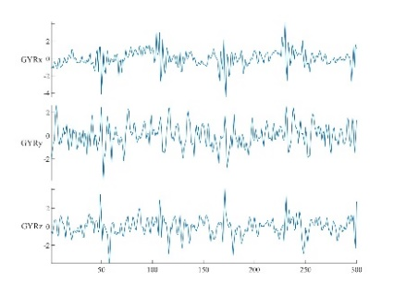
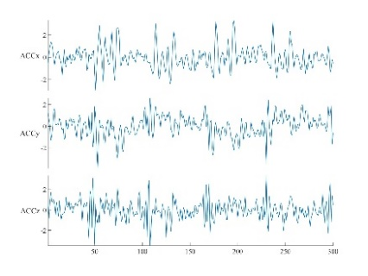






Adopted Representations
Representations in time and the time-frequency domains
Training of user-specific models with impostor data made available during enrolment
  fine tuning VGG-16 and ResNet18 networks; custom networks for time and time-frequency templates
  training with siamese strategies (contrastive loss) or through binary classifiers (cross-entropy)
    tests using data from impostors other than those employed for training
accelerometer (time)
gyroscope (time)
accelerometer (spectrogram)
gyroscope (spectrogram)
Subject 1, Session 1
Subject 1, Session 2
Subject 2, Session 1

Slide 24



Results
SCG data commonly allow achieving better verification performance than GCG ones
  best results in lying conditions with sensors at the pulmonary valve
Transfer learning not effective in cross-session recognition
  better performance achieved with custom networks
Training with a siamese strategy preferable on most occasions (best results with an ensemble)
  SCG and GCG fused at score level

Slide 25


Activity Recognition
Continuous recognition could be accomplished using a two-stage process
  the activity a user is performing has to be first determined
    pre-trained networks fine tuning effective for Human Activity Recognition (HAR)
  a verification model specifically learned for that condition is then employed

Slide 26

Explainability
Evaluation of the most relevant contributions in an heartbeat
  guided gradient-weighted class activation mapping (Grad-CAM) used to combine coarse and fine info
  analysis on the time, frequency, and spatial (axis) domains

Slide 27


Semi-supervised learning
Unlabeled data collected for other purposes could be exploited to improve discriminabiity
  mechanical measurements of heart activity not yet widespread
  use of sequence-to-sequence models
    transmute mechanical into electrical measurements
Tests on a dataset with SCG/GCG and ECG data from 29 subjects
  cross-validation by training on 26 subjects and testing on the others
  binary discriminative models trained with ECG-like signals
E. Maiorana, “Transmuting Wearable Sensor Data: From Inertial to Electrical-like Measurements of Heart Activity”, DeLTA 2024

Slide 28


Commercial Wristbands
Possibility for multi-modal approaches
  exploitation of photopletismography (PPG) and electrodermal activity (EDA)
    PPG collected to estimate heart rate, calories burned, and metabolic equivalent of task
    EDA used in wristbands to measure physiological arousal, as a proxy for emotions and stress

Slide 29





PPG/EDA Dataset
Data from 26 subjects using an Empatica Embrace wristband
  recordings in resting conditions and during unsupervised activities
  three acquisition sessions taken in distinct days
Collected signals quite different from those acquired using prototypes or medical devices

Slide 30



Discriminative Loss Functions
Networks trained to favor discriminability over separability
  attempt to derive more generalizable representations
  use of additive angular additive margin penalty loss (AAMP)
    proposed for face, tested for other traits such as vein patterns
CNN + LSTM networks trained as binary classfiers
  for each user:
    a subset of the other subjects used for training purposes
    the remaining ones considered for tests
SoftMax
AAMP
J. Deng, J. Guo, N. Xue and S. Zafeiriou, "ArcFace: Additive Angular Margin Loss for Deep Face Recognition," 2019 IEEE/CVF CVPR, 2019

Slide 31



Performance
PPG signals much more relevant than EDA
  results comparable with those achievable with prototypal devices
  performance improvement when using data from multiple sessions for training
    need for tools able to simulate inter-session variability (e.g., generative approaches for synthetic signals)
D. Y. Hwang and D. Hatzinakos, “PPG-based personalized verification system,” IEEE CCECE, 2019
TPR
TPR
FPR
FPR
TPR
FPR

Slide 32
Conclusions
Wearable biometrics is an active research area with applications for real-life scenarios
  significant interest for scenarios such as IoT and Metaverse
Research possibilities
  improving recognition performance and better handling time variability
    networks specifically designed and trained for physiological signals
    few-shot learning
      loss functions able to generalize well to unseen data
      distance metric learning
    multimodal learning could allow integrating and correlating information across different biometric traits
    incremental/continuous learning
  data augmentation strategies for physiological signals needed
    generative AI
  evaluating sensor interoperability
    domain adaptation
  preserving data privacy
    federated learning could allow training models on-device while keeping biometric data decentralized

Slide 33
References
P. Arnau-Gonzalez, S. Katsigiannis, M. Arevalillo-Herraez, N. Ramzan, “BED: A new dataset for EEG-based biometrics”, IEEE IoT Journal, 2021
S. Bianco, P. Napoletano, “Biometric recognition using multimodal physiological signals”, IEEE Access, 2019
J. Blasco, T.M. Chen, J. Tapiador, P. Peris-Lopez, “A survey of wearable biometric recognition systems”, ACM Computing Surveys, 2016
J. Blasco, P. Peris-Lopez, “On the feasibility of low-cost wearable sensors for multi-modal biometric verification”, Sensors, 2018
Y. Cao, Q. Zhang, F. Li, S. Yang, Y. Wang, “PPGPass: Nonintrusive and secure mobile two-factor authentication via wearables”, INFOCOM 2020
C. Cornelius, et al., “Who wears me? bioimpedance as a passive biometric”, USENIX Conference on Health Security and Privacy, 2012
D. Ekiz, Y.S. Can, Y. Dardagan, F. Aydar, R. Kose, C. Ersoy, “End-to-end deep multi-modal physiological authentication with smartbands”, IEEE Sensors Journal, 2021
T. Enamamu, N. Clarcke, P. Haskell-Dowland, F. Li, “Smart watch based body-temperature authentication”, IEEE ICCNI, 2017
S. Hinatsu et al., “Attack on PPG Biometrics: Presentation Attack by Stealth Recording and Waveform Estimation”, IEEE EMBC 2021
D. Hwang, B. Taha, D. Lee, D. Hatzinakos, “Evaluation of the time stability and uniqueness in PPG-based biometric system”, IEEE TIFS, 2021
H. Kim et al., “A wearable wrist band-type system for multimodal biometrics integrated with multispectral skin photomatrix and electrocardiogram sensors”, Sensors, 2018
E. Lee, A. Ho, Y. Wang, C. Huang, C. Lee, “Cross-domain adaptation for biometric identification using photoplethysmogram”, IEEE ICASSP 2020
F. Lehmann, D. Buschek, “Heartbeats in the wild: A field study exploring ECG biometrics in everyday life”, CHI SIGCHI 2020
S. Mahto, T. Arakawa, T. Koshinaka, "Ear Acoustic Biometrics Using Inaudible Signals and Its Application to Continuous User Authentication", EUSIPCO 2018
E. Maiorana, “Deep learning for EEG-based biometric recognition”, Neurocomputing, Vol. 410(14), pp: 374-386, 2020

Slide 34
References
E. Maiorana, “Learning deep features for task-independent EEG-based biometric verification”, Pattern Recognition Letters, Vol. 143, pp: 122-129, 2021
E. Maiorana, "A Survey on Biometric Recognition using Wearable Devices", Pattern Recognition Letters, 2022
E. Maiorana, C. Romano, C. Massaroni, E. Schena, “BIOWISH: Biometric Recognition using Wearable Inertial Sensors detecting Heart Activity”, IEEE Transactions on Dependable and Secure Computing, pp. 1-14, 2023
E. Maiorana, “Transmuting Wearable Sensor Data: From Inertial to Electrical-like Measurements of Heart Activity”, DeLTA 2024
T. Nakamura, V. Goverdovsky, D. Mandic, “In-ear EEG biometrics for feasible and readily collectable real-world person authentication”, IEEE TIFS, 2018
Z. Nie, Y. Liu, C. Duan, Z. Ruan, J. Li, L. Wang “Wearable biometric authentication based on human body communication”, IEEE BSN 2015
A. Ometov et al., "A Survey on Wearable Technology: History, State-of-the-Art and Current Challenges", Computer Networks, 2021.
J.R. Pinto and J.S. Cardoso, “Explaining ECG Biometrics: Is It All In The QRS?”, BIOSIG 2020
R. Raji, M. Adjeisah, X. Miao, A. Wan, “A novel respiration pattern biometric prediction system based on artificial neural network”, Sensor Review, 2020
W. Saadat, S. Raurale, G. Conway, J. McAllister, “Wearable antennas for human identification at 2.45 GHz. IEEE Transactions on Antenna Propagation, 2022
S. Schneegass, Y. Oualil, A. Bulling, “Skullconduct: Biometric user identification on eyewear computers using bone conduction through the skull”, CHI Conference on Human Factors in Computing Systems 2016
K. Suzaki, K. Shimizu, K. Oguchi, “Feasible personal identification by eye blinking using wearable device, IEEE CSPA 2019
U. Yadav, S. Abbas, D. Hatzinakos, “Evaluation of PPG biometrics for authentication in different states”, IEEE ICB 2021
B. Yang and W. Lee, “Human body odor based authentication using machine learning”, IEEE Symposium Series on Computational Intelligence 2018

Slide 35
Thanks for your attention!
Questions?
emanuele.maiorana@uniroma3.it

