Slide 1
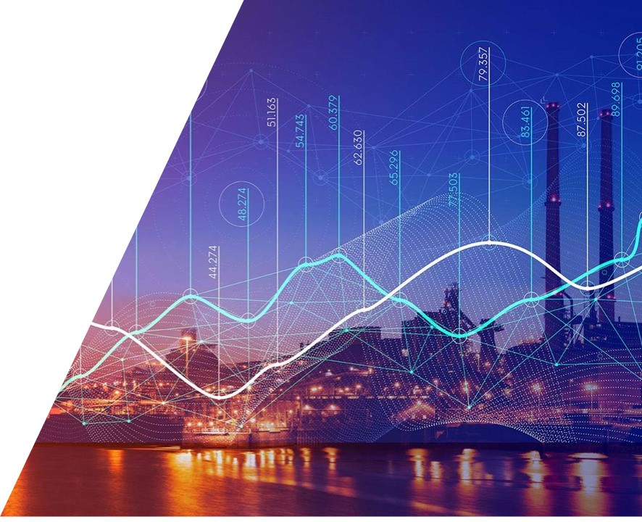
Digital Transformation in Steel Industry
IFAC/INSTICC IN4PL 2024, Porto,
Dr. Priv. Doz.
Georg Weichhart
Digital Transformation Manager
Notes:
International Conference Innovative Intelligent Industrial Production and Logistics IN4PL 2024; supported by IFAC, INSTICC

Slide 2
Contents
1 Introduction
Primetals Technologies
Application Domain: Steel Making
Vision of a Smart Plant
2 Megatrends impacting the steel industry
Decarbonization
Aging Workforce & Gen Z
Digitalization
3 Conclusions & Challenges
Conclusion
Challenges for Digital Transformation

Slide 3
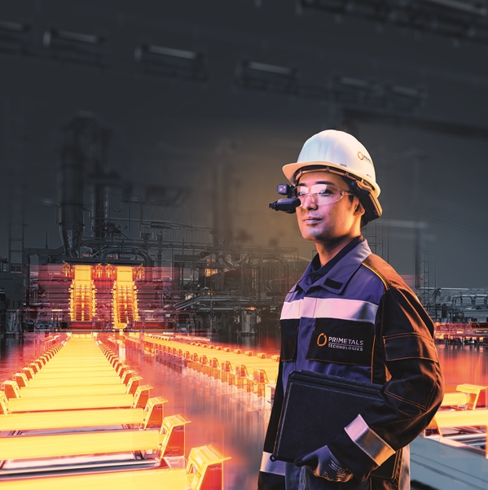
Introduction
Primetals Technologies
Steel Production Process

Slide 4
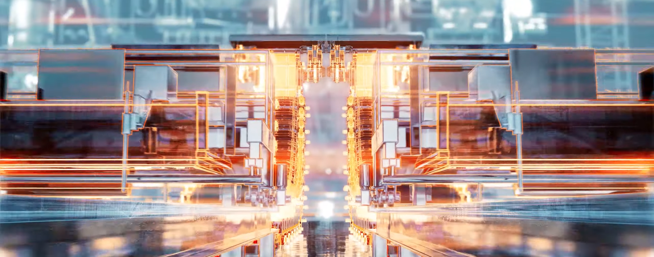
Primetals Technologies
Introduction

Slide 5

Introduction
https://youtu.be/YD14wdDteqg
Notes:
https://youtu.be/YD14wdDteqg
Make Green Steel happen: https://youtu.be/AXFSSr7Qly8

Slide 6
Application Domain: Steel Making
Introduction
Steelmaking - worldsteel.org
Notes:
To make steel in a blast furnace, coal must first be turned into coke. Coke has a dual role in the steelmaking process. First, it provides the heat needed to melt the ore, and second, when it is burnt, it has the effect of ‘stealing’ the oxygen from the iron ore, leaving only the pure iron behind. In the coking plant, coal is heated in the absence of oxygen to 1250c. This removes any impurities in the coal, resulting in coke, which is a porous substance that is nearly all carbon.
Sinter plant – YouTube: https://www.youtube.com/watch?v=nATw-FTyS9c
The sinter plant turns iron ore into sinter, which is the optimal product for the blast furnace. Sinter is made by burning a mix of iron ore powder, fluxes and recycled substances from the steel plant to create an open-grained, consistent substance. The sinter is then crushed, cooled and screened for dust. Sometimes, iron ore is supplied in the form of iron ore pellets. These need no further processing and are ready for use using the direct reduction iron (DRI) steelmaking method.
In a blast furnace, fuel (coke), ores, and flux (limestone) are continuously supplied through the top of the furnace, while a hot blast of air (above atmospheric pressure and sometimes with oxygen enrichment) is blown into the lower section of the furnace through a series of pipes called tuyeres, so that the chemical reactions take place throughout the furnace as the material falls downward. The end products are usually molten metal and slag phases tapped from the bottom, and waste gases (flue gas) exiting from the top of the furnace. The downward flow of the ore along with the flux in contact with an upflow of hot, carbon monoxide-rich combustion gases is a countercurrent exchange and chemical reaction process.
Direct reduction refers to solid-state processes which reduce iron oxides to metallic iron at temperatures below the melting point of iron. Direct reduced iron (DRI), also called sponge iron, is produced from the direct reduction of iron ore (in the form of lumps, pellets, or fines) into iron by a reducing gas which contains elemental carbon (produced from natural gas or coal) and/or hydrogen. When hydrogen is used as the reducing gas no carbon dioxide is produced.
Direct reduction processes were developed to overcome the difficulties of conventional blast furnaces. DRI plants need not be part of an integrated steel plant, as is characteristic of blast furnaces. The initial capital investment and operating costs of direct reduction plants are lower than integrated steel plants and are more suitable for developing countries where supplies of high grade coking coal are limited, but where steel scrap is generally available for recycling. Many other countries use variants of the process.
https://www.youtube.com/watch?v=UNjrcAQjne4
Basic oxygen steelmaking, also known as Linz-Donawitz steelmaking or the oxygen converter process, is a method of primary steelmaking in which carbon-rich molten pig iron is made into steel. Blowing oxygen through molten pig iron lowers the carbon content of the alloy and changes it into low-carbon steel.
https://www.youtube.com/watch?v=FKkH6c3xn8E

Slide 7
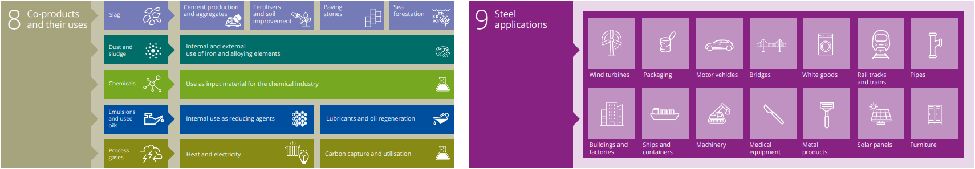
Application Domain: Steel Making
Introduction
Steelmaking - worldsteel.org

Slide 8
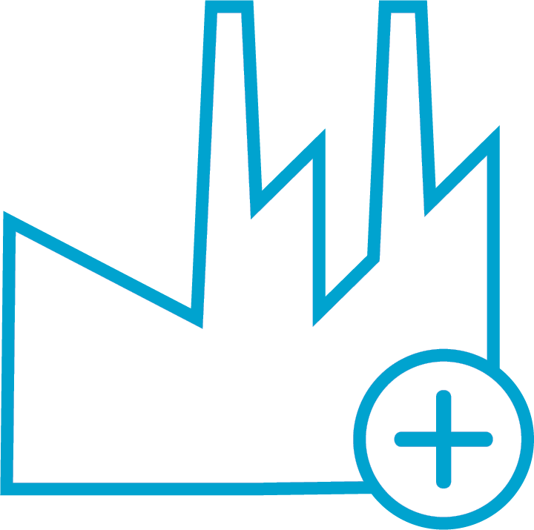



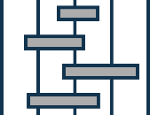



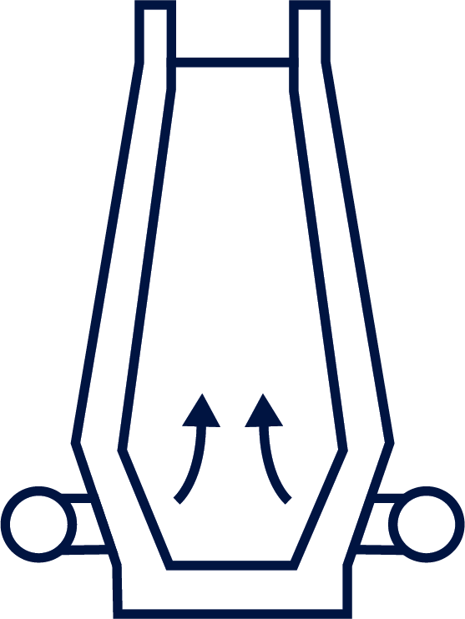


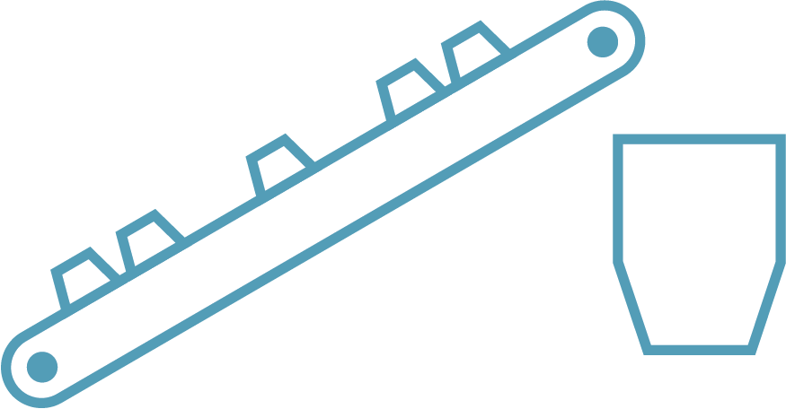
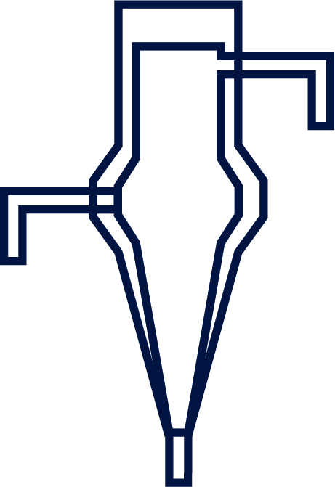
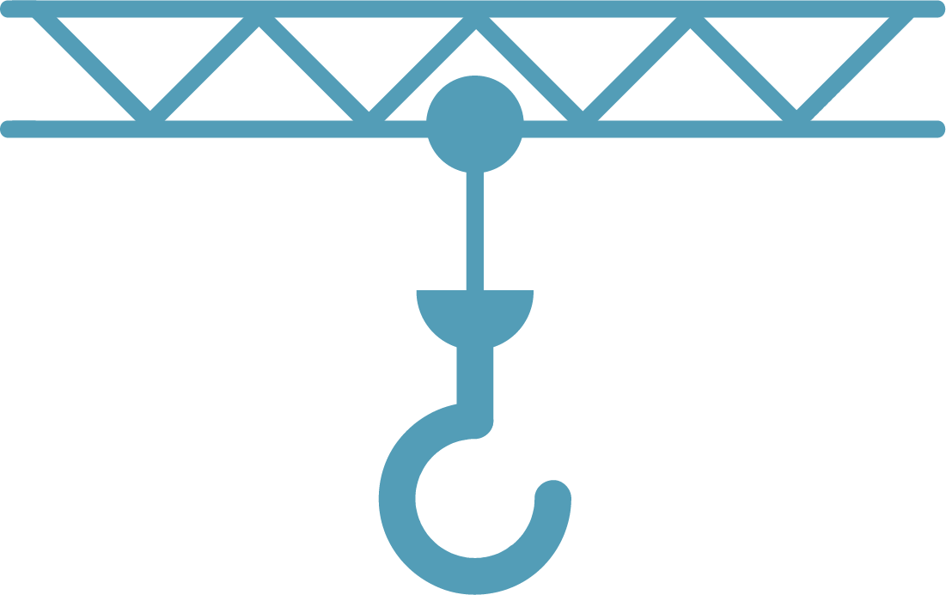
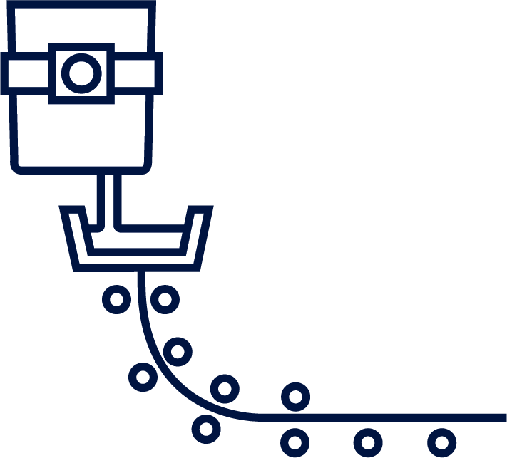




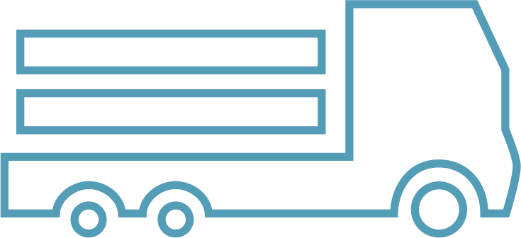



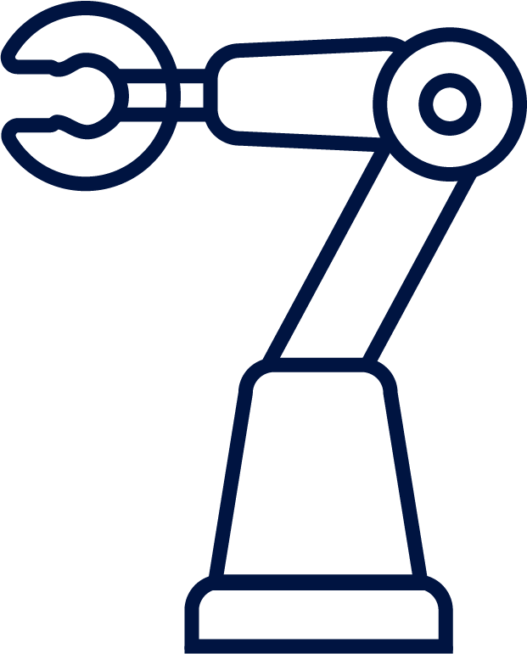

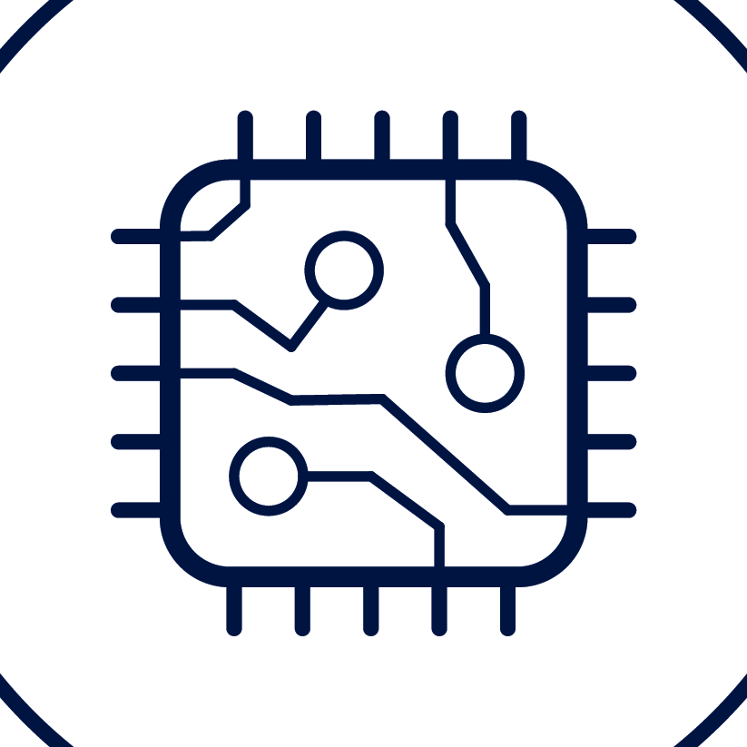

Primetals Technologies’ Smart Plants intelligently optimized and connected
- A Vision
Introduction
Smart Maintenance
Services
Modular upgrades & modernizations
Connected eServices
Consulting, Know How & online trainings
Online platform
(spares, digital docu)
Remote support & monitoring
Digital unity
Ironmaking Optimizer
Maintenance and Asset Technology
Through-Process Quality Control
Asset Life Expert
Intralogistics
Smart Plant Iron Making
Blast Furnace, Direct Reduction, etc.
Intralogistics
Smart Plant Steel Making
& Casting
Electric Arc Furnace,
Smelter, Casting Machines
Intralogistics
Smart Plant Hot & Cold Rolling
Hot Rolling, Cold Rolling, Pickling, Finishing
Intralogistics
Metals Intelligence
Data Analytics, AI, Assistance, Digital Twin, Intelligent Maintenance
Metals Intelligence
Data Analytics, AI, Assistance, Digital Twin, Intelligent Maintenance
Metals Intelligence
Data Analytics, AI, Assistance, Digital Twin, Intelligent Maintenance
Raw material
logistics
& handling
Automatic yards
Ladle Tracking
& monitoring
Heat planning
& logistics
Automatic yards
Logistics & Planning
Automatic transportation
Automatic yards
Logistics & Planning
Automatic transportation
Robotics & KI
Sensor Systems
Smart Mechatronics
Robotics & KI
Sensor Systems
Smart Mechatronics
Robotics & KI
Sensor Systems
Smart Mechatronics
Smart
Factory
Notes:
Smelter, a furnace powered by electrical energy and used for melting and final reduction of direct reduced iron (DRI). Operated together with a direct reduction plant and an LD converter (BOF), the Smelter is producing hot metal for the steelmaking plant and liquid slag that can be used in the cement industry. The conventional BF – LD converter route results in almost two tons of CO2 per ton of liquid steel. Thanks to the new smelter technology, CO2 emissions will be reduced by a factor of six, to 0.33 tons of CO2 per ton of liquid steel.

Slide 9
Definitions
Introduction
For Semantic Interoperability
Digital Transformation (DT/DX):
company-wide socio-technical process that leads to the development of new business models
Digitalization:
IT and digital technologies used to alter existing business processes
Digitization:
technical process of converting analogue signals to digital signals
Digital Transformation
Digitalization
Digitization

Slide 10
Definitions
Introduction
Level 4: Enterprise Resource Planning
Planning Horizon: Days – Months; Enterprise
Level 3: Manufacturing Planning and Execution System
Planning Horizon: Hours (Shifts); Plant / Shop Floor
Automation Pyramid
ISO 95;
Level 2: Monitoring, Supervision and Human Interfaces
Planning Horizon: Seconds – Minutes; Production machine
Level 1: Field level Sensors, Actuators; Programmable Logic Controller
Planning Horizon: Sub-seconds; System
Level 0: Physical Production Process

Slide 11
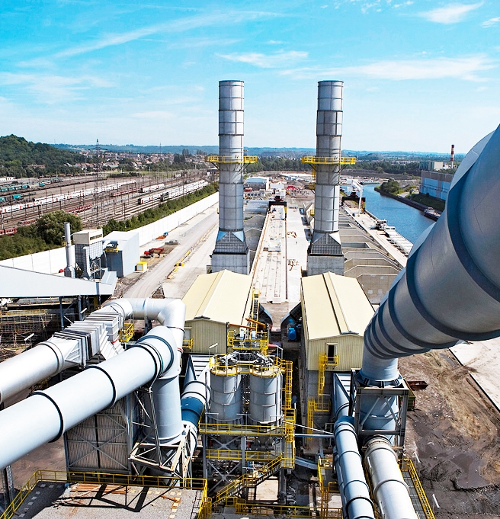
Megatrends impacting the steel industry
Decarbonization

Slide 12








Facts & figures about steel (2023)
Challenge
~1 850 Mt/a
1 t
1.85 t
3.6 Gt CO₂ /a
CO_{2e}
70% of the steel production runs on coal
CO₂ generation almost double than steel
Steel production causes appr. 8-9%
of global CO₂ emissions
2 200 Mt/a by 2050
70%
by 2050
75%
by 2050
Demand growth slow down to 1% p.a.
Driven by emerging markets & renewable energy
Decarbonizing steel requires massive amounts of green electricity
Steel consumers demanding green steel
for scope 3 already today

Slide 13
Decarbonization will take place in phases
Megatrend: Decarbonization
Development phases
Optimization Phase
(-2027)
Transition Phase
(2027 – 35)
Final Phase
(Green Steel) (2035 – 2050)
Raw material optimization | H2 enrichment in DRI plant to 30% H2 injection in BF/Pellet/EAF | 100% H2 based DRI (Direct Reduced Iron) plants
Improved maintenance | Hybrid flexible melt shops | Renewable power EAF’s (Electric Arc Furnace)
Endless processes | Starting phase for CCUS | Carbon direct avoidance Increased deployment of CCUS (Carbon Capture, Utilization, Storage)
Major technology changes to reach CO₂ reduction targets
Progressive
CO₂ reduction
10-30%
30-40%
70-80%
Process optimization using digital models
Energy optimization using intelligent automation
Data analytics for scrap avoidance, continuous optimization, model improvement (for process optimization)
Digitalization
in the steel industry

Slide 14
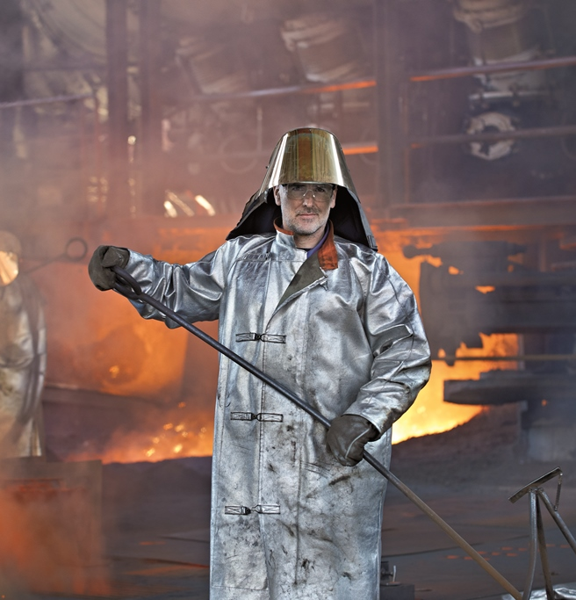
Megatrends impacting the steel industry
Changing Workforce

Slide 15
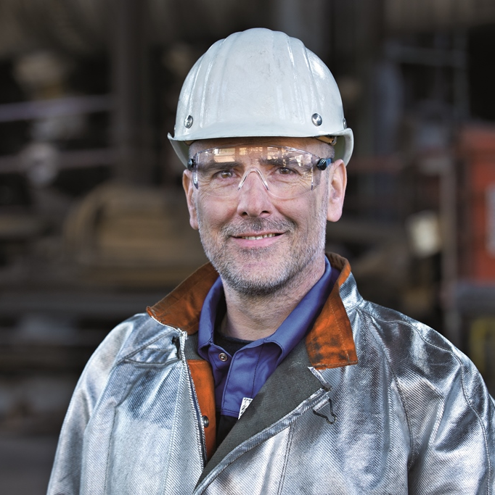
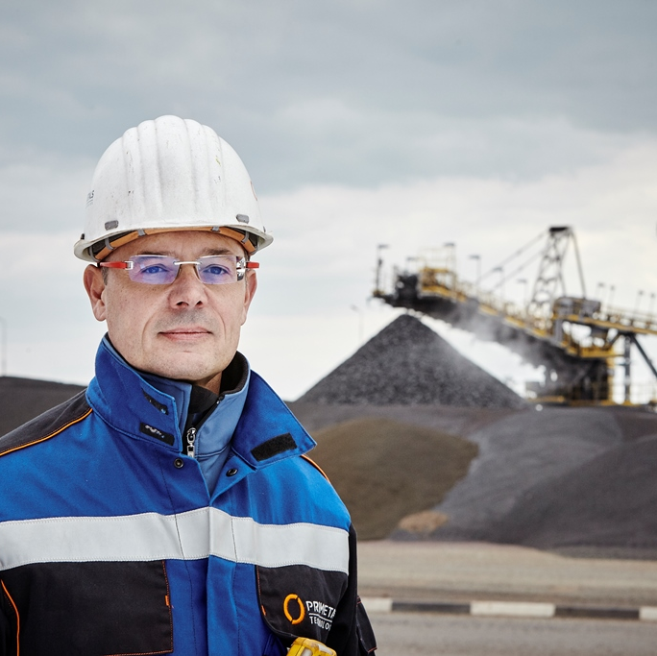
Employees with in-depth knowledge are being replaced by a digitally-savvy Gen Z
Megatrend: Changing Workforce
Going out: Aging workforce
Plants operated for 20+ years
Knowledge on basic processes in plant will leave the company
Knowledge missing on new technologies
Coming in: Gen Z
Digital tools savvy
Less committed to work abroad
Less likely to do night shifts
Less people available

Slide 16
Autonomous plant mission
Megatrend: Changing Workforce
Increase plant autonomy level
Reduce the need for manual intervention
Increased productivity
Process stabilization
Quality improvement

Slide 17
Operator tasks today and within the framework of automated operation
Megatrend: Changing Workforce
Operator tasks today
Automated operation
Technology
Operator input
in standard operation
Operator input
in emergencies
Artificial Experts
Digital Assistants
Plant supervision
Computer Vision
Logging, documentation
Assistants for
logging, documentation
Enabler
Traditional
operation control
Operator guidance
fast information access

Slide 18

Megatrends impacting the steel industry
Digitalization

Slide 19
Digital Optimization of Resource Usage
Megatrend Digitalization
Eight types of waste … and the digital countermeasures
Defects | Digital Assistants, AI and Data Analytics, Through Process Optimization
Over-production | Production Management Systems, Business Intelligence, KPI
Transportation | Digital Twins, Simulation, Fully Automated Yard, Advanced Tracking System, Online Heat Scheduler,
Waiting | eServices, Condition Monitoring, Smart Sensors, Comprehensive Maintenance Management
Inappropriate processing | Digital Twins, Data- and Physical Models, Simulation, Big Data, Predictions, Rules
Motion | Data and Information Management, Digital Organization, Workflows
Inventory | Maintenance and Asset Technology, Spare Part Management Digital Assistants Robotics, Modular Power & Drive Solutions Remote Support & Monitoring
Wasted human potential | Knowledge Management, Consulting, Online Training

Slide 20



TPO: Through Process Optimization
Megatrend Digitalization
Data exploration
Quality assurance
Analytic insights
Forecast
Assist
Evaluate
Enforce
Measure and analyze
Root cause analysis
Visualize
Implementation services
Predictive analytics
Navigate
Commissioning
Simulation
Capture
Customizing
Training
Prescriptive analytics
Quality excellence

Slide 21
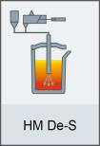
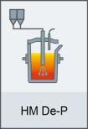
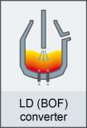
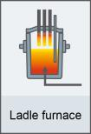
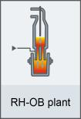
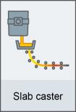
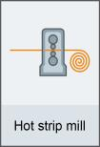
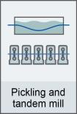
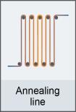
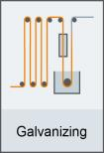


Benefit from TPO & TPQC through-process rules
Megatrend Digitalization
Compensational Actions Across Processing Units
Hot Metal
Desulfurization / Dephosphorization
Basic Oxigen Furnace
Linz / Donawitz Converter
Ruhrstahl Heraeus Degassing system - Oxygen Blowing
①
②
③
④
ExampleS
  Quality issue at HSM, e. g.: - Incorrect Coiling Temperature
  (Hot Strip Mill) - Suspicion of Rolled-in Scale Defects
  (from Surface Inspection System)
Possible compensations
  Adapt / slow down pickling speed
  Adapt annealing cycle on annealing furnace of CAL (Continuous Annealing Line)
  Adapt annealing cycle on annealing furnace of CGL (Continuous Galvanizing Line)
  Downgrade and re-allocate an appropriate production order

Slide 22






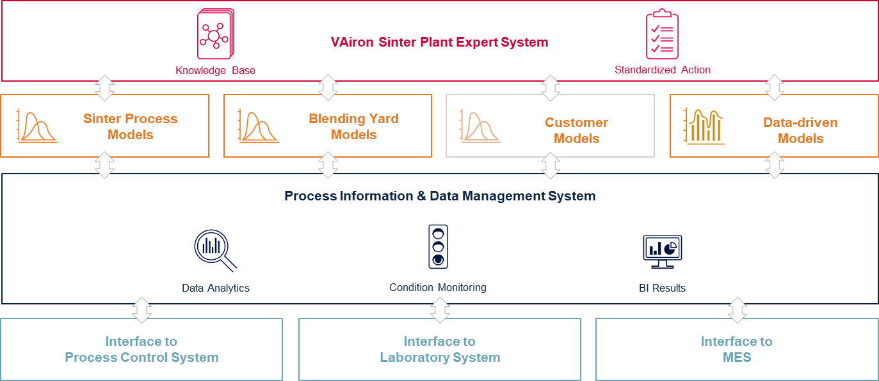
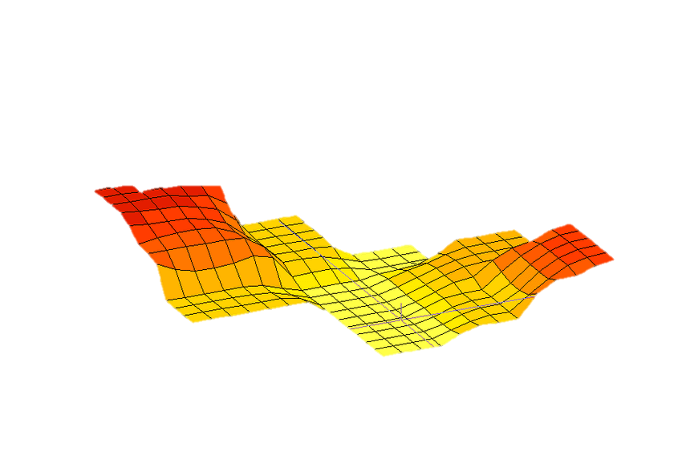
Preparation → Statistics→ AI → Modelling → Deployment
Megatrend Digitalization
domain know-how
data analytics know-how
Select data,
add features
Clean,
integrate
Transform, inteoperable
Discretize, categorize
Prepared data
domain know-how, data analytics know-how,
metallurgical know-how, automation know-how
data analytics know-how
Prepared data
Data analytics (tool box)
Patterns & insights
Deploy data driven model
Improved physical models

Slide 23
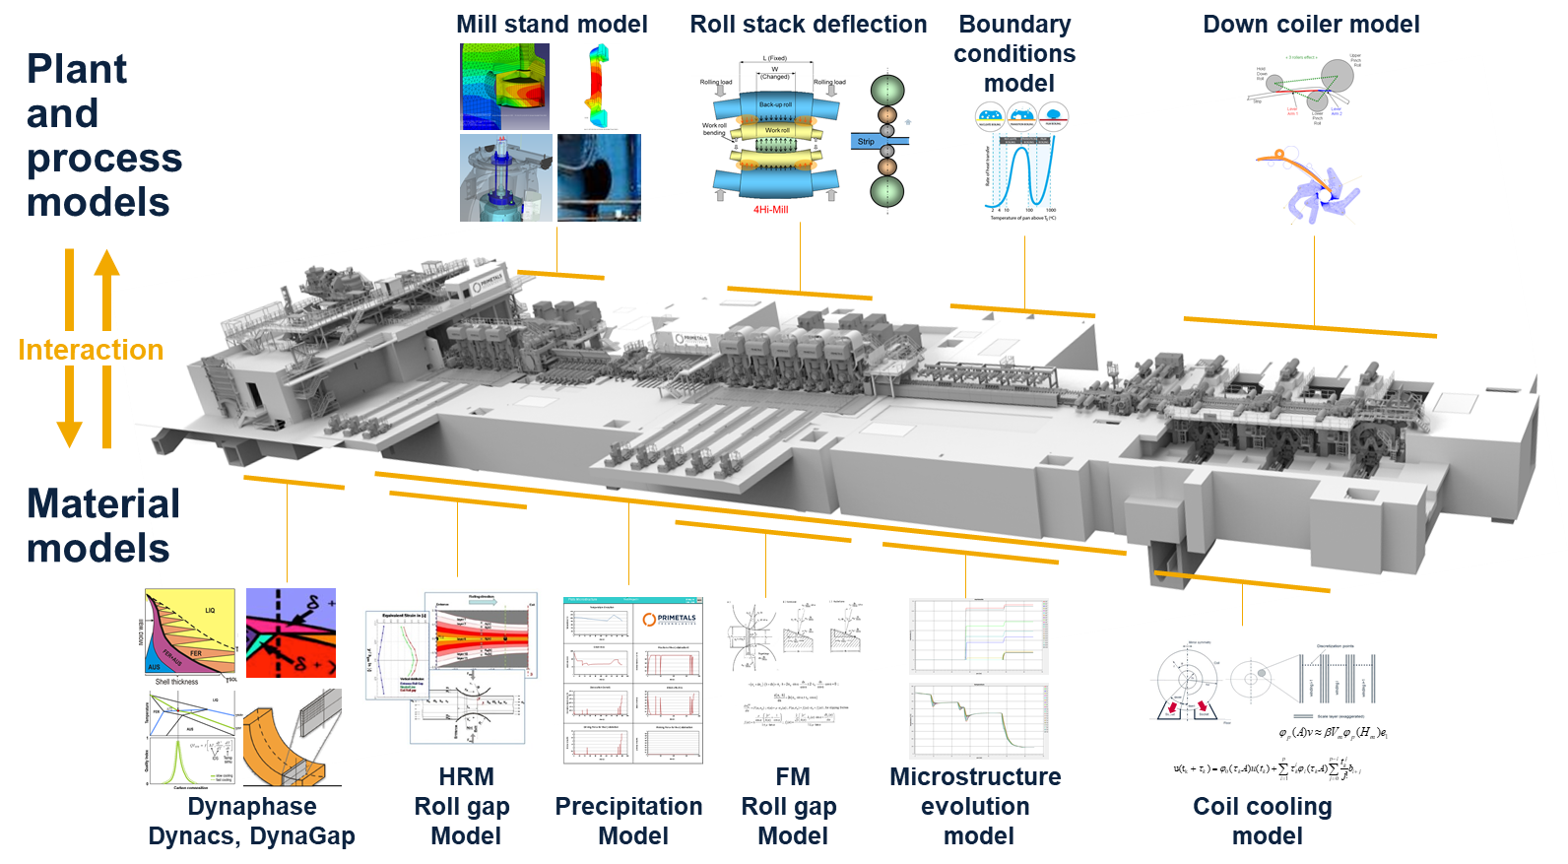
Simulation: Digital Twins & Metallurgical Models
Megatrend Digitalization

Slide 24
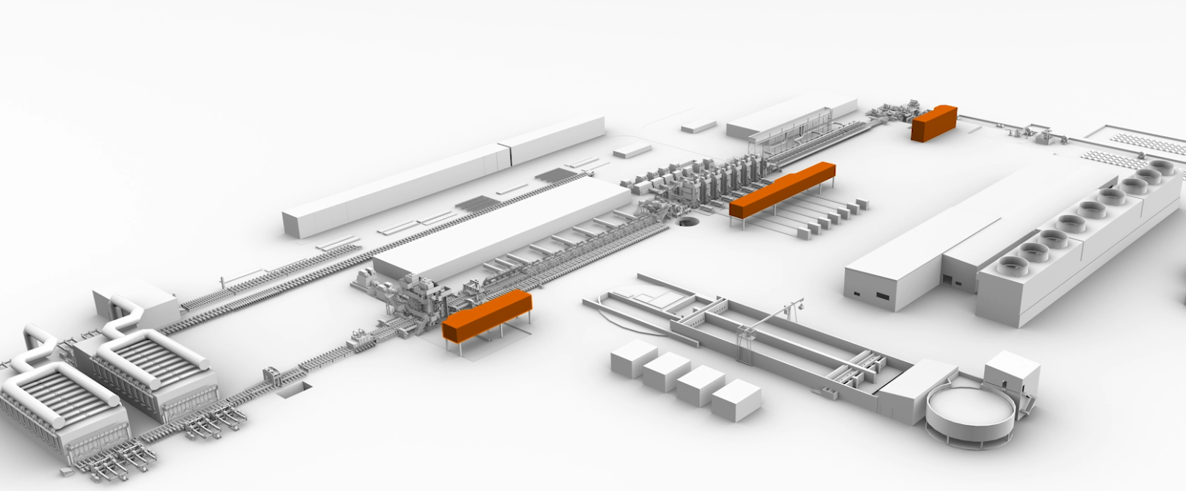
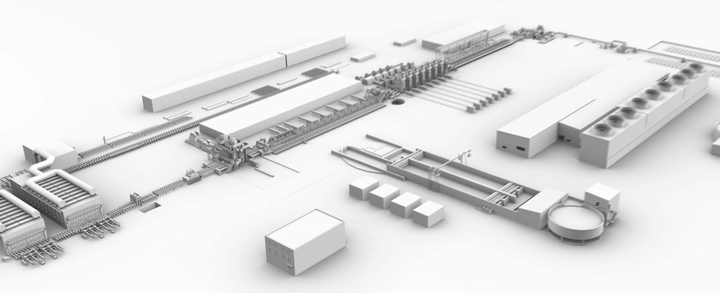
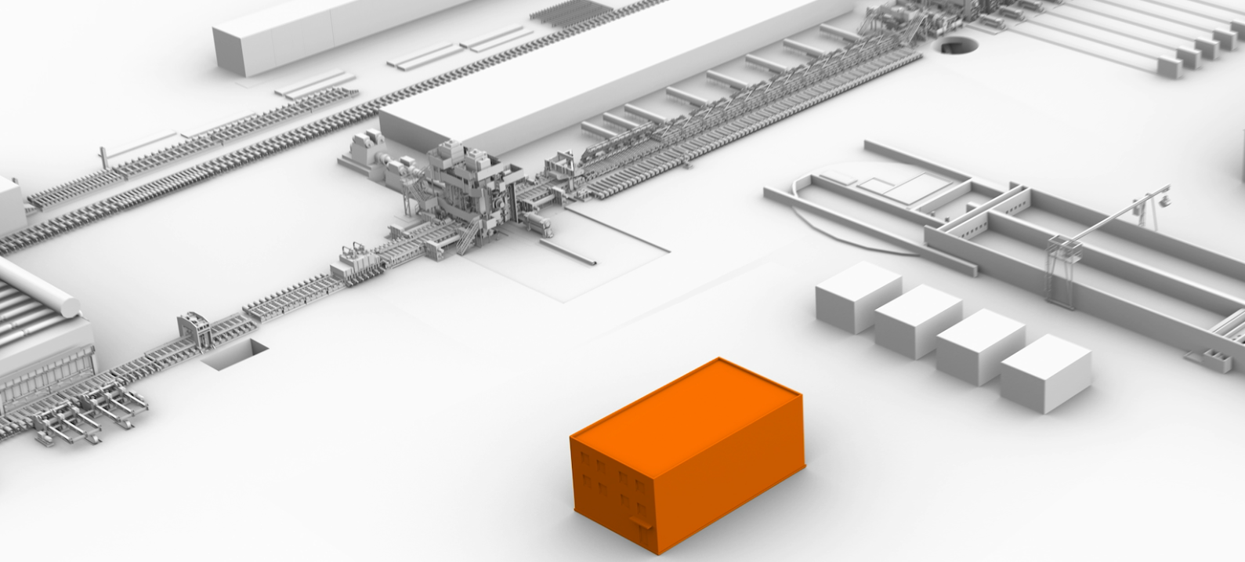


Central Operation Cockpit for a Hot Strip Mill
Megatrend Digitalization
Classic Design
Direct view to each plant area
Camera view in critical plant areas
Operation pulpit in each plant area
Central Control Room
Integration into single pulpit
Data interoperability
too many monitors and operating elements
Central Operation Cockpit
Ergonomical Re-Design
Intelligent Operator Guidance
Remote Operation Capability

Slide 25
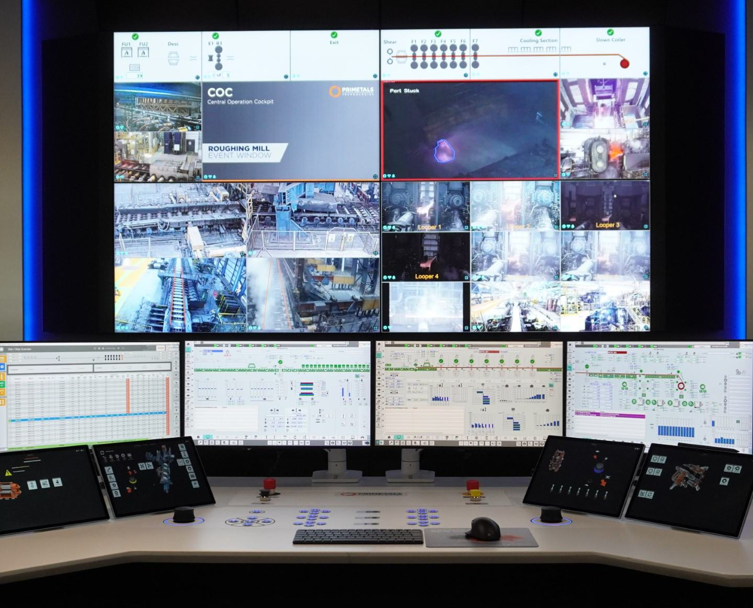
Central Operation Cockpit (COC)
Optimized Ergonomic Design
Megatrend Digitalization
Integration of camera streams and classic HMI and digital assistants
Automatic switching of camera streams based on actual operational status and events
Intelligent augmentation of camera images with overlays (e.g., tracking data and other guiding information)
1
2
1
Plant overview
Camera streams for required process view
SCADA level for process operation
Operating elements for manual process intervention (conventional and touch elements)
2
3
3
4
4
Restricted © Primetals Technologies 2021-2024. All rights reserved.

Slide 26
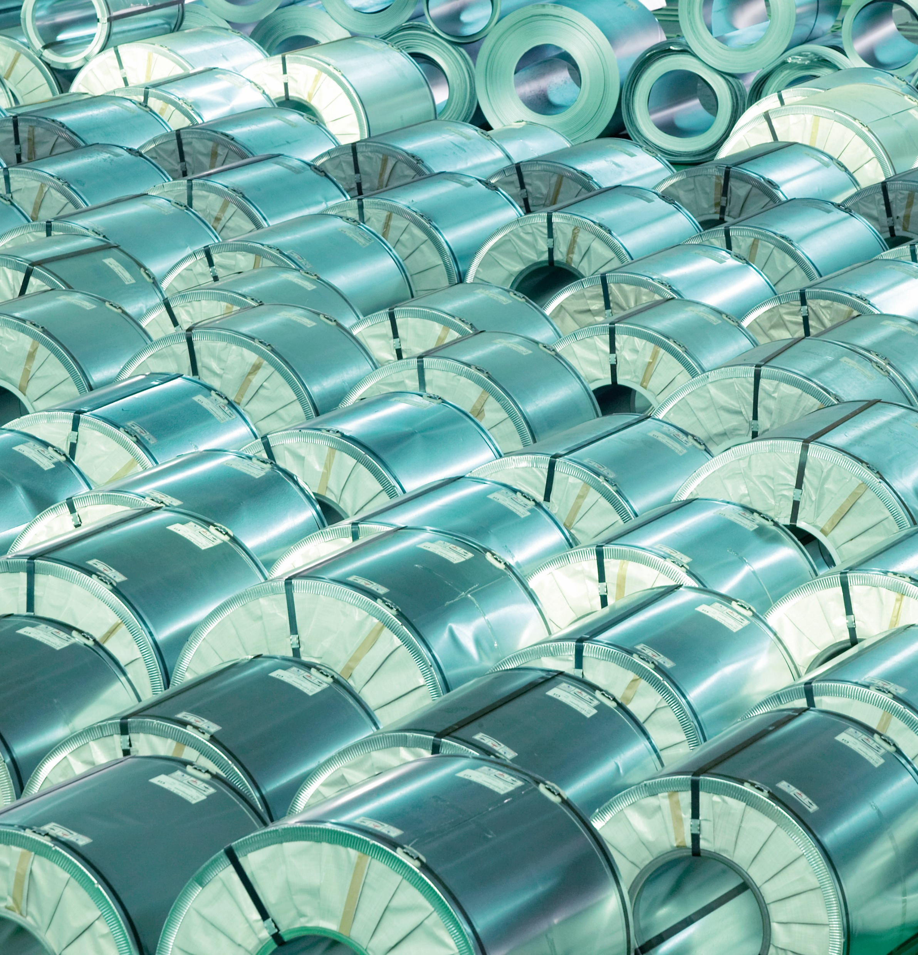
Conclusion & Challenges

Slide 27
Conclusion & Challenges
Conclusions & Challenges
Important megatrends impacting the future of steel
Green steel
  Steel is very good to recycle
  Current production process is emitting
  1,9 T_{CO2} / 1 T_{Steel}
  Digitalization helps to optimize current and future Processes
Changing workforce
  Less people
  Changing demands, more sensitive to work environment
Digitalization & digital transformation
  Optimize processes to save resources
  Support swift reaction to problems
Digital for steel industry (including automation of systems) is a challenge with many opportunities ahead
  Steel industry requires very stable and resilient software and hardware systems
  Maintenance and evolution support for hard- & software for 20+ years
  Data integration pipelines from automation to supply chain; running for years
  Data analytics with huge amounts of good data; limited amounts of bad data;
  Digitalization workflow / product life cycle of plants
Digital transformation and digital innovation along very demanding physical processes
Innovations like COC focus on users / customers
Innovations like TPO are focused on the process

Slide 28
Upcoming Book
Advertisement
Series:
  Automation, Collaboration, & E-Services
  Springer Nature, https://www.springer.com/series/8393
  Editor: Shimon Y. Nof
Book title:
Authors:
  François Vernadat, University of Lorraine, LGIPM, Metz, France
  Arturo Molina, Tecnologico Nacional de Mexico, Instituto Tecnologico de Tlahuac III, Mexico City, Mexico
  Hervé Panetto, University of Lorraine, CNRS, CRAN, Vandœuvre-lès-Nancy, France
  Georg Weichhart, Primetals Technologies Austria GmbH, Linz, Austria
Interoperability Principles and Standards: Applications to Collaborative and Automated Systems

Slide 29
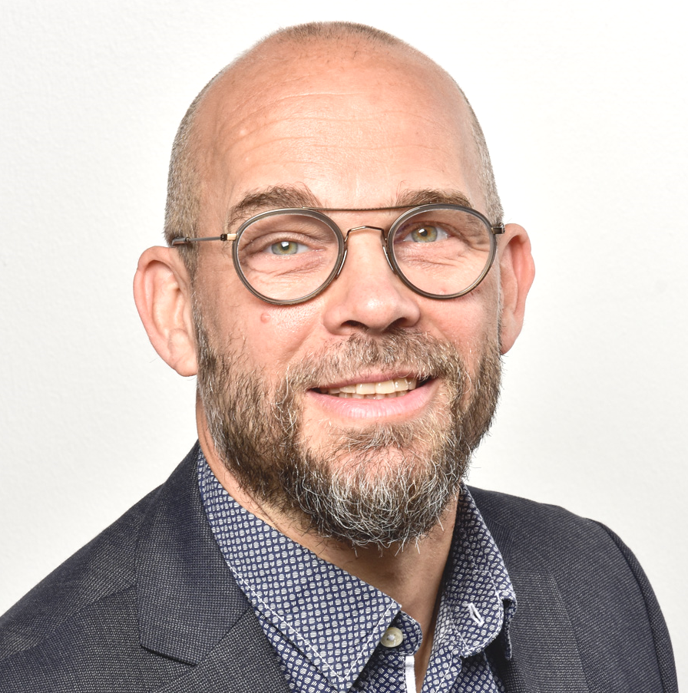
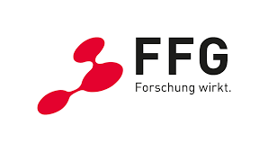
Dr. PD. Georg Weichhart
Digital Transformation Manager
T +43 (664) 6150567
E georg.weichhart@primetals.com
Primetals Technologies Austria
Turmstrasse 44
4031 Linz
Austria
This work has been partially funded by the Research Promotion Agency in project SuStA – Sustainable Steel Analytics (project nr. FFG 912120)
https://www.ffg.at/

Slide 30
Thank You

