Slide 1

Green Optimization Techniques for Future Wireless Systems
Professor John Thompson FIEEE¹
¹ Institute for Digital Communications, School of Engineering, The University of Edinburgh, Edinburgh UK
Email: john.thompson@ed.ac.uk

Slide 2

Wireless Systems in 2030
  What are Potential Applications/Use Cases?
  Physical Layer and Spectrum Issues?
  Energy Efficiency
  Optimization and Machine Learning
  Applications to Communication Systems
  Future Research Topics in Green Communications

Slide 3
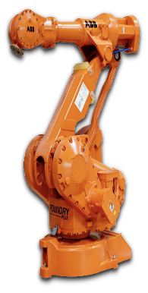







Wireless 2030: Key Applications
Robotics Applications:
Cyber-Physical Systems:
Autonomous Vehicles
Industrial Automation
Image: Distilnfo
Smart Cities
Smart Grid
E-Health
Yet More Broadband:
Virtual/Augmented Reality:
Data Driven Systems:
Image: Lenovo
Image: Reuters
Image: Telegraph

Slide 4
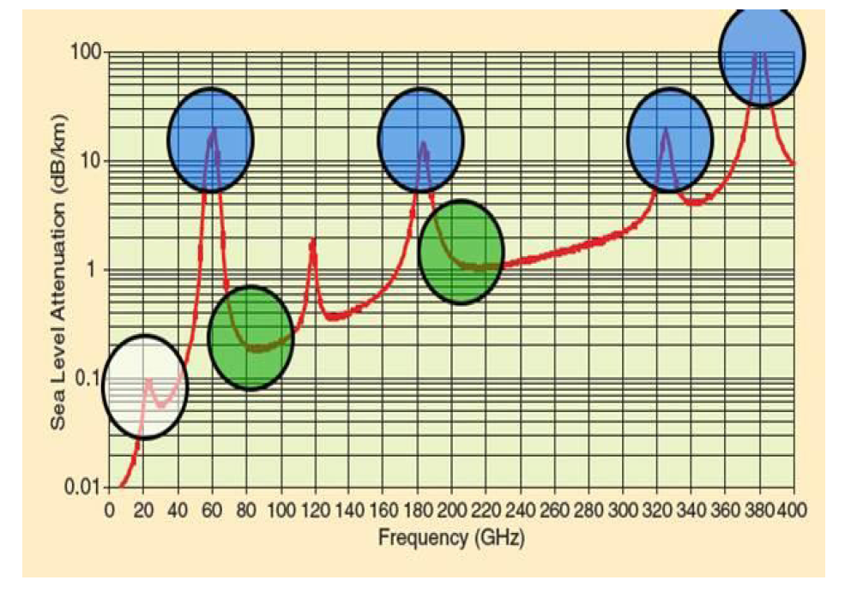
Wireless 2030: Spectrum Issues
Millimetre wave bands provide higher capacity; use directional beamforming to mitigate channel effects [1]
First systems to launch operate around 24-28 GHz
Research needed to develop higher frequency technologies – when should we stop?
Figure 2 of T.S. Rappaport et al, IEEE Access, May 2013
[1] Source: P. Cao et. al., "Constant Modulus Shaped Beam Synthesis via Convex Relaxation," IEEE AWP Letters, pp. 617-620, 2017.

Slide 5
Wireless 2030: Data Growth
Very difficult to predict 2030 data requirements:
  Ericsson predicts ~5 fold increase in next 5 years
  5G networks will start to impact in this time frame
  Video and immersive services will be key drivers
  Internet of Things systems will also grow significantly, though only a fraction will use cellular connection
×2.5
×5
Image: Ericcson

Slide 6
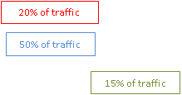
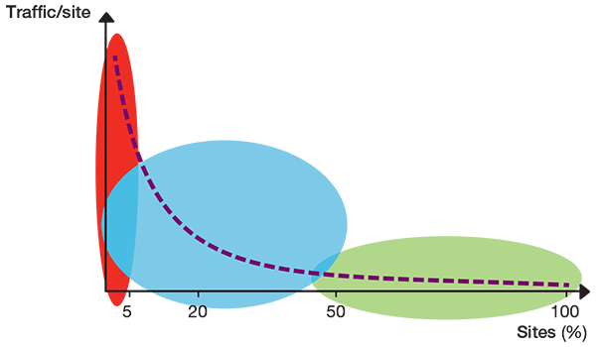
Wireless 2030: Energy Efficiency
  Around 2010, several projects (Green Radio, EARTH, GreenTouch) studied wireless energy efficiency
  Some key findings:
    Not a simple single solution to achieve significant reductions
    Need to study the energy consumption of the whole system
    In cellular networks, data traffic is very non-uniform in time and in area, so we need flexible/adaptive solutions
  5G can reduce energy over 4G as follows [2]:
    Minimal base station signalling enables “deep sleep”
    Massive MIMO improves link energy efficiency
    Small cells can provide high capacity where needed
Source: Ericsson
[2] Ericcson Blog: https://www.ericsson.com/en/blog/2019/9/energy-consumption-5g-nr

Slide 7
Ten Years of Green Radio – Network Evolution
  In June 2022 issue of IEEE Trans Green Comms & Networking, published an editorial article on current status and future research topics
Table 1: Energy Comparisons 2010 (UK) vs 2021 (28 Countries)
.
Table 2: Typical UK Mobile Operator
Characteristics 2010 vs 2021
Metric | 2010 (UK) | 2021 Data (28 Countries)
Base Station Energy Consumption % of total | 57% | 73-77%
Network Power Consumed per user/link | 3W | 1.69 W
Power Consumption of One Base Station Site | 7.3 kW | 3.3 kW
Renewable Energy Sources Used | 6.5% | 46%
Diesel Generation | N/A | 11%
Metric | 2010 (UK) | 2021 (UK)
Network Types | 2G + 3G networks | 2G + 3G + 4G + initial 5G deploy-ments
Spectrum Ownership | Typical 40 MHz | Typical 250-350 MHz
Data Volume | 1x | 300x
Service Type | voice/short message service with some data | mainly data services

Slide 8
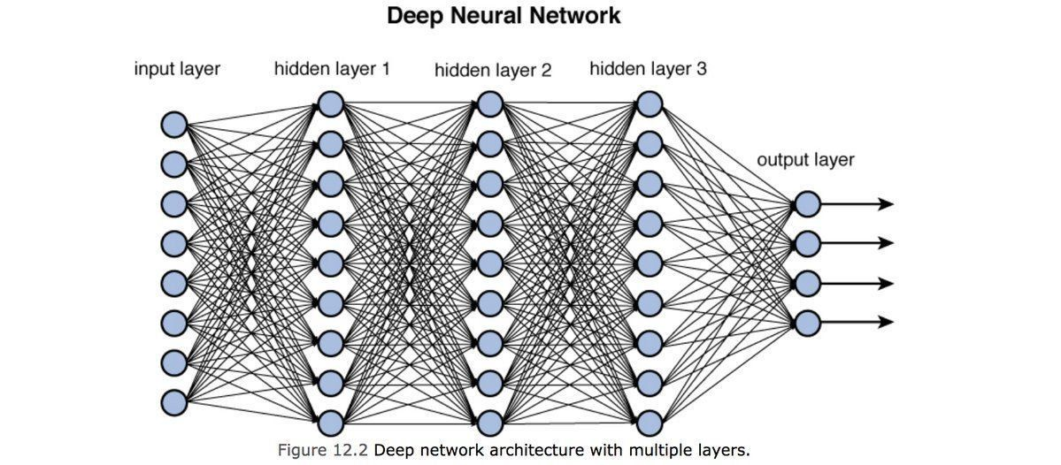
Wireless 2030: Machine Learning
  Lots of potential for application in future networks:
    Manage the huge range of parameter settings and configurations in existing wireless standards
    Augment physical layer transmission/reception
    Help to optimize and configure entire wireless networks
  Key issues:
    Managing performance, scalability and complexity
    Managing security – many recent papers demonstrate sensitivity to well designed attacks/data corruption
    Learner needs good quality and robust data for training
Image: Towards Data Science

Slide 9
Optimization/Machine Learning Examples
  Discuss two distinct applications where we have applied optimization & machine learning approaches
  First case study is for optimizing energy consumption in Hybrid millimetre-wave systems
  Second case study is optimising beam training in a mm-wave wireless communications system

Slide 10
Hybrid MIMO System
Nº TX Antennas N_{T} >> Nº of Spatial Streams N_{S}
Want to minimise No of activated RF Chains L_{T} to reduce power consumption

Slide 11
Energy Efficiency
Communications system has TX power levels P_{TX}
Given the spectral efficiency R(P_{TX})
And the TX/RX power consumed P(P_{TX})
The Energy Efficiency is defined by:
Minimum rate constraint on R(P_{TX})
This is a difficult quantity to optimise: ratio of two complex functions!

Slide 12
Power Modelling
Interested in the total power P consumed by the transmit-receive system, not TX power P_{TX}
Use a model that computes the power for each element of TX/RX, incl circuit power
Assume TX power amplifier is 40% efficient
Summing these terms gives total power consumed P(P_{TX})

Slide 13
Baseline Approach: Brute Force
Goal: Find Nº of RF chains to maximise EE
Basic Approach:
  Measure the channel matrix H
  For each Compute R(P_{TX}) and P(P_{TX}) for each possible number of RF chains
  Find the number L’ that maximises EE
This approach directly solves the problem [3]
Method is complex as we have to design a complete receiver for each Choice of RF chains!
[3] Source: R. Zi et al., “Energy efficiency optimization of 5G radio frequency chain systems”,
IEEE Journ. Sel. Areas Commun., Vol. 34, no. 4, pp. 758-771, Apr. 2016..

Slide 14
Proposed: Dinkelbach Method
First idea : Use approximation for rate R(P_{TX})
Second idea: We adopt the Dinkelbach Method:
  Used to optimize the ratio of two functions
  Use several iterations to find the optimum number of RF chains L_{T}^{opt} and value of EE
Method much simpler than brute force but yields good Energy Efficient solutions [4]
[4] Source: A. Kaushik et. Al, "Dynamic RF Chain Selection for Energy Efficient and Low Complexity Hybrid Beamforming in Millimeter Wave MIMO Systems," in IEEE Transactions on Green Communications and Networking, vol. 3, no. 4, pp. 886-900, Dec. 2019

Slide 15
Simulation Settings
Simulated a single user MIMO system using 1000 Monte Carlo Runs with N_{T}=32 and N_{R}=8 antennas
Systems Studied:
Brute Force
Dinkelbach
Analog – 1 RF chain
Digital – One RF chain per antenna

Slide 16
Dinkelbach Convergence Results
N_{T}=32 & N_{R}=8 antennas
Observation: Convergence of Dinkelbach Method achieved within 3 iterations

Slide 17
Energy & Spectral Efficiency Results
N_{T}=32 & N_{R}=8 antennas
Observation: Dinkelbach Method achieves similar EE to Brute Force method but lower SE than Digital method

Slide 18
Performance with Nº of TX Antennas
SNR=10dB & N_{R}=8 antennas
Observation: Dinkelbach Method performs well but EE degrades slightly with N_{T} (better angular resolution)

Slide 19
Hybrid Conclusions
  Hybrid architecture is a promising technology for mmWave communications systems
  We have explored Energy Efficient solutions for operating spatial multiplexing systems
  The Brute Force approach achieves the best Energy Efficient solutions but with high complexity
  Our Dinkelbach Method performs almost as well but with much lower complexity
  Future Work: Study impact of low resolution analogue-to-digital converters on performance

Slide 20


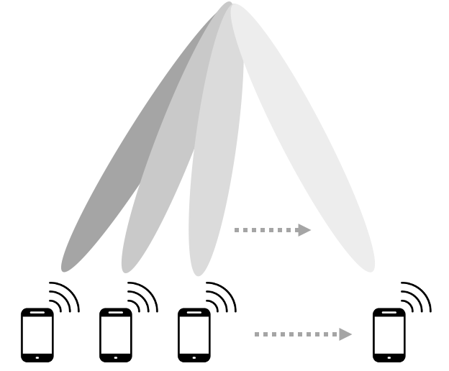





Motivation: Mm-wave Beam Tracking
MmWave channels exhibit spatial sparsity, which has been exploited by researchers to propose several low-complexity beam training methods.
For a mmWave channel with the receiver mobility, the channel condition changes with the dynamics of the environment, e.g., the receiver velocity, the moving scatterers, etc.
To obtain a strong beam alignment for a mobile receiver, the amount of beam training overhead required also changes with the varying channel.
Propose an intelligent beam training mechanism [5], which can adjust the amount of beam training according to the changes in the environment. The goal is to minimise the total beam training overhead while maintaining a high data rate for the mobile receiver.
Beam Tracking for A Mobile Receiver.
[5] Source: Narengerile et al, “Deep Reinforcement Learning-Based Beam Training for Spatially Consistent
Millimeter Wave Channels, to appear IEEE PIMRC 2021..
Notes:
I will start with the motivation of this work.
It is already known that millimeter wave channels exhibit spatial sparsity. This feature has been exploited by researchers to propose various beam training techniques with low complexity. This indicates that the amount of beam training required is dependent on the channel condition. For a fast-changing environment, the channel condition will change rapidly due to the dynamics in the environment, where frequent beam training will be required. This could cause a large amount of beam training overhead. We want to have an intelligent beam training mechanism, which can adjust the amount of beam training based on the changes in the channel. The goal is to maintain a minimum beam training overhead while achieving a high data rate for a mobile receiver.

Slide 21
Deep Reinforcement Learning (DRL) Beam Training Process
DRL Block
Beam Training
Data Transmission
Take a channel measurement.
Execute the selected beam training method.
Transmit the data using the selected beam pair.
Spectral Efficiency (bit/s/Hz).
Historical Beam Training Data.
Select a beam training method.
Obtain an optimal beam pair.
The DRL block will learn the dynamics of the environment given the current channel measurement and historical beam training data.
The DRL block will switch between different beam training methods for different channel conditions.
The goal is to achieve a good trade-off between the average beam training overhead and the average spectral efficiency for a mobile mmWave channel.
Notes:
The proposed DRL-based beam training process is shown on this slide. Firstly, the DRL block will select a beam training method given the current channel measurement and the past beam training data. Then the selected beam training method is implemented to offer a good beam pair for data transmission. The spectral efficiency is evaluated as the performance metric. The DRL block will switch between different beam training methods for different channel conditions. The ultimate goal is to obtain a good trade-off between the average beam training overhead and the average spectral efficiency when the receiver is constantly moving.

Slide 22
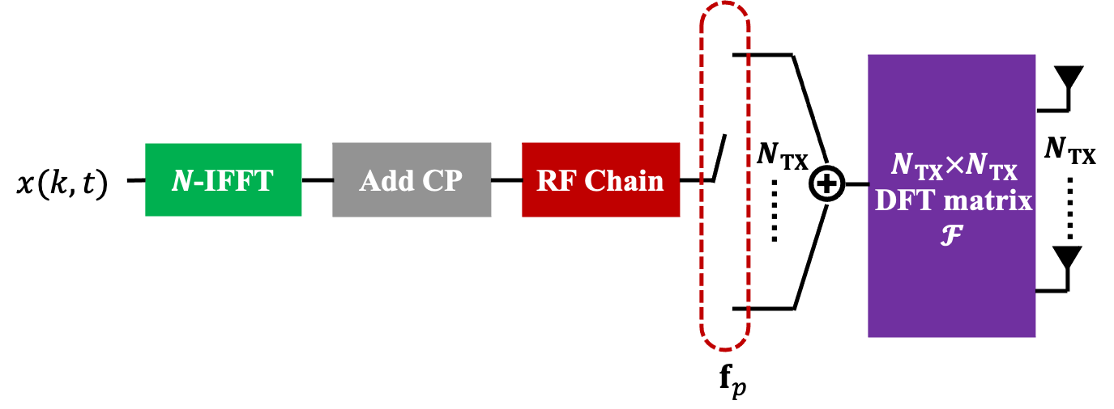
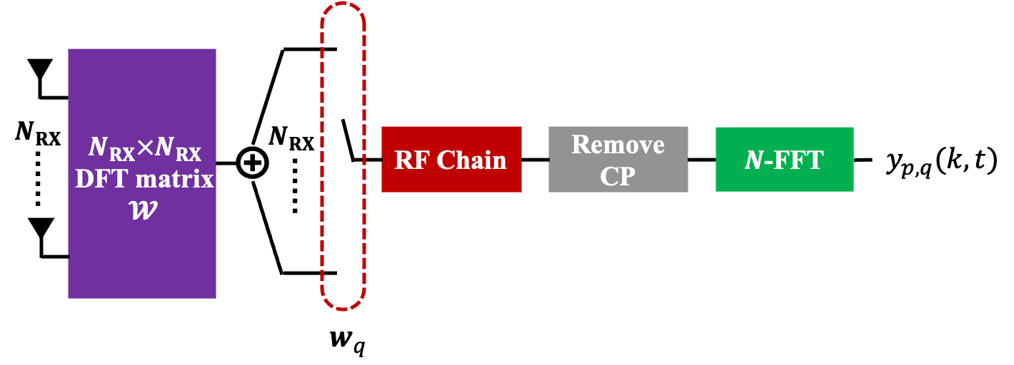
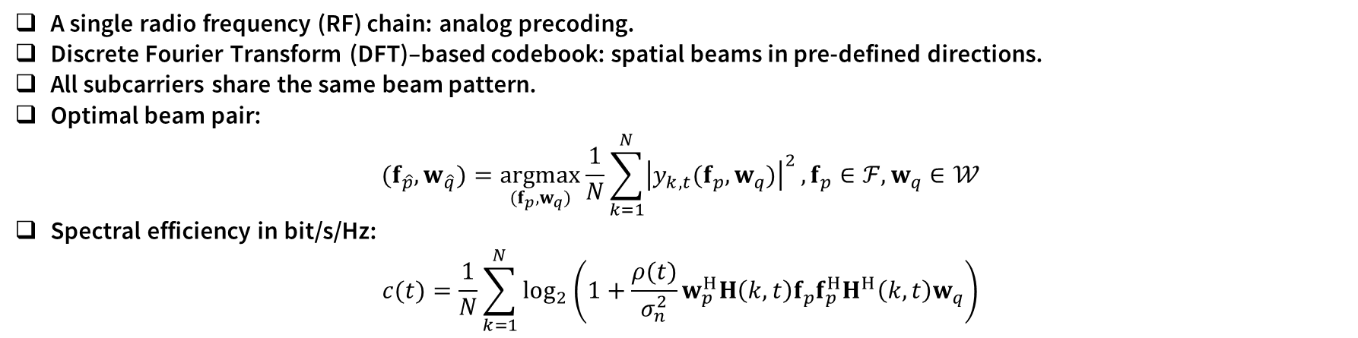
System Model
  A Single-User OFDM MIMO System for The Downlink.
$$y_{p,q}\left(k,t\right)=\sqrt{ρ(t)}w_{q}^{H}H\left(k,t\right)f_{p}x\left(k,t\right)+w_{q}^{H}n\left(k,t\right)$$
BS
UE
A single radio frequency (RF) chain: analog precoding.
Discrete Fourier Transform (DFT)–based codebook: spatial beams in pre-defined directions.
All subcarriers share the same beam pattern.
Optimal beam pair:
$$(f_{\hat{p}},w_{\hat{q}})=\underset{(f_{p},w_{q})}{argmax}{\frac{1}{N}\sum_{k=1}^{N}{{\left|y_{k,t}(f_{p},w_{q})\right|}^{2}}},f_{p}∈ℱ, w_{q}∈𝒲$$
Spectral efficiency in bit/s/Hz:
$$c(t)=\frac{1}{N}\sum_{k=1}^{N}{\log_{2}\left(1+\frac{ρ(t)}{σ_{n}^{2}}w_{p}^{H}H\left(k,t\right)f_{p}f_{p}^{H}H^{H}\left(k,t\right)w_{q}\right)}$$
Notes:
We consider a single-user OFDM MIMO system for the downlink. A single RF chain is used at both the base station and the user equipment for analog precoding. The DFT-based beamforming codebook is used. The selection of a particular beam is controlled by a digital switch placed in-between the RF chain and the beamforming matrix. The best beam pair is selected to maximise the received signal power when averaged over N subcarriers. The received signal at a certain subcarrier is given by this equation. The vector w and the vector f are beamformers, which are selected from the DFT codebooks. The same beam pattern will be used for all subcarriers. The spectral efficiency in bit per second per Herz is given by this equation.

Slide 23


Channel Model
3GPP TR 38.901 channel model [6]
  Carrier frequencies: from 0.5 to 100 GHz.
  Each spatial cluster consists of 20 non-resolvable multipath components.
Spatial Consistency [6]
  Spatial consistency Procedure A.
  Realistic channel impulse response (CIR) samples with the receiver mobility.
The trajectory of the UE is sampled at random locations, at which the channel is updated with spatial consistency and followed by the beam training process.
Non-Line of Sight (NLOS).
Cluster
NLOS
Moving
LOS
NLOS
Cluster
[6] Source: 3GPP TR 38.901, “Study on channel model for frequencies from 0.5 to100 GHz,” 2017.
Notes:
The channel model used in the work is the 3GPP TR 38.901 channel model, which can model the channel at carrier frequency from 500 megahertz to 100 gigahertz. In this research, we only consider the non-line-of-sight channels. The signals are received at the receiver via multipath components. For the multipath components that have similar delays, they are treated as one cluster. In this channel model, each cluster consists of 20 non-resolvable scatterers. response samples when the receiver is constantly moving. We assume that the trajectory of the receiver is sampled with random spacings. The channels at those sampled locations are updated with spatial consistency and followed by the beam training process.

Slide 24
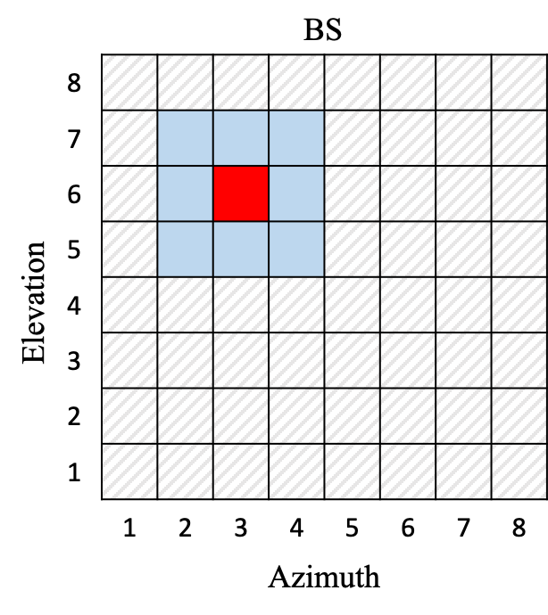
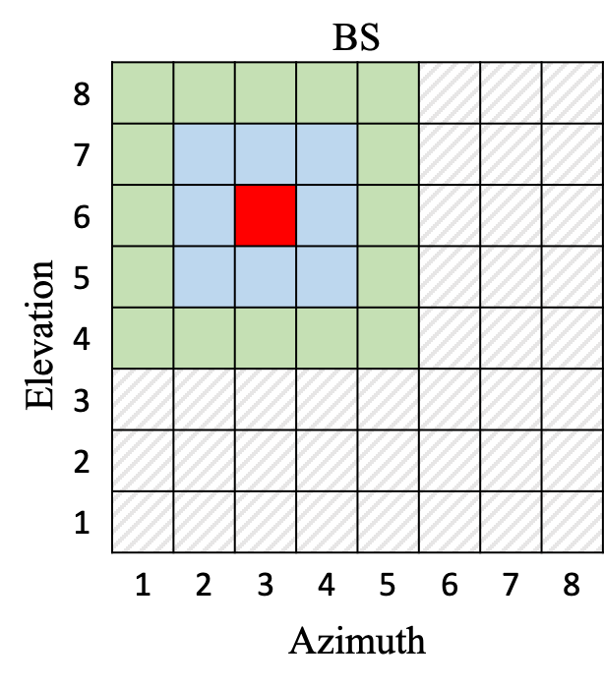
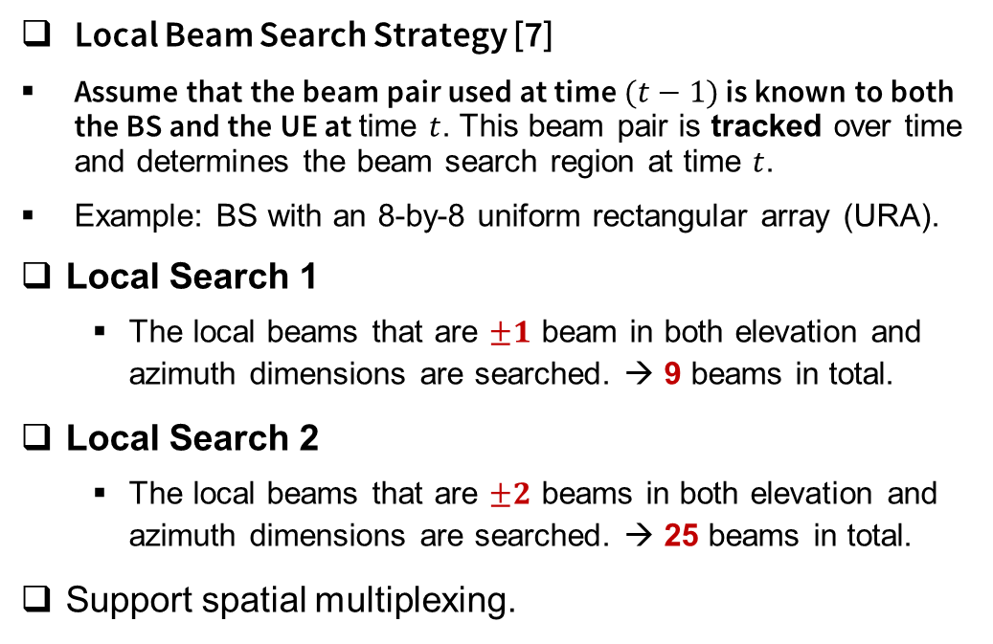
Beam Training Methods
Local Beam Search Strategy [7]
Assume that the beam pair used at time $(t−1)$ is known to both the BS and the UE at time $t$. This beam pair is tracked over time and determines the beam search region at time $t$.
Example: BS with an 8-by-8 uniform rectangular array (URA).
Local Search 1
  The local beams that are $±1$ beam in both elevation and azimuth dimensions are searched. → 9 beams in total.
Local Search 2
  The local beams that are $±2$ beams in both elevation and azimuth dimensions are searched. → 25 beams in total.
Support spatial multiplexing.
Beam Selection Information at Time $(t−1)$
Beam Index | BS | UE
Three-Dimensional Beam | 43 | 29
Elevation Beam | 6 | 4
Azimuth Beam | 3 | 5
Local Search 1
Local Search 2
Local Search 1
Local Search 2
[7] Source: Narengerile et. Al, “Low- complexity beam training for tracking spatially consistent millimeter wave channels,” in Proc. IEEE PIMRC, 2020.
Notes:
Before describing the DRL framework, I’ll first introduce a low-complexity beam training method which will be used by the DRL approach for efficient beam training. This is a local beam search strategy.
We assume that the beam pair that was used at the previous time-step is known to both the base station and the user equipment at the current time-step. This beam pair will be tracked over time and will determine which beams to search at the current time-step. I’ll explain the process at the base station as an example. The same process can be implemented at the user equipment. Consider that the base station uses an 8-by-8 rectangular antenna array. This table shows the index of the beam pair selected at the previous time-step. The selected transmit beam no. 43 is represented by the red box in the 2-dimensional illustration of the codebook, which is mapped to the sixth beam in the elevation and the third beam in the azimuth. We propose two local beam search strategies, local search 1 and local search 2. As the name suggested, in local search 1, the local beam that are plus and minus 1 beam in both elevation the azimuth dimensions are searched. As a result, 9 beams in total are tested at the base station. The beam search region can be extended to include the local beams that are plus and minus 2 beams in both dimensions in local search 2. This will lead to 25 beams in total to be searched. Given that the millimetre wave channel is sparse in space, there is no need to extend the beam search region any further. This local search strategy also supports spatial multiplexing, which can be applied to for example the second strongest beam that is also tracked over time.

Slide 25
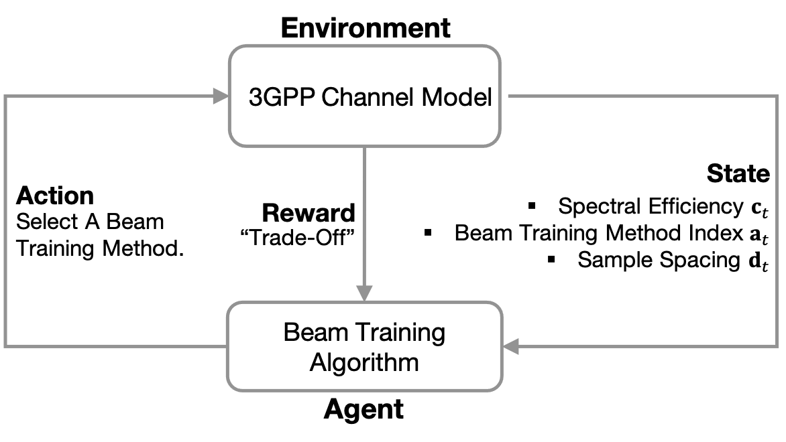
DRL-Based Beam Training Algorithm
At the beginning of UE’s trajectory, an exhaustive beam search is implemented to obtain a reference beam pair for tracking.
Before the beam training, the current channel condition is assessed using the tracked beam pair → a “pre-measurement”.
Notes:
The beam training framework is shown on this slide. The environment is modelled by the 3GPP channel model. Features are extracted from the channel and are provided to the agent. The agent will select a beam training method to implement. The reward is defined to reflect the trade-off between the training overhead and the spectral efficiency. At the beginning of the trajectory, exhaustive beam search is performed to obtain an initial beam pair to track. One important step is that, before implementing any beam training, the current channel condition is evaluated using the tracked beam pair. The result is called a pre-measurement, which will be used to select the beam training method.

Slide 26
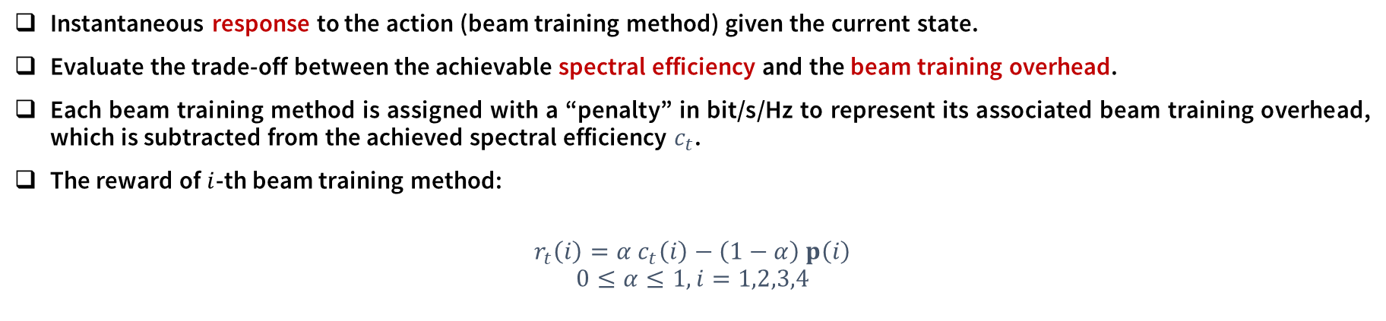
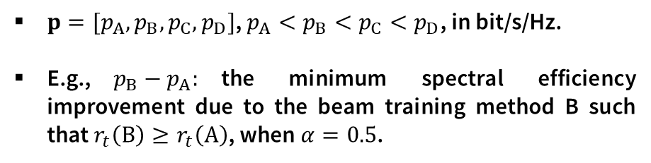
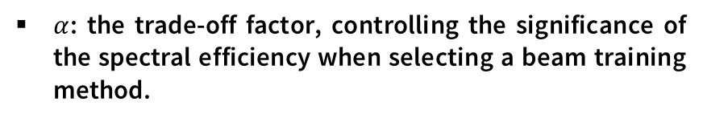
Reinforcement Learning: Reward
Spectral Efficiency
Beam Training Overhead
Instantaneous response to the action (beam training method) given the current state.
Evaluate the trade-off between the achievable spectral efficiency and the beam training overhead.
Each beam training method is assigned with a “penalty” in bit/s/Hz to represent its associated beam training overhead, which is subtracted from the achieved spectral efficiency $c_{t}$.
The reward of $i$-th beam training method:
$$r_{t}\left(i\right)={α c}_{t}\left(i\right)−\left(1−α\right) p\left(i\right)$$
$$0≤α≤1, i=1,2,3,4$$
$α$: the trade-off factor, controlling the significance of the spectral efficiency when selecting a beam training method.
$p=[p_{A},p_{B},p_{C},p_{D}]$, $p_{A}<p_{B}<p_{C}<p_{D}$, in bit/s/Hz.
E.g.,$p_{B}−p_{A}:$the minimum spectral efficiency improvement due to the beam training method B such that $r_{t}\left(B\right)≥r_{t}\left(A\right)$, when $α=0.5$.
Notes:
The reward is defined to evaluate the trade-off between the spectral efficiency and the beam training overhead. Ideally, we want low overhead and high data rate. The training overhead is set equal to the number of beam measurements required, which can be much higher than the spectral efficiency value. To avoid the reward being dominated by the training overhead, we assign a penalty to each beam training method to represent its associated training overhead. The reward of the action is given by this equation, where the penalty is subtracted from the achieved spectral efficiency. There is an important factor alpha, which is called the trade-off factor. Alpha controls the significance of the spectral efficiency when selecting a beam training method. For example, we can choose the alpha to be 1 to provide very high data rate to support high data volume. By tuning the value of alpha, the DNN can be trained to provide different levels of spectral efficiency for different wireless services. We assume the beam training methods A,B,C and D are sorted in the ascending order of the training overheard.
The positive difference between adjacent penalty values, such as p of b minus p of a, is the minimum improvement in the spectral efficiency due to the implementation of method B such that the reward for B is greater than the reward for A when alpha equals to 0.5. In another word, this difference is the condition that the method B can be selected rather than the method A.

Slide 27
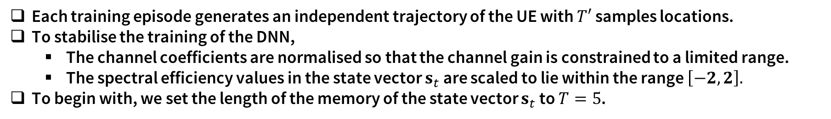
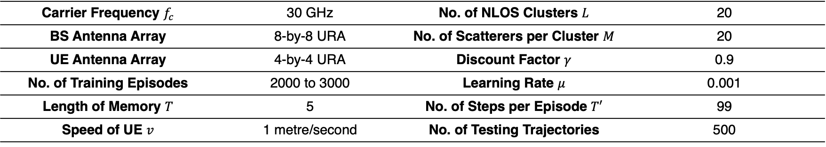
Simulation Results
Carrier Frequency $f_{c}$ | 30 GHz | No. of NLOS Clusters $L$ | 20
BS Antenna Array | 8-by-8 URA | No. of Scatterers per Cluster $M$ | 20
UE Antenna Array | 4-by-4 URA | Discount Factor $γ$ | 0.9
No. of Training Episodes | 2000 to 3000 | Learning Rate $μ$ | 0.001
Length of Memory $T$ | 5 | No. of Steps per Episode $T′$ | 99
Speed of UE $v$ | 1 metre/second | No. of Testing Trajectories | 500
Each training episode generates an independent trajectory of the UE with $T′$ samples locations.
To stabilise the training of the DNN,
  The channel coefficients are normalised so that the channel gain is constrained to a limited range.
  The spectral efficiency values in the state vector $s_{t}$ are scaled to lie within the range $\left[−2,2\right].$
To begin with, we set the length of the memory of the state vector $s_{t}$ to $T=5$.
Notes:
The DNN is trained with 2000 to 3000 episodes, where each episode generates an independent trajectory for the user. The user is assumed to move at a constant speed of 1 meter per second. To start with, each component in the state will contain 5 past samples. To stabilise the training of the DNN, we first normalise the channel coefficients to limit the channel gain. Secondly, the spectral efficiency values in the state are scaled to lie within the range from minus 2 to plus 2 approximately.

Slide 28
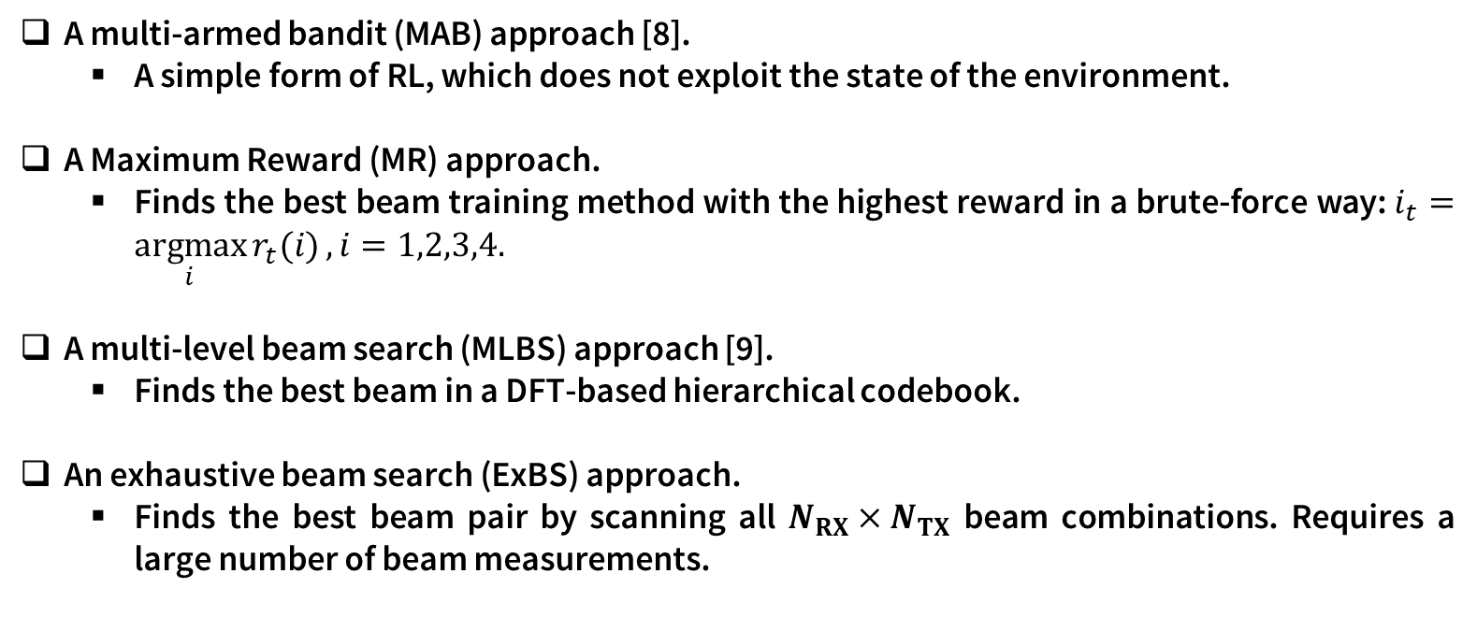
Benchmark Beam Training Algorithms
A multi-armed bandit (MAB) approach [8].
  A simple form of RL, which does not exploit the state of the environment.
A Maximum Reward (MR) approach.
  Finds the best beam training method with the highest reward in a brute-force way: $i_{t}=\underset{i}{argmax}{r_{t}(i)},i=1,2,3,4.$
A multi-level beam search (MLBS) approach [9].
  Finds the best beam in a DFT-based hierarchical codebook.
An exhaustive beam search (ExBS) approach.
  Finds the best beam pair by scanning all $N_{RX}×N_{TX}$ beam combinations. Requires a large number of beam measurements.
[8] J.Zhang, Y.Huang, Y.Zhou, and X.You,“Beam alignment and tracking for millimeter wave communications via bandit learning,” IEEE Trans. Commun, vol. 68, no. 9, pp. 5519–5533, 2020.
[9] A. Alkhateeb, O. El Ayach, G. Leus, and R. W. Heath, “Channel estimation and hybrid precoding for millimeter wave cellular systems,” IEEE JSTSP, vol. 8, no. 5, pp. 831–846, 2014.
Notes:
To compare with the proposed DRL approach, four different beam training strategies are implemented. A multi-armed bandit approach is implemented. The MAB is a simple form of reinforcement learning. Its difference from the Q-learning is that MAB does not exploit the state of the environment. A maximum reward approach is also implemented, which finds the best beam training method in a brute-force way by testing them all. The DRL, MAB and the maximum reward, they use the same reward function. Then, two conventional beam training approaches are implemented. One is a multi-level beam search, which is also known as the hierarchical beam search. The other one is the exhaustive beam search, which tests all possible beam combinations.

Slide 29
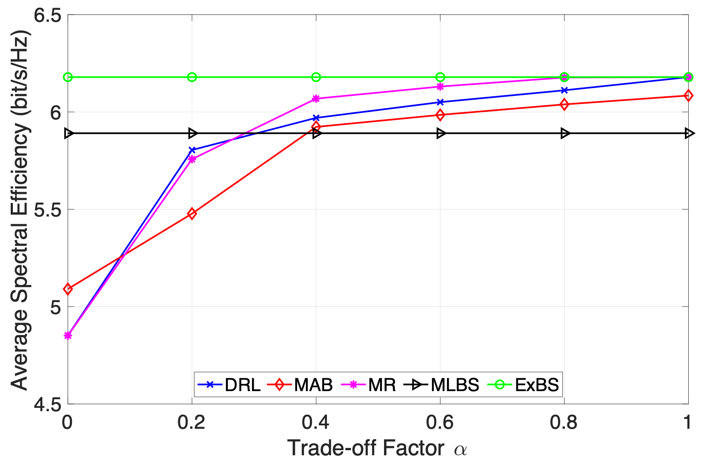
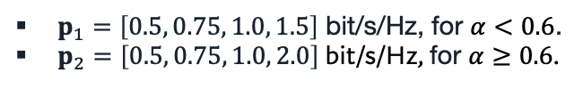
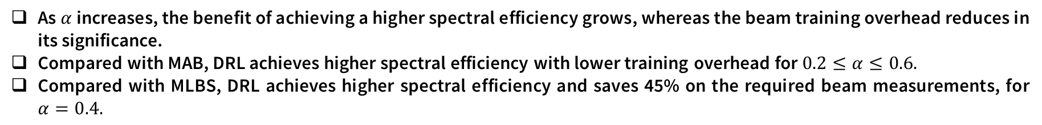
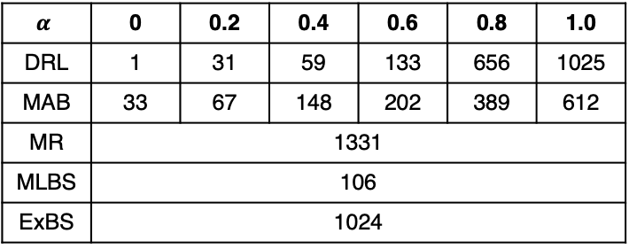

Effects of the Trade-off Factor α
Average Spectral Efficiency
Average No. of Beam Measurements
$$α$$ | 0 | 0.2 | 0.4 | 0.6 | 0.8 | 1.0
DRL | 1 | 31 | 59 | 133 | 656 | 1025
MAB | 33 | 67 | 148 | 202 | 389 | 612
MR | 1331
MLBS | 106
ExBS | 1024
$p_{1}=\left[0.5, 0.75, 1.0, 1.5\right]$ bit/s/Hz, for $α<0.6$.
$p_{2}=\left[0.5, 0.75, 1.0, 2.0\right]$ bit/s/Hz, for $α≥0.6$.
Reward: $r_{t}\left(i\right)={α c}_{t}\left(i\right)−\left(1−α\right) p\left(i\right)$
As $α$ increases, the benefit of achieving a higher spectral efficiency grows, whereas the beam training overhead reduces in its significance.
Compared with MAB, DRL achieves higher spectral efficiency with lower training overhead for $0.2≤α≤0.6.$
Compared with MLBS, DRL achieves higher spectral efficiency and saves 45% on the required beam measurements, for $α=0.4.$
Notes:
Firstly, we demonstrate the effect of the trade-off factor alpha. In this simulation, we use two penalty vectors to compute the reward. P one is used for alpha less than 0.6. p two is used for alpha greater than 0.6. The only difference is that p two further limits the activation of exhaustive beam search. In the preliminary simulations, we’ve tried different values for the penalties. These values in p one and p two are chosen because they can provide good performance with reasonable training overhead. This figure shows the average spectral efficiency per location. We see that as alpha increases, the spectral efficiency for DRL, MAB and maximum reward also increases. This is because that as alpha increases, the benefit of achieving a higher spectral efficiency increases, whereas the beam training overhead reduces in its significance. As a result, the number of beam measurements required also increases with the alpha. Compared to MAB, for alpha between 0.2 and 0.6, DRL can achieve higher spectral efficiency with lower beam training overhead. When compared with multi-level beam search, for alpha equals to 0.4, DRL achieves higher spectral efficiency and saves about 45% on the required beam measurements. Therefore, we consider 0.4 as a good choice for alpha as it can provide a good trade-off.

Slide 30

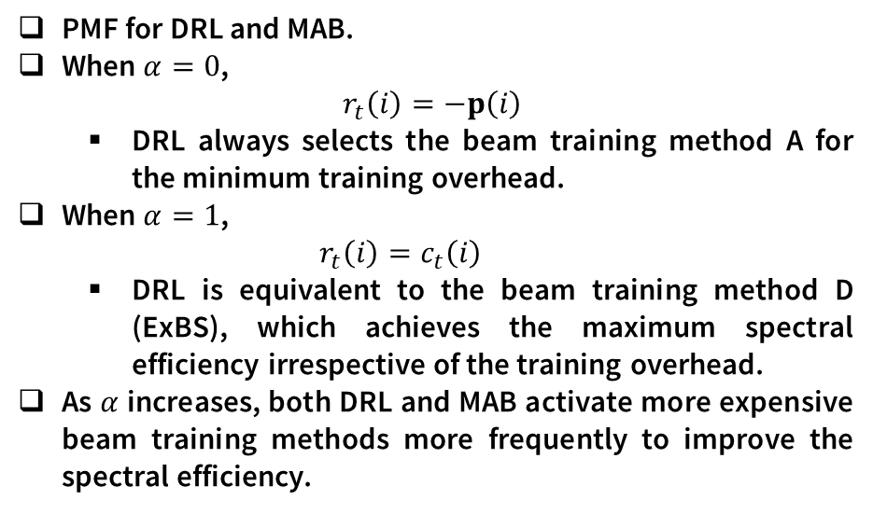
Effects of the Trade-off Factor α
Probability Mass Function (PMF) of Action Selection
PMF for DRL and MAB.
When $α=0$,
$$r_{t}\left(i\right)=−p\left(i\right)$$
  DRL always selects the beam training method A for the minimum training overhead.
When $α=1$,
  $$r_{t}\left(i\right)=c_{t}\left(i\right)$$
  DRL is equivalent to the beam training method D (ExBS), which achieves the maximum spectral efficiency irrespective of the training overhead.
As $α$ increases, both DRL and MAB activate more expensive beam training methods more frequently to improve the spectral efficiency.
Reward: $r_{t}\left(i\right)={α c}_{t}\left(i\right)−\left(1−α\right) p\left(i\right)$
Notes:
This slides shows the probability mass function of action selections for the two reinforcement learning approaches, the DRL and MAB. We see that when alpha equal to 0, the reward is solely described by the penalty. Therefore, DRL always selects the beam training method A for the minimum training overhead. When alpha equals to 1, DRL is equivalent to exhaustive beam search, which achieves the maximum spectral efficiency irrespective of the training overhead. As alpha increases, both approaches activate more expensive beam training methods more frequently to improve the spectral efficiency.

Slide 31
Beam Training: Conclusions
This work proposes a novel beam training algorithm using DRL for mobile mmWave channels.
The proposed algorithm can learn from the historical beam measurements and intelligently switch between different beam training methods based on channel conditions.
Simulation results show that DRL can approach the performance for exhaustive beam search while saving at least 92.2% on the required beam training overhead.
A flexible reward function is proposed, which can be tuned to meet different data rate requirements.
For future work, it is worthwhile to test the current DRL model using different channel datasets, such as with MATLAB ray-tracing simulation data.
Notes:
In summary, this paper proposes a beam training algorithm using deep reinforcement learning for mobile millimetre wave channels, which can learn from the historical beam measurements and switch between different beam training methods for different channel conditions. Simulation results show that the proposed algorithm can approach the spectral efficiency for exhaustive beam search and save at least 92% on the required beam training overhead. A flexible reward function is proposed, which can be adjusted to meet different data rate requirements. The effect of the amount of past information is also investigated. For future work, it is worthwhile to test the current DRL model using different channel datasets, such as the ray tracing data from the MATLAB ray tracing simulator.

Slide 32
Green Radio – Future Research Topics
  In June 2022 issue of IEEE Trans Green Comms & Networking, published an editorial on current status and future research topics:
  Energy Efficiency for New Services: Virtual Reality and Metaverse apps are likely to be energy intensive – need to design energy efficient alternatives
  Energy Efficient Open-RAN Networks: New network designs will bring together new technologies, but face significant energy efficiency issues
  Using the Full Pareto Boundary: Increasingly complex networks need advanced optimization to find energy efficient solutions
  Resolving Conflict through Machine Learning: Intelligent learning techniques will help us to achieve high performance

Slide 33
Thanks for your attention!
Questions?

Slide 34
What is Open RAN?
  Currently Base Station Networks are typically purchased from a single vendor – Vertical Integration
  Open Radio Access Networks (Open RAN) enable networks to be built from multiple blocks sold by different vendors – Horizontal Integration
  It remains to be seen how widely Open RAN will be deployed, but provides a completely different model for future wireless network deployment
Figure 2 from “Understanding O-RAN”, Polese et al (arxiv 2202.01302)

